Slide 1


DS-Connect®:
How the Down Syndrome Registry Can Benefit You and Your Community
Down Syndrome Alliance of the Midlands, Omaha, Nebraska
May 19, 2015
Melissa Parisi, MD, PhD
Eunice Kennedy Shriver National Institute of Child Health and Human Development (NICHD)
National Institutes of Health (NIH)

Slide 2
Objectives
Why is research important?
What is DS-Connect®: The Down Syndrome Registry?
Demonstration of the registry data
The Professional Portal
Resources

Slide 3
Why should I care about research?
Advances in Medical Science requires a team effort:
  Researchers -People with Down syndrome
  Physicians -Their families
Recent Down syndrome research has led to clinical trials of medications to improve learning and memory.
Challenges for researchers, clinical investigators, and the Down syndrome community, especially for cognition research:
  Identifying families for clinical studies
  Understanding the health and medical issues for people with DS
  Developing outcomes that can measure meaningful changes

Slide 4

Goals of a Registry
Collection of information about individuals with a specific condition
Purposes:
  Understand a condition and its “natural history”
  Identify which medications or treatments are being used
  Help scientists identify research projects to develop new treatments
  Determine if an FDA-approved medication is safe or to meet other regulatory requirements (post-marketing surveillance)

Slide 5
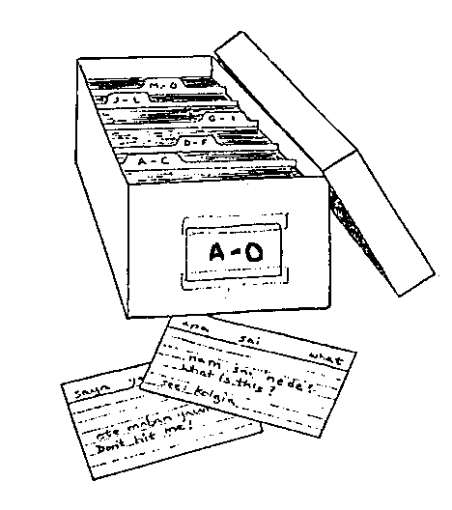
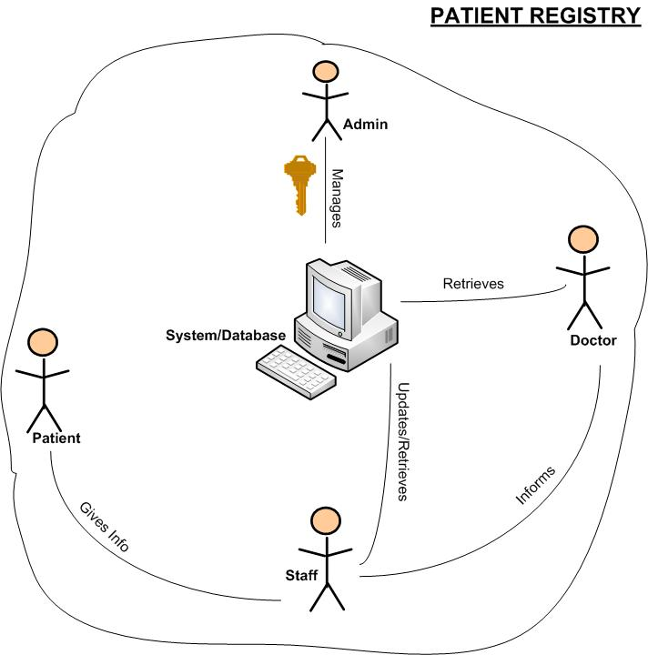

Different types of registries

Slide 6
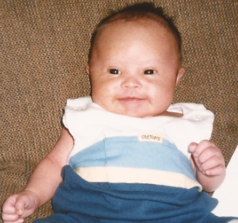






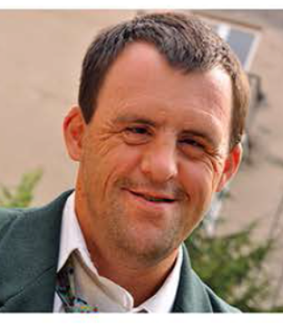

Who knows
them best?

Slide 7


YOU!!

Slide 8
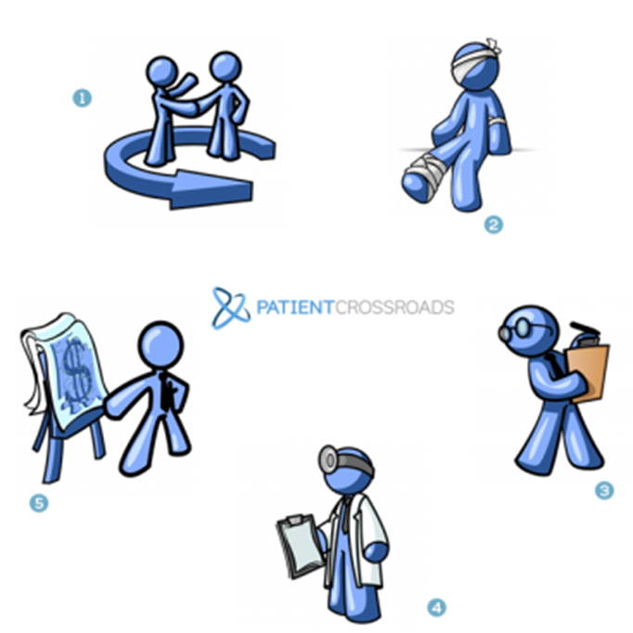
A new model: Family-centered registries
Foundations, Institutions, or the Government sponsor registries, act as the trusted gatekeeper.
Families or Self Advocates register and provide health history information.
Coordinators may curate data, answer questions, assist with participation.
Clinicians/Researchers have access to aggregated, de-identified data.
Industry uses the de-identified data for study planning and pre-screening for enrollment.
Slide compliments of Kyle Brown, PatientCrossroads

Slide 9

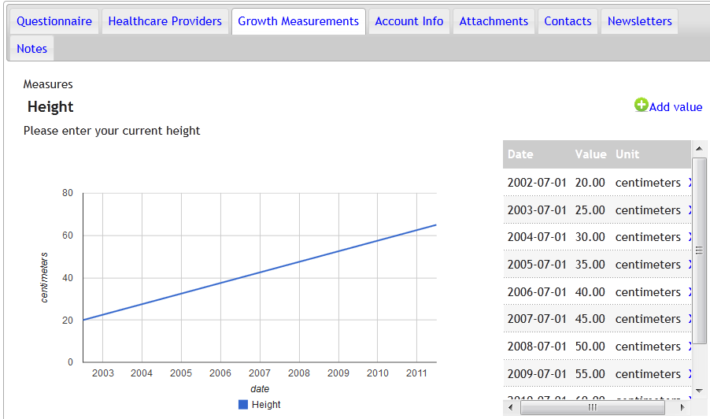
But that’s not all…
Document the growth of my child

Slide 10
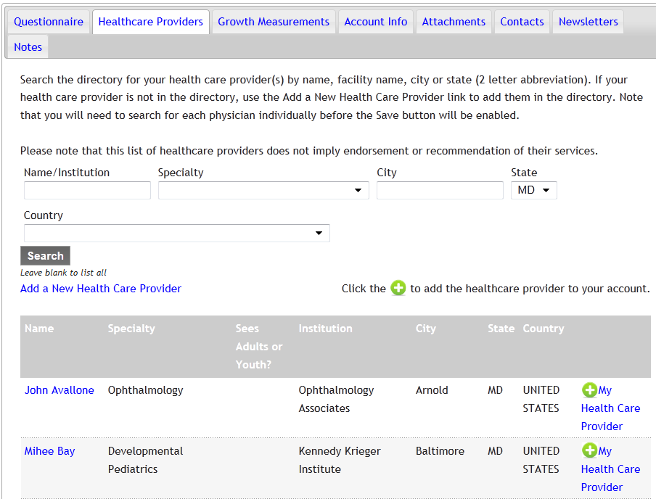
But that’s not all…
Access a health care provider list

Slide 11
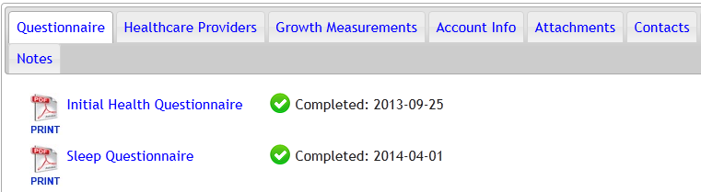
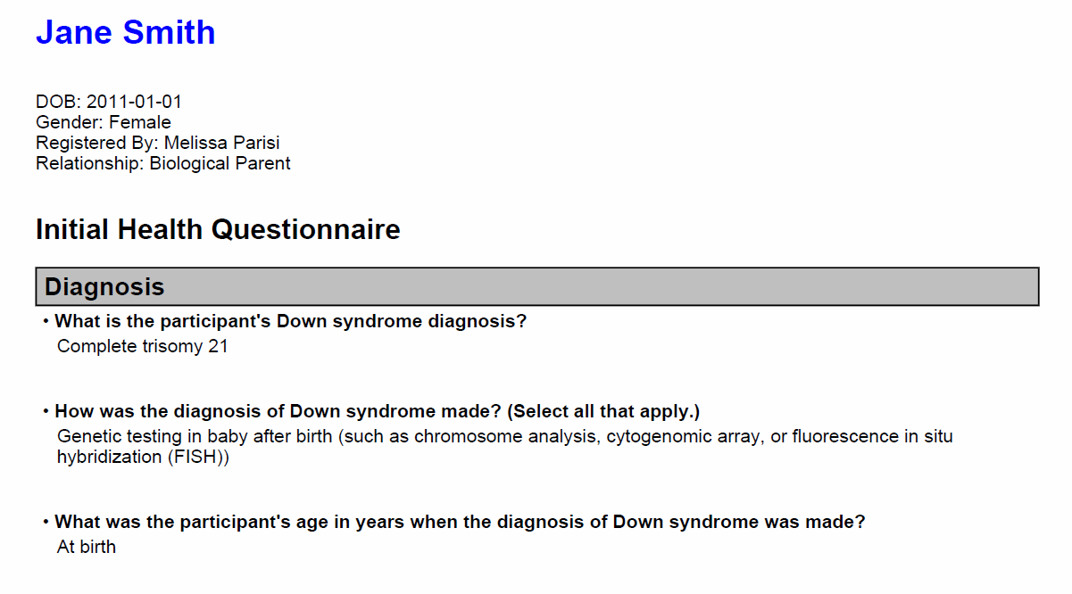
But that’s not all…
Print out my child’s medical history

Slide 12
But that’s not all…
Find out about research that impacts people with Down syndrome
Connect with resources on Down syndrome
Connect with researchers

Slide 13
Why are we doing this?
We had the participation and support of the DS advocacy and medical groups
New clinical trial opportunities needed willing volunteers
We set aside the resources to create it
No national DS registry existed, and families asked for one!

Slide 14
A Brief History of DS-Connect®
2010: Meetings were held to discuss a registry…
2011: The DS Consortium was founded by NIH
2012: A contract was awarded to PatientCrossroads
2013: DS-Connect® was launched
2014: DS-Connect® Professional Portal was launched
2015: Spanish-language version, mobile device compatibility will be rolled out

Slide 15
DS-Connect®
What it is:
A secure, confidential, online survey tool to collect basic information about people with Down syndrome
Goals of DS-Connect®:
To identify the features of DS across a large population of those with DS
To identify individuals with DS who may be eligible for research studies
To allow individuals with DS and their families to look at their information and compare it to de-identified information from other Registry participants
Features:
Potential to aggregate data from individuals with DS globally
Provide a database and educational system that has value for those with DS
Enable researchers to use de-identified data to develop studies on medical issues, natural history, and treatments

Slide 16
How does it work?
The Down Syndrome Consortium: supports and promotes the Registry.
  The Registry Team: manages the content and sends out notices and other information.
Two oversight boards for DS-Connect®
  The DS-Connect Operations Board oversees the day-to-day activities of the Registry, develops surveys, and makes decisions about access to Registry information. It also works with the registry coordinators and Governance Board to implement policies.
  The DS-Connect Governance Board makes decisions about the overall policies and procedures that govern the Registry.
The Research Review Committee oversees Professional Portal Access Requests

Slide 17
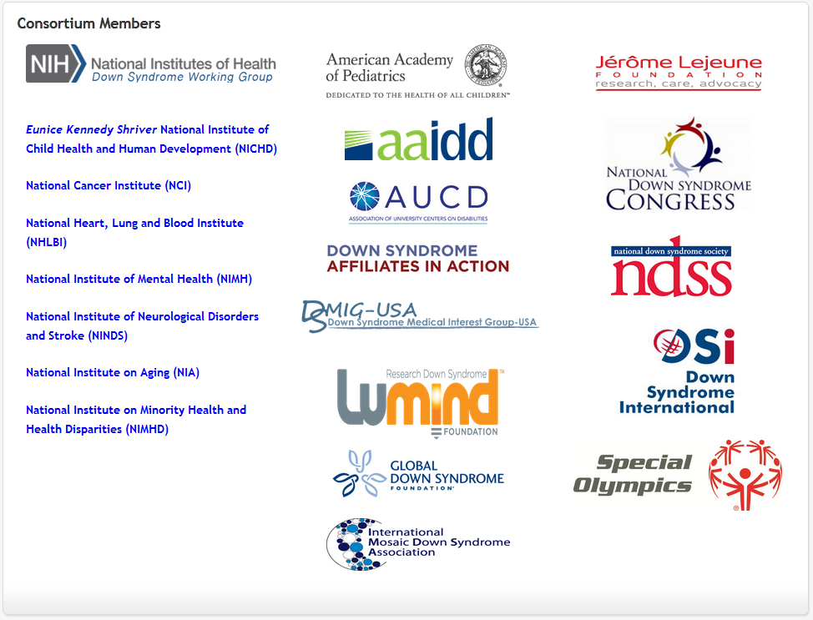

DS-Connect®: Who is involved?
DS Consortium
Self-advocates

Slide 18
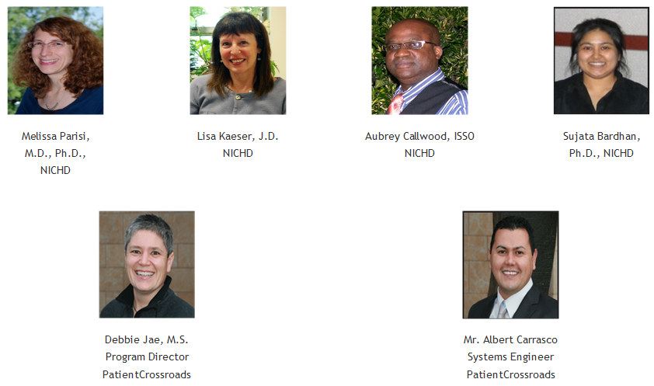
DS-Connect®: Who is involved?
Registry Team

Slide 19
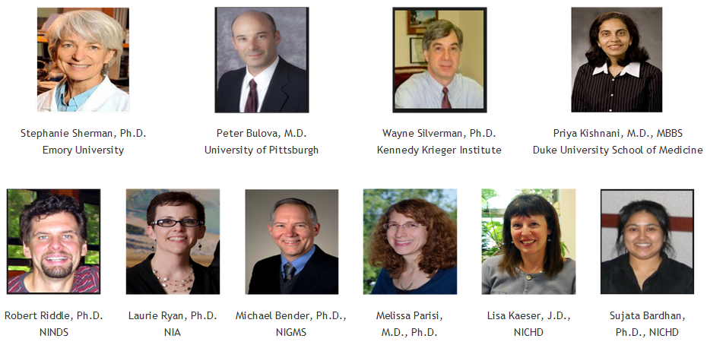
DS-Connect®: Who is involved? Operations Board

Slide 20
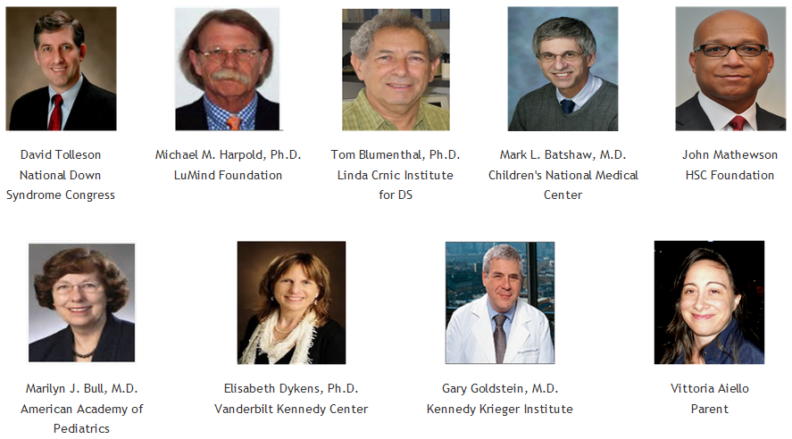
DS-Connect®: Who is involved? Governance Board
Name
Affiliation/Institute

Slide 21
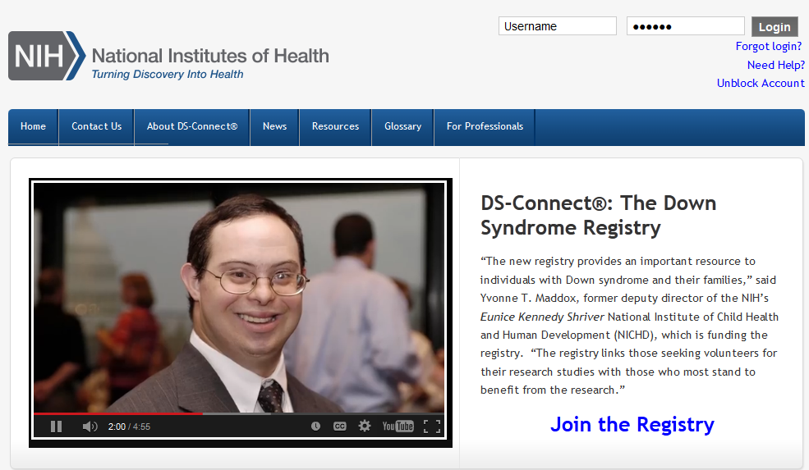
DS-Connect® Home Page
Launched Sept. 6, 2013

Slide 22
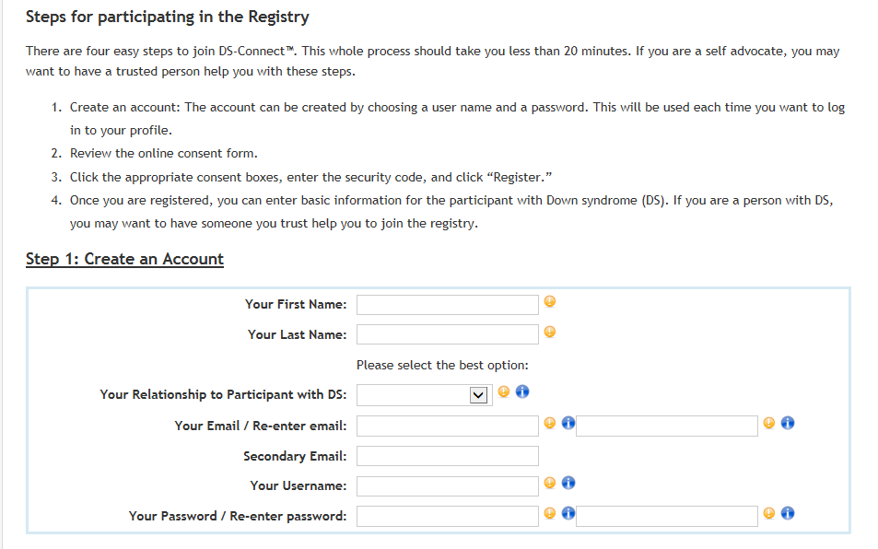
Registration page for individuals and families

Slide 23
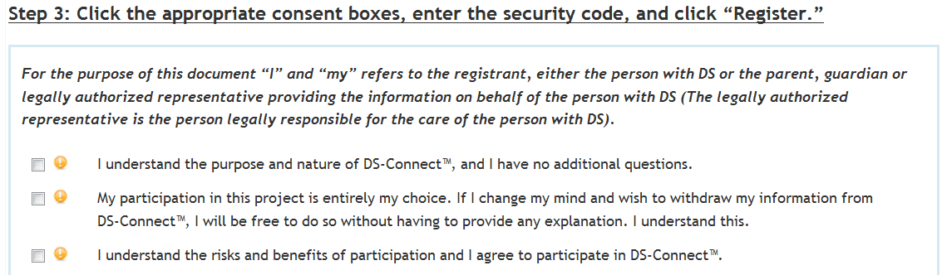
DS-Connect®: Provide Consent

Slide 24
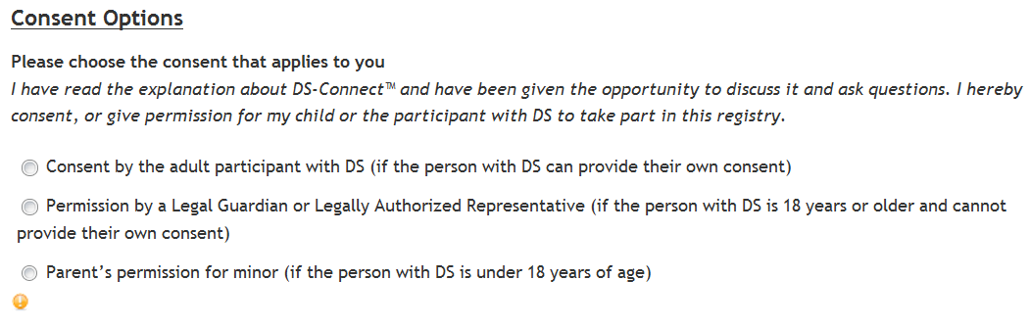
DS-Connect®: Choose Consent Options

Slide 25
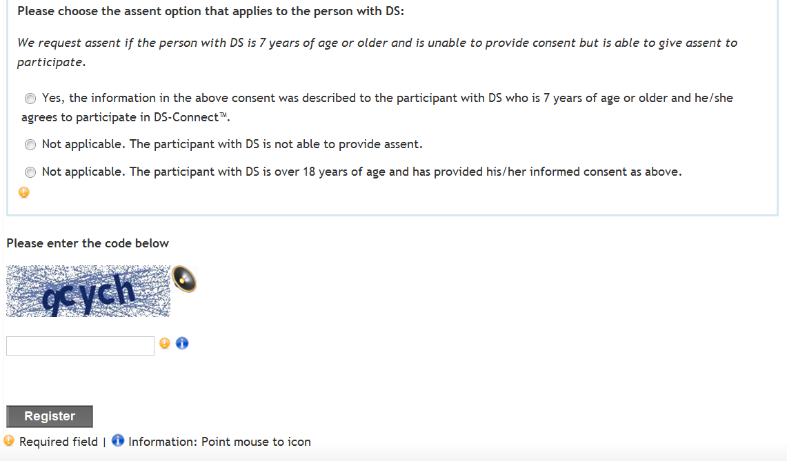
DS-Connect®: Choose Assent Options

Slide 26
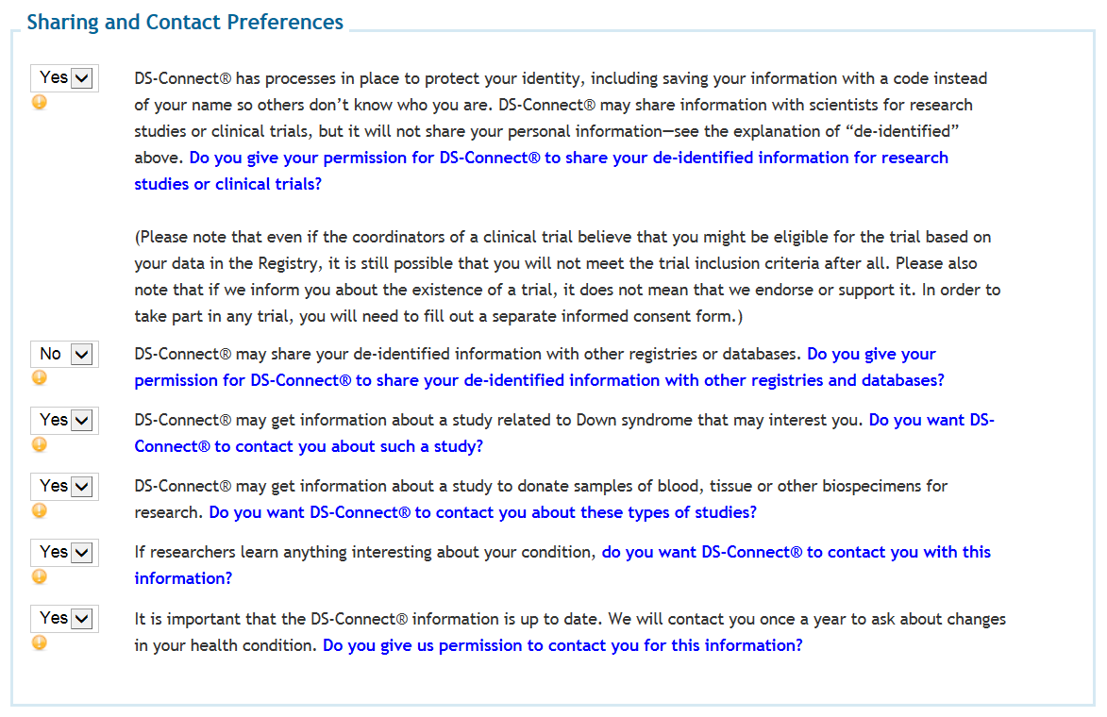
Sharing and Contact Preferences

Slide 27
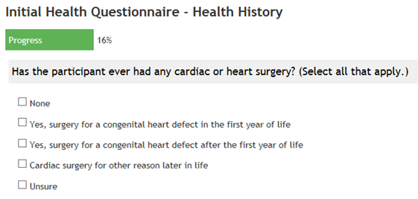
Sample Question

Slide 28
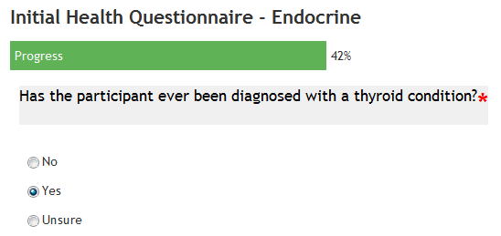
Sample Trigger Question

Slide 29
Multiple Survey Modules
Initial Health Survey with
“Trigger Questions” that lead
to other surveys:
Initial Health Questionnaire
Thyroid Questionnaire
Heart Questionnaire
Sleep Questionnaire
Skeletal Questionnaire
Gastrointestinal Questionnaire
Adulthood Questionnaire
Diabetes Questionnaire
Celiac Disease Questionnaire
Adulthood Questionnaire
Men’s Health Questionnaire
Women’s Health Questionnaire
Leukemia Questionnaire
Development Questionnaire
Prenatal and Birth Questionnaire
Just launched Dec 2014
{
Available to all registrants

Slide 30
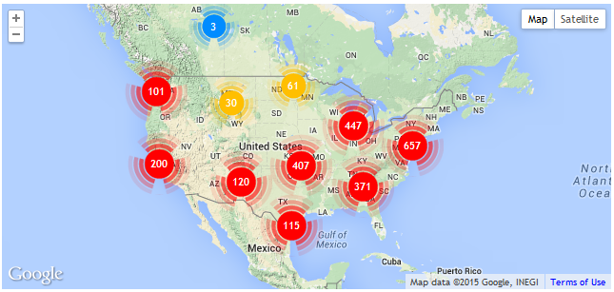
Current DS-Connect® Registrants: North America
2541 as of May 13th, 2015

Slide 31
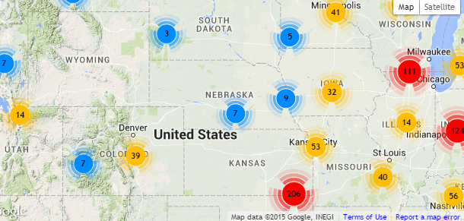
Current DS-Connect® Registrants: The Heartland
16 in Nebraska as of May 13th, 2015

Slide 32
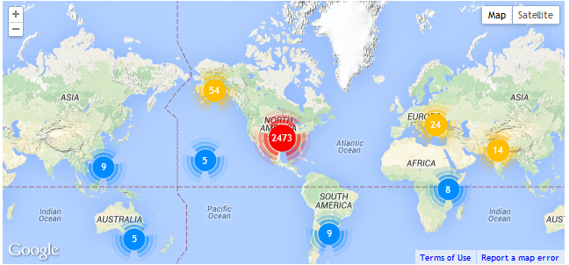
Registrants World-wide
60 outside U.S. as of May 13th, 2015

Slide 33
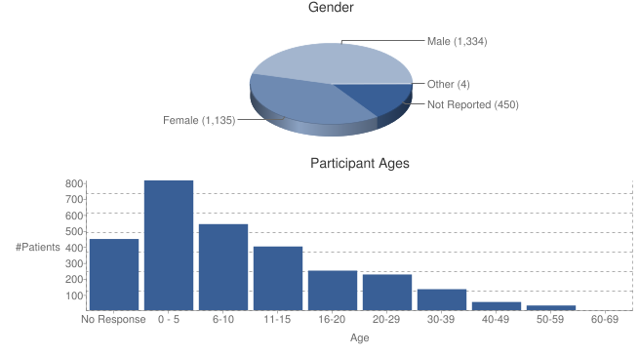
Explore the data: demographics

Slide 34
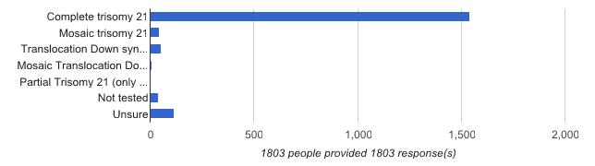
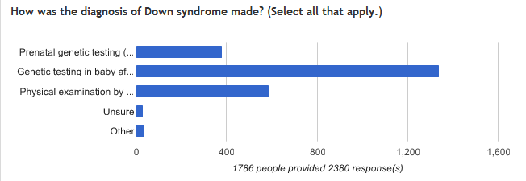
Explore the Data
Aggregated, de-identified data:
Available to registered families and professionals

Slide 35
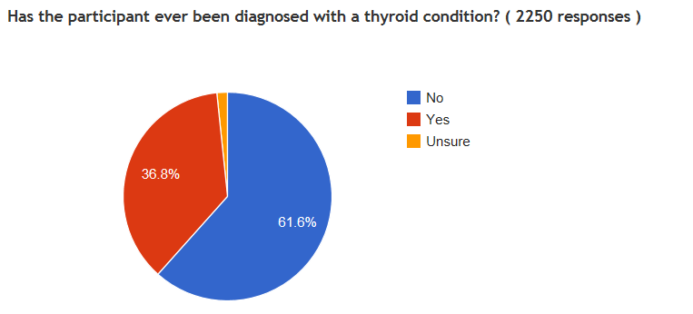
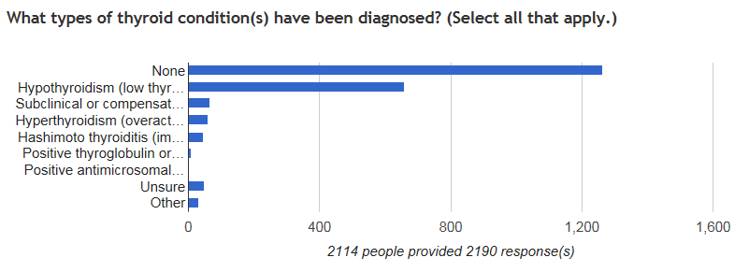
Explore the Data: Thyroid

Slide 36
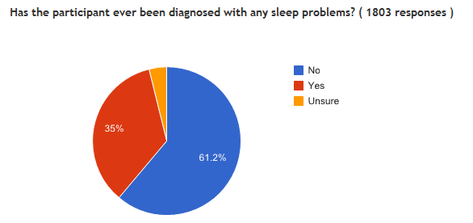
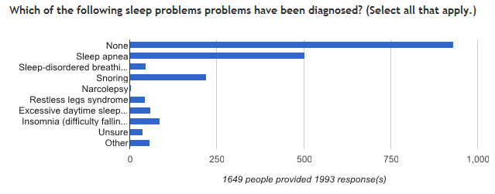
Explore the Data: Sleep

Slide 37

How secure is it?
Meets stringent data security requirements to protect personally identifiable information
  ~ 250 security controls are checked regularly
  Information is encrypted
  Password requirements (At least 8 characters long, 1 upper case, 1 lower case, 1 symbol, 1 number)
  Example: P@ssword3
  Passwords must be changed every 10 months
  No social security info is collected
  No personal bank account info
  is collected

Slide 38

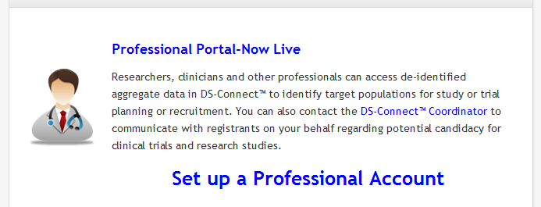
Portal for Professionals
Link available on home page
No direct access to Registry participants
Registry Coordinator will contact eligible families about the study or trial
Participants can choose whether to contact investigators to join

Slide 39
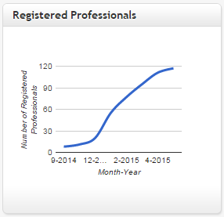
Professional Portal: Researchers

Slide 40
Professional Portal: Tiers of access
Access Level 1: View data identical to Registrants’ view and can perform basic searches of de-identified data
Access Level 2: More customized searches, to propose new survey modules, statistical analysis, publication or presentation.
Access Level 3: For posting a study announcement, study recruitment, commercial purposes.
NOTE: Investigators will NEVER be able to contact participants directly. The Registry Coordinator will inform the participant of any clinical study of interest.

Slide 41
Professional Portal: Research Review Committee
Peter Bulova, M.D. (Director, University of Pittsburgh Adult Down Syndrome Center)
Priya Kishnani, M.D., M.B.B.S. (Division Chief, Medical Genetics, Duke Department of Pediatrics, Duke University School of Medicine)
Stephanie Sherman, Ph.D., DS-Connect® RRC Chair (Professor, Emory University Department of Human Genetics)
Wayne Silverman, Ph.D. (Director, Intellectual Disabilities Research, Kennedy Krieger Institute)
Marilyn Bull, M.D., DS Consortium member (Board of Directors, American Academy of Pediatrics)
A family member of a person with Down syndrome
Other member(s) if specialty expertise is needed.

Slide 42
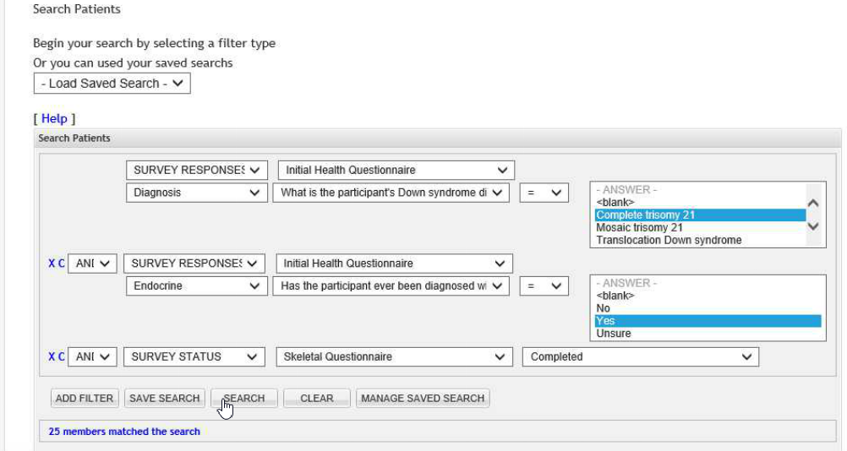
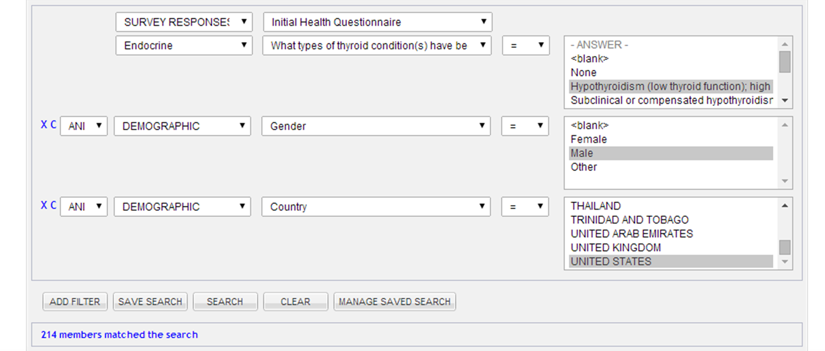
Professional Portal: Search Function

Slide 43
Examples of Research Requests
Online survey of parent experiences in feeding their children with Down syndrome
Phone interview of parents to learn how children with Down syndrome find their way
Test blood samples from infants with Down syndrome for thyroid problems
Study sleep in children with Down syndrome

Slide 44
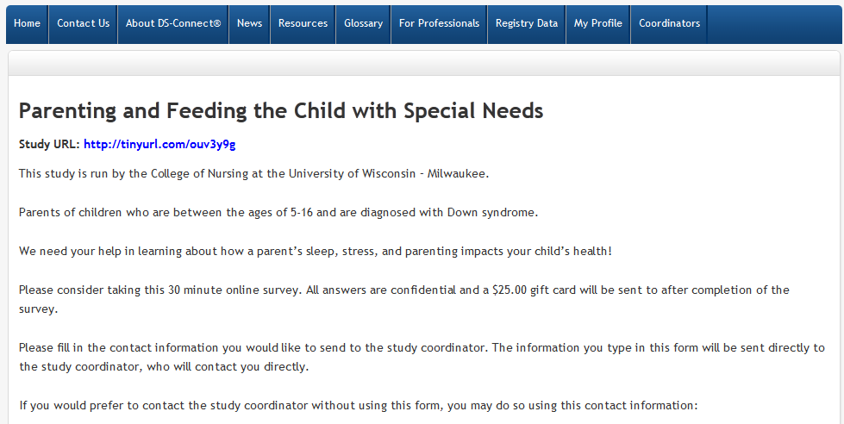
Research Request: Feeding children with Down Syndrome

Slide 45
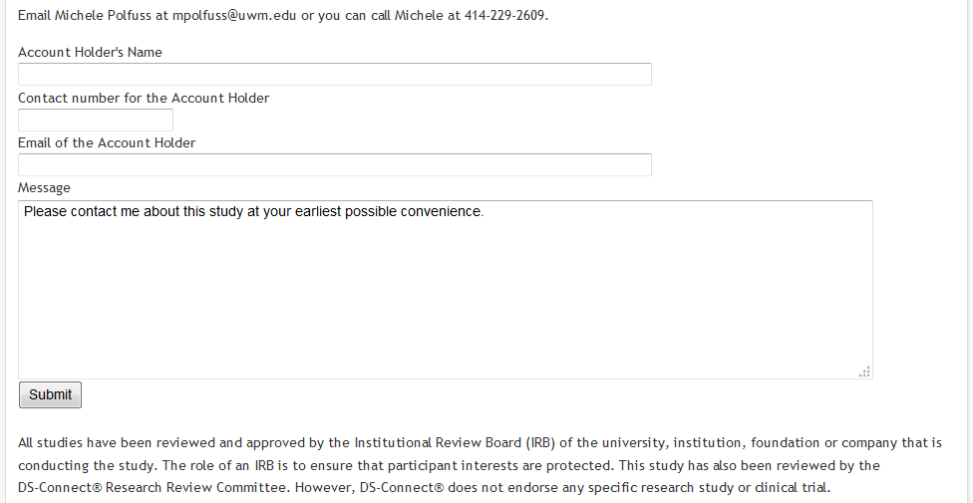
Research Request-continued

Slide 46

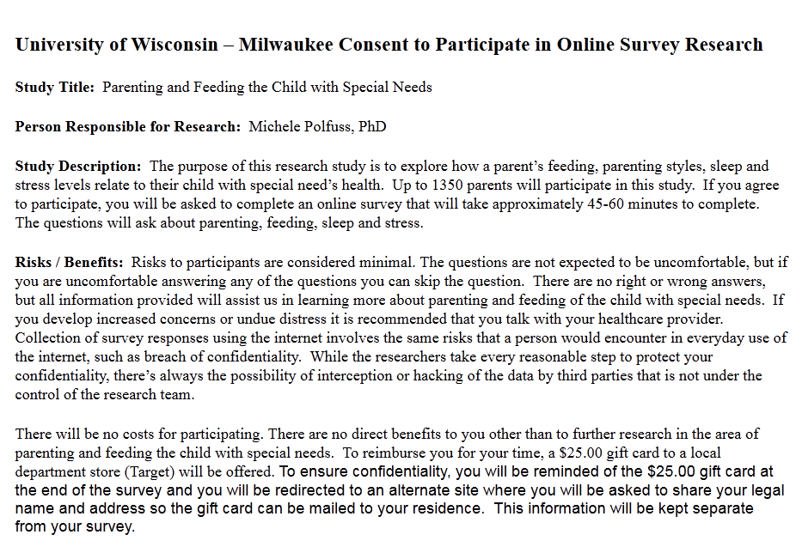
Link to the Feeding Survey study

Slide 47

Why should I sign up?
All DS-related health information matters
You can find healthcare providers
You can update your information at any time
You can print out your survey answers and share them with medical providers
You can plot your growth on DS growth charts
You can let NIH and scientists know about health needs of individuals with DS of all ages
You can connect with researchers to participate in clinical studies
It only takes a few minutes…

Slide 48
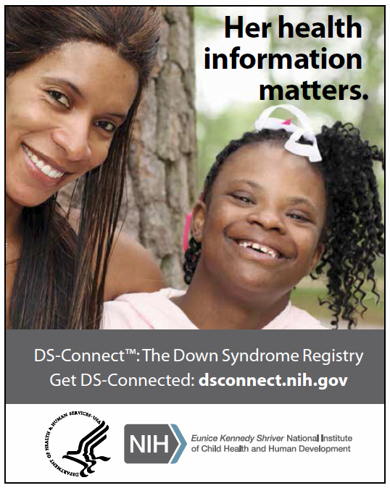
What Can I Do to Help?
Spread the Word!
Electronic Toolkit available:
  Video Testimonial-YouTube
  Facebook info-cards
  Badges
  Tweets
  Flyers
All resources free of charge
Contact us at:
DSConnect@nih.gov

Slide 49
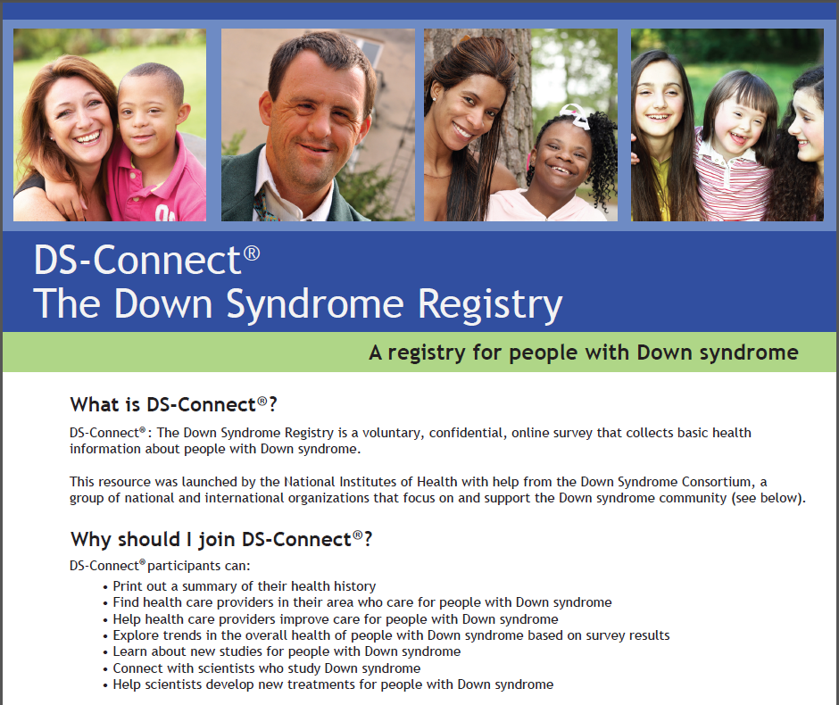
Flyer available on home page

Slide 50
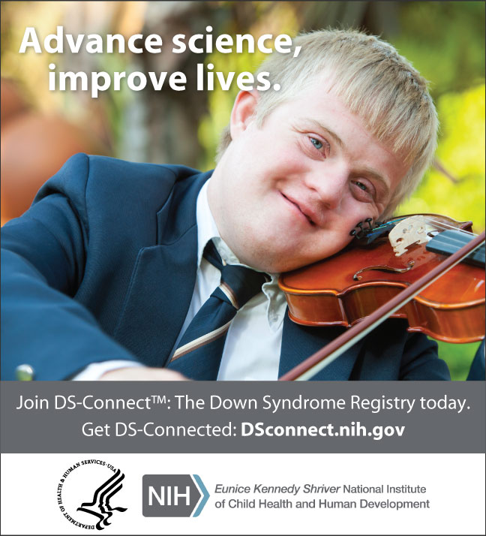
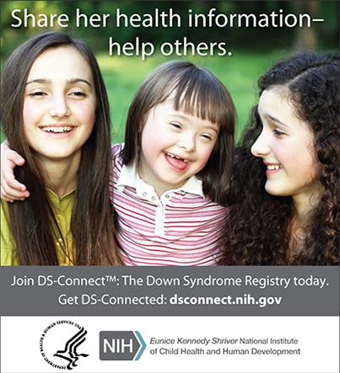
Info-cards: Get DS Connected!
https://DSConnect.nih.gov

Slide 51
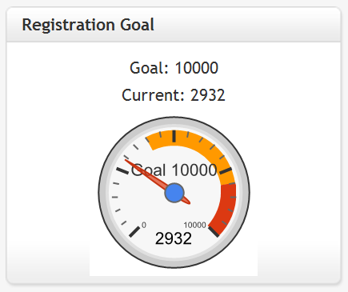
The Ultimate Goal: Helping all individuals reach their full potential.
https://DSConnect.nih.gov

Slide 52

Acknowledgments
External Scientific Reviewers
Registry Governance Board
Registry Operations Board
Research Review Committee
Down Syndrome Consortium
Individuals with DS and their Families
NIH Down Syndrome Working Group
DS-Connect® development team:
  Sujata Bardhan, PhD
  Aubrey Callwood
  Debbie Jae, MS
  Lisa Kaeser, JD
  Vanessa Rangel Miller, MA, MBA
  Christina Stile
  Yvonne Maddox, PhD
Self-advocates

Slide 53
Thank you!
Melissa Parisi
parisima@mail.nih.gov
https://DSConnect.nih.gov

