Slide 1
Munroe-Meyer Institute
Caring for Champions
Karen B. Wilson, OD
Vision Clinic

Slide 2
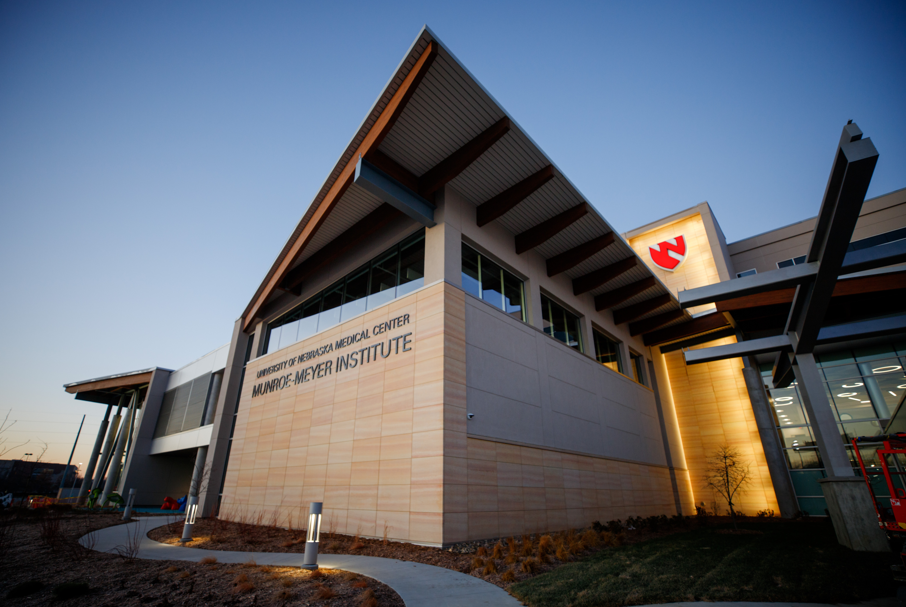

Slide 3
Caring for Champions
Vision Clinic
The Caring for Champions vision clinic opened in April of 2021. Vision care is a new service offered here at MMI. We share space with dental and wellness clinics.
We are honored to be a part of the MMI organization; and proud to be in MMI's new headquarters.
MMI provides a multitude of services to those with intellectual and developmental disabilities, including medical care, rehabilitation therapy, and behavioral health.

Slide 4
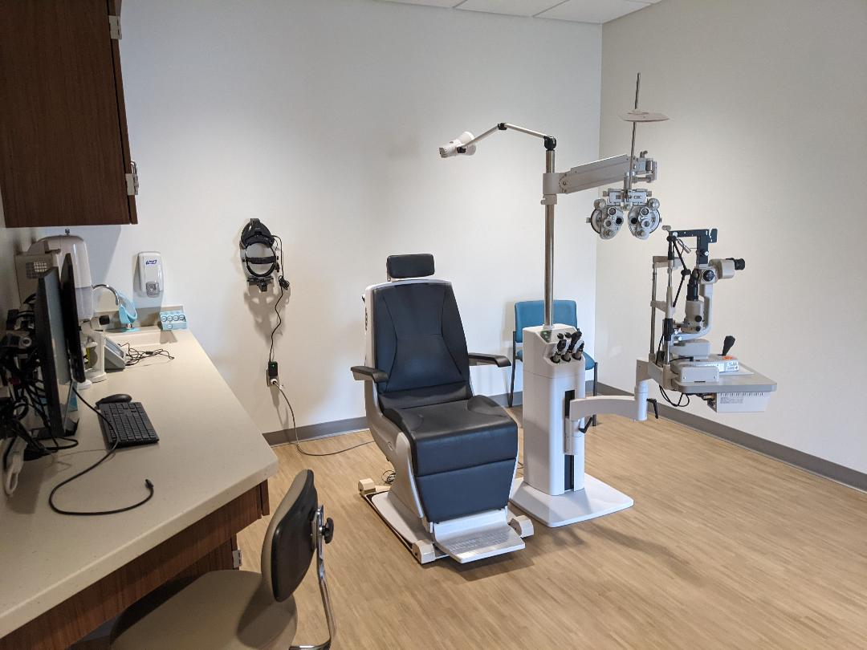
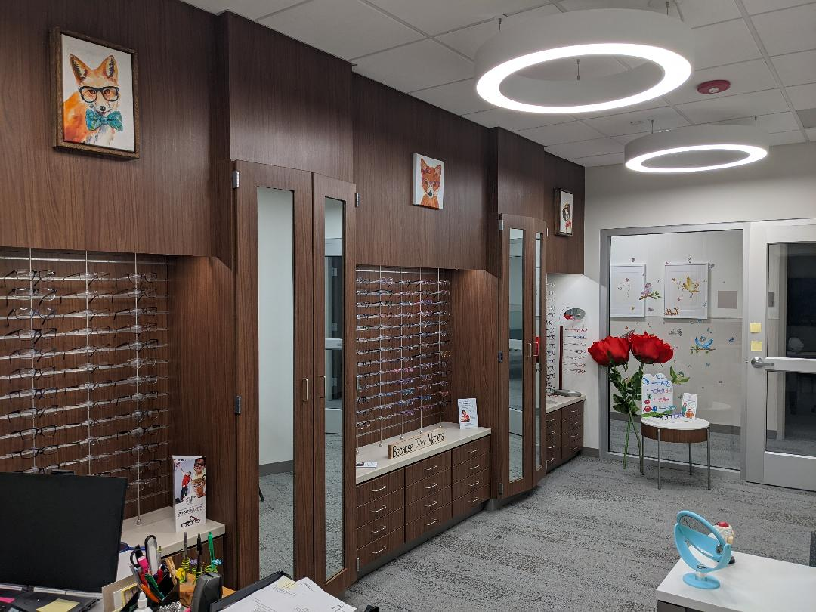
Comprehensive eye exams
It has been stated that learning for sighted individuals is over 80% visual: so very important to have an annual eye exam!
We provide comprehensive eye care to patients from 2 years old to 99+!
We have a full optical department and prescribe and provide eye -glasses and contact lenses.
We have many styles of frames; something for everyone!

Slide 5
Statistics from Special Olympics Screenings
These statistics provided the motivation to create the Caring for Champions Clinics!
RE: vision screening:
~20%+ : never had eye exam!!
~40% need glasses, ~16% undiagnosed eye disease
~ 10-15% visual impairment (low vision)

Slide 6

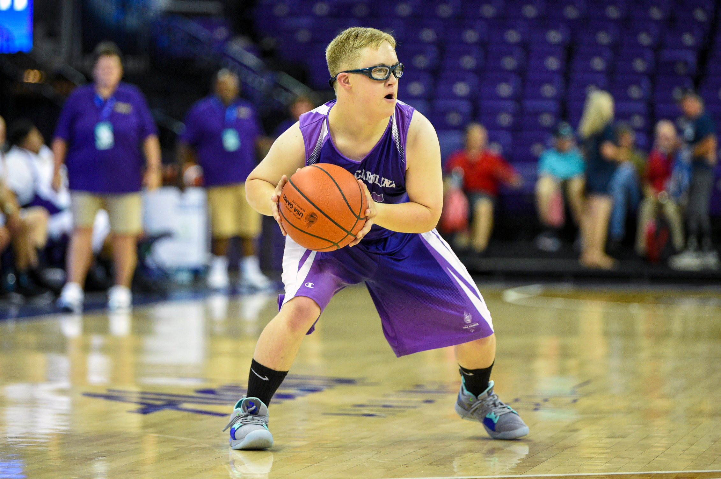
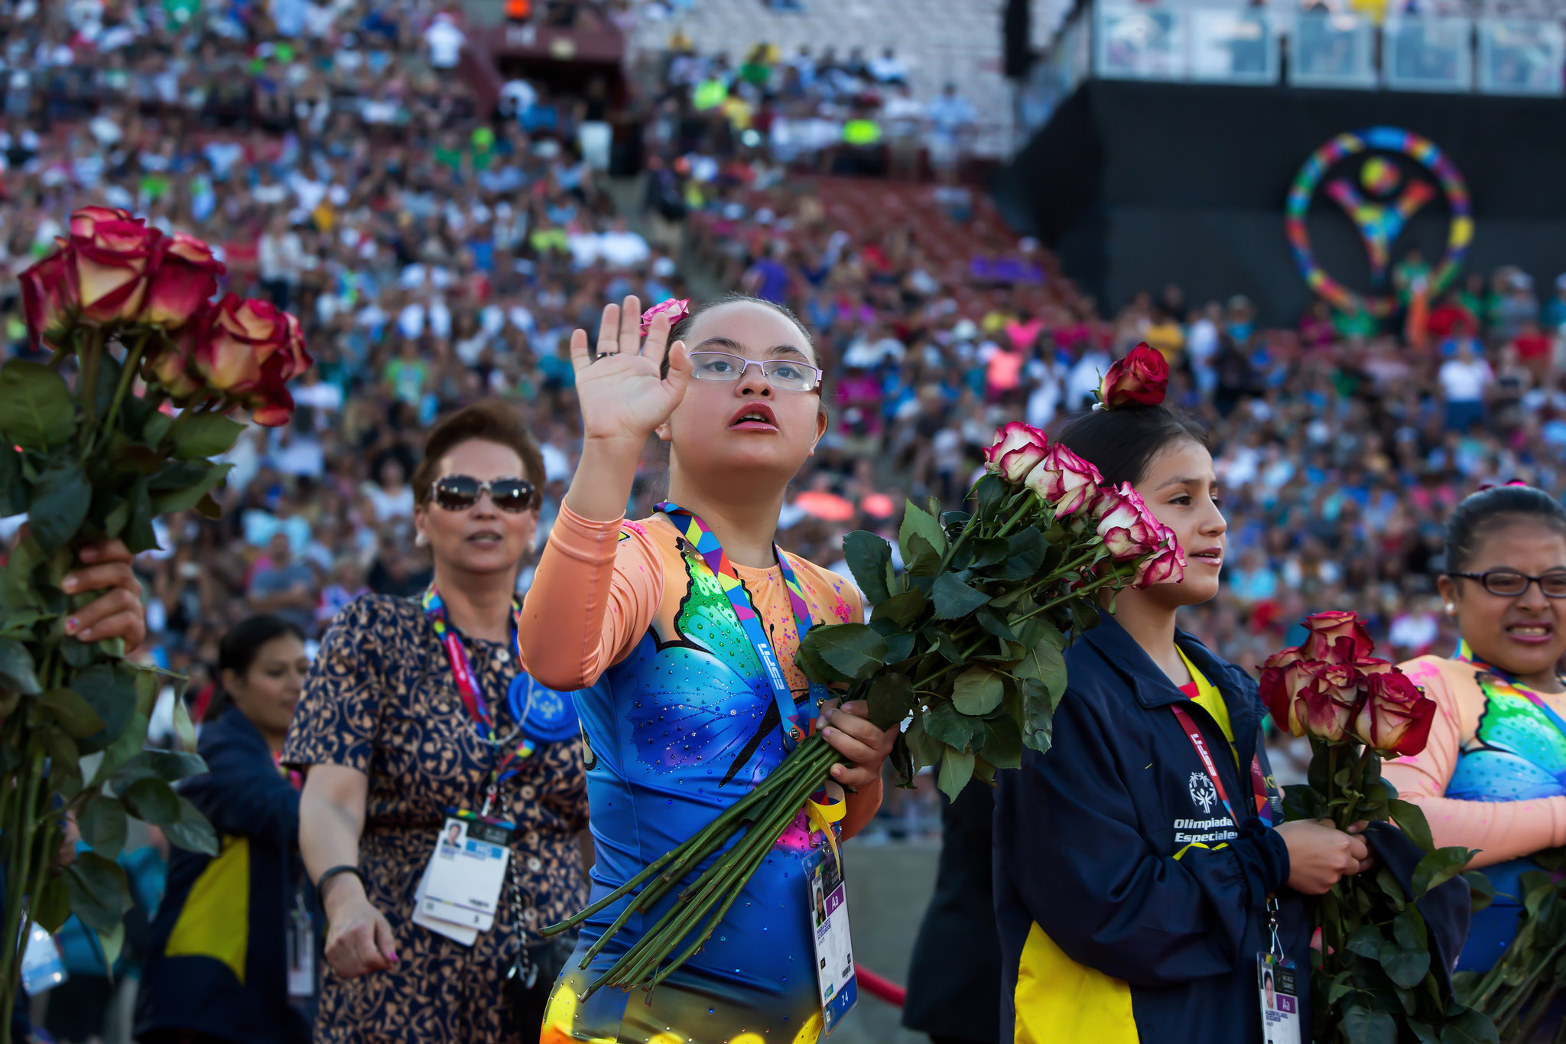

Slide 7
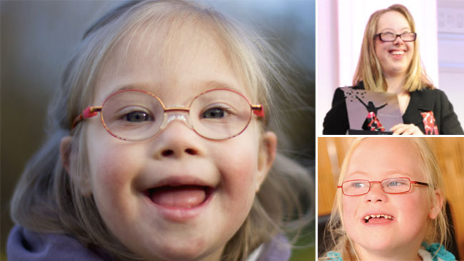
Visual disorders in Down Syndrome
Much higher incidence of:
High refractive errors: most commonly hyperopia, astigmatism.
Impaired accommodation: Many benefit from a reading add: bifocals, no-line multi-focal
Convergence insufficiency, oculomotor dysfunction (tracking, reading)

Slide 8
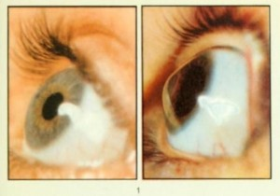
Ocular disorders in Down Syndrome
Cataract:
Corneal dystrophies: keratoconus:
(up to 40%: assoc: eye-rubbing)
Treatment: spectacles, contact lenses, corneal
cross-linking, corneal transplant

Slide 9
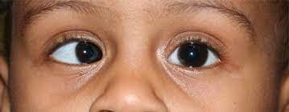
Ocular disorders in Down Syndrome
Strabismus: eye-turns
Treatments: spectacles, prism, muscle surgery, botox injections
Blepharitis: inflammation of eyelids
Can cause infections, corneal scarring etc.
Hordeolum: 'Stye':
Untreated can cause chalazion: eyelid 'bumps'

Slide 10
Vision Clinic Goals
To provide state of the art care, diagnosis and treatment of eye disorders and vision in a calm inviting atmosphere; to provide our patients the best possible vision to achieve their goals at school, at work, in their chosen sport and in all their daily activities.
Appointments available on Tuesdays and Fridays.
We accept most insurance plans
We invite visits to get acquainted and tour our facilities: therapists, providers, team members, caregivers welcome.
Appointment # 402-559-6418; website: unmc.edu/mmi
THANK –YOU!!

