Slide 1
Ready, Set, MOVE! Gross Motor Skills in Children with Down Syndrome
Amy Beyersdorf, PT, PCS
Sara Garcia, PT, DPT, PCS
November 2, 2021

Slide 2
Objectives
Families will understand the physical factors related to the diagnosis of Down Syndrome and how they relate to gross motor skill development.
Families will understand the importance of active learning and initiation of movement as it relates to cognition and overall development
Families will learn about the 6 F words (of childhood disability) and how to incorporate these into their overall goals for their child
Families will learn about Early Intervention and School based services along with community resources available to all children with developmental disabilities.

Slide 3
Down syndrome (DS) is the most common chromosomal abnormality and results from the presence of full or partial extra copies of the genes on chromosome 21.
Every year about 6,000 babies are born with Down Syndrome. That means that 1 in every 700 babies in the US.
Notes:
80% born
We wanted to focus on specific physical characteristics of Down Syndrome and relate how these may affect the acquisition of motor skills.

Slide 4
Physical Characteristics of Down Syndrome
Hypotonia
Ligamentous Laxity
Decreased Strength
Small Stature

Slide 5
Physical Characteristics of Down Syndrome
Hypotonia

Slide 6
Hypotonia
abnormally low muscle tone
reduced resting muscle tension and decreased resistance to passive stretch or rapid movement
Infants often feel “floppy” in neck, trunk, arms, and legs
Notes:
Hypotonia is a medical term used to describe decreased muscle tone. Normally, even when relaxed, muscles have a very small amount of stiffness/contraction that gives them a springy feel and provides some resistance to (passive )movement.
Hypotonia may originate from disturbances in physiology of central or peripheral NS or end organs (muscles and muscle groups)
G Paleg, R Livingstone (Care pathway for Therapeutic Interventions)

Slide 7
Notes:
Stop at 1:31

Slide 8
Notes:
1- motor function - decreased joint stability, joint hypermobility, weakness, and/or decreased activity and endurance--associated with reduced developmental experiences --in turn altering typical progression of gross and fine motor abilities and can interfere with ability to attain positions and acquisition of developmental milestones.
2-Postures -can interfere with functional activities -- reaching, sitting, standing and crawling/walking, which can lead to participation restrictions.
3- Sleep quality-When combined with muscle weakness, can interfere with sleep by limiting ability to change position during rest: this can contribute to discomfort and poor sleep quality.
4-Reflux and/or constipation due to abnormalities in coordination of voluntary and involuntary muscle function.
5-Chewing/swallowing--can have drooling and feeding problems (e.g. chewing or swallowing).

Slide 9
Functional Impact of Hypotonia
Appears weak because works harder to gain control over movement in all postures.​
Initiation of movement slower; see muscle activation in a quick burst -- then difficulty sustaining.​
Joint laxity / hypermobility commonly co-occurring.​
May “stiffen” muscles as a result of effort to stabilize against gravity. ​
Less active exploration of environment -- impacts learning / educational outcomes. ​
Decreased somatosensory (tactile,proprioception) awareness; poor body awareness​
Slower reaction times
Notes:
There is a continuum for Hypotonia where some are affected with moderate and others mild

Slide 10
Physical Characteristics of Down Syndrome
Ligamentous Laxity
Notes:
Children who have low muscle tone can be very flexible. They are often described as having lax ligaments, hypermobility or being doublejointed. This is because the muscles do not hold the joints together as tightly as in people with normal muscle tone.
In most cases, although hypermobility is a factor in gross motor delay, it does not have any serious effects.
This extra flexibility is usually most noticeable in the fingers, ankles and knees. It can make it hard to control the position of the joints.
People with hypermobility can find it difficult to know where their body is in relation to their environment, e.g. slopes, different surfac

Slide 11
Ligamentous Laxity or Hypermobility
Muscles do not hold the joints together very tightly
Results in extra flexibility especially in fingers, ankles and knees
Ligaments that hold bones together have more slack
Notes:
Rubber band scenario
Tendons are cable-like structures which connect muscles to the muscle attachments on bones.
Ligaments are similar to tendons but attach bones to each other.
The ligaments in people with Down syndrome are more elastic than in typically developing people. The effect of having ligaments which are more stretchy than usual is that the joints are capable of a much greater range of movements than is typical.

Slide 12
What does this mean for my child?
We cannot change the muscle tone or lessen the laxity, BUT
Avoid stretching ligaments further (ex: lifting infant under arms instead of pulling or lifting up by arms)
Provide opportunities to improve strength around joints through safe weight bearing activities
Strength WILL improve with practice and opportunities and can help stabilize joints when moving against gravity
Notes:
Provide opportunities to improve strength around joints through safe weight bearing activities such as prone, positioning on all fours and encourage child to use own body to move heavier objects/toys by pushing through surface

Slide 13
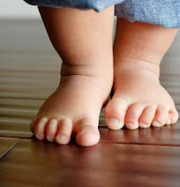
Foot alignment
Flat feet –
Normal in first 2 years of life (97% of 18 month olds)
Laxity of joints and lack of muscle control lead to flattening of the arch
Pronation
Heel tilts inward and weight is on the inside of the foot
Often the knees and hips can become misaligned
This Photo by Unknown Author is licensed under CC BY
Notes:
Flat Feet: Intrinsic laxity and lack of neuromuscular control resulting in flattening of the arch when weight bearing
Pronation: Heel can tilt into valgus and the weight line shifts medially causing the midfoot to collapse.

Slide 14
Flat feet or Pronation?
Notes:
Calcaneous is large and with ligamentous laxity the top of the heelbone can tilt inward. Often the talus (internal bone) follows as well as the midfoot. This can lead to pronation.
Forefoot sometimes turns outward with the collapse of the medial arch

Slide 15
What causes pronation in kids with DS?
Joint instability can affect foot alignment and is influenced by :
Joint laxity
Decreased muscular support (cocontraction) around the joint,
Decreased proprioception (understanding location of foot and joints in space)
Decreased postural tone
Notes:
Joint instability contributes to nonoptimal musculoskeletal alignment and is influenced by the following:

Slide 16
To brace or not to brace?

Slide 17
Research studies
Efficacy of Orthoses for Children with Hypotonia, A Systematic Review:
Weber and Martin, Pediatric Physical Therapy, 2014
Systematic review that looked at 10 articles
Looked at efficacy of orthoses for children with hypotonia
Notes:
Results for body structure and function components but not participation (ICF)

Slide 18
Research studies
FO- foot orthotic—3 studies (low level)-looked at structural alignment
Recommendation: addition of PT intervention recommended to:
Strengthen LE musculature to improve push off and augment support of the knee,
Dynamic activities in addition to FO’s
ICF activity: all 10 included ICF activity domain
7 articles reported benefits to activity domain
3 articles suggest that orthoses may be detrimental to rate of gross motor development and should wait until after acquisition of independent walking
SMO’s: 5 studies
Looper: concern that SMO’s may constrain child’s ability to explore movement strategies and could be detrimental when child is learning to walk

Slide 19
Bottom line:
Researchers suggest waiting to use orthoses until child achieves independent ambulation
All authors agree orthoses may be beneficial for gross motor skills but that it is an individual decision
Include Physical therapy in the decision to brace AND to assist with
1. monitoring of braces fit
2. providing suggestions for motor planning activities
3. dynamic balance activities
Notes:
Looper and Ulrich suggested waiting to implement orthoses until independent ambulation

Slide 20
Surestep Orthotics
The Surestep SMO (supramalleolar orthosis) has had a big impact on the orthotic management for children with hypotonia.
Use of extremely thin, flexible thermoplastic to compress the soft tissues of the foot.
Have been known for stabilizing children while still allowing for natural development.

Slide 21
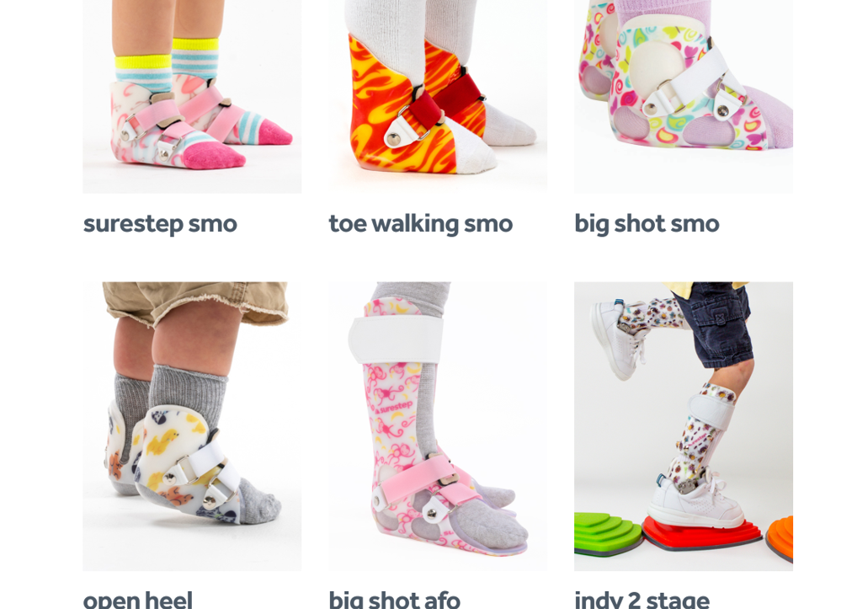
Surestep
https://surestep.net/products/

Slide 22
Cascade products : https://cascadedafo.com/

Slide 23
Example of Pronated feet
Notes:
4;18 WITH BRACES

Slide 24
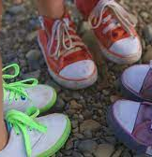
What about shoes?
Shoes can provide good foot alignment
Shoes can be used with or without braces
Shoes should have
solid heel counter to hold the heel vertically
flexible sole and toe box
medial arch support
Surround the foot well with good support- lace up have better support
Nonslip soles
BUT…Barefoot is best!

Slide 25
Physical Characteristics of Down Syndrome
Decreased Strength

Slide 26
Decreased Strength
Children with Down Syndrome have decreased muscle strength
This can contribute to gross motor delays as children lack strength and endurance (ability to keep going) to learn skills quickly.
Strength can improve with repetition and practice

Slide 27
Physical Characteristics of Down Syndrome
Short Stature

Slide 28
Physical Attributes
Short arms and legs –affects some motor skills
Fine motor skills
Grasp on utensils and pencil
ADL’s
Gross motor skills
Learning to prop sit
Balance once upright (wide stance)
Notes:
Children with Down Syndrome often have shorter arms and legs than other children, which can make some physical activities harder, e.g. when they are learning to sit and want to balance with their hands.

Slide 29
Ready, Set, MOVE!

Slide 30
Why is movement important?
Interplay between moving and gathering information about our environment builds intellect
Research suggests that early object interaction, sitting, and locomotor behaviors are important for promoting…
cognitive
perceptual-motor
language
social-emotional development.
Notes:
Grounded Cognition article
Cognition: includes a wide range of mental processes such as those involving perception, action, memory, language problem solving, reasoning, decision making and social interactions
Grounded cognition: “perceptual-motor experiences play an integral role in cognition
-in past, we viewed cognition as a process occurring separately from body, environment and other people and perceptual info was simply input. Behavior occurred as a result of output from a cognitive system that was separate and unaffected by perceptual-motor experiences.

Slide 31
Exploration and Initiation of Movement
Independent mobility helps to organize developmental changes in spatial cognition and emotions
Independent mobility has also been shown to influence social-communicative behaviors of infants and to be linked to cognitive memory
Research evidence shows the association between motor development and cognition, language and social development (Lobo, Harbourne, Dusing, McCoy, 2013)
Notes:
Campos and Nertenthal suggested that independent mobility is an organizer of psychological changes in typically developing infants, especially developmental changes in social understanding, spatial cognition, and emotions
Meta analysis: self produced locomotion has an effect on spatial cognitive performance in typical children (Yan JH, Thomas JR, Downing JH: Locomotion improves children’s spatial search: a meta-analytic review, Perceptual Motor skills 87: 67-82: 1998.)
Self produced locomotion has also been shown to influence social-communicative behaviors of infants and to be linked to cognitive memory

Slide 32
How can moving/locomotion affect communication and social interactions?
As infants improve locomotor skills and expand these experiences through crawling or moving, they are likely to;
1. Use more gestures to communicate with others
2. Demonstrate more positive affect
3. Initiate interactions with others more often during free play

Slide 33
What does this mean?
We move to learn
Initiating movement—will enhance muscle activation and spatial awareness AND cognitive concepts and social interactions
Exploration will build confidence
Allow mistakes— promotes problem solving movements, spatial awareness, social interactions and thinking skills
Notes:
Allow mistakes—this allows time to problem solve not only movements, but spatial awareness, social interactions and thinking skills

Slide 34
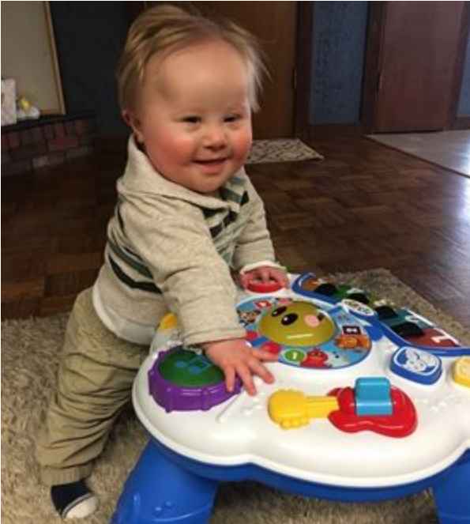
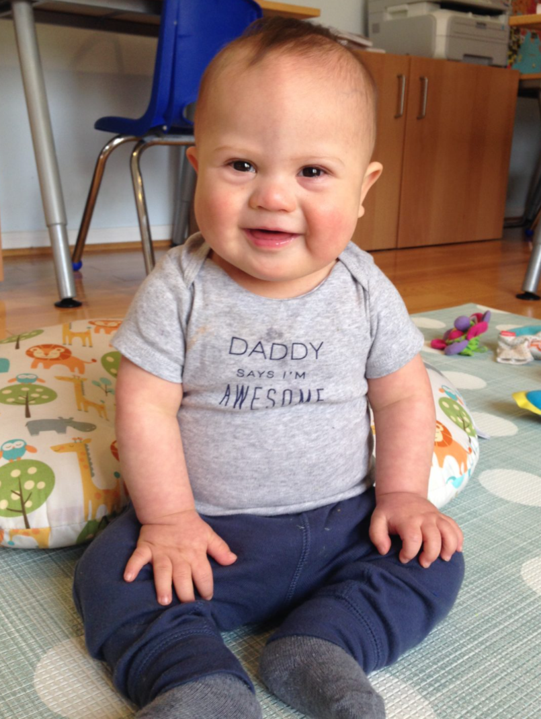
Motor Skill Development
Notes:
How does all this relate to motor skill development?
Motor milestones most likely will be delayed but are very dependent on physical and medial complications and strengths of each individual child.
We like to measure success and progress by looking at specific milestones, but we need to keep in mind that other forms of learning and progress are also taking place along with movement.

Slide 35
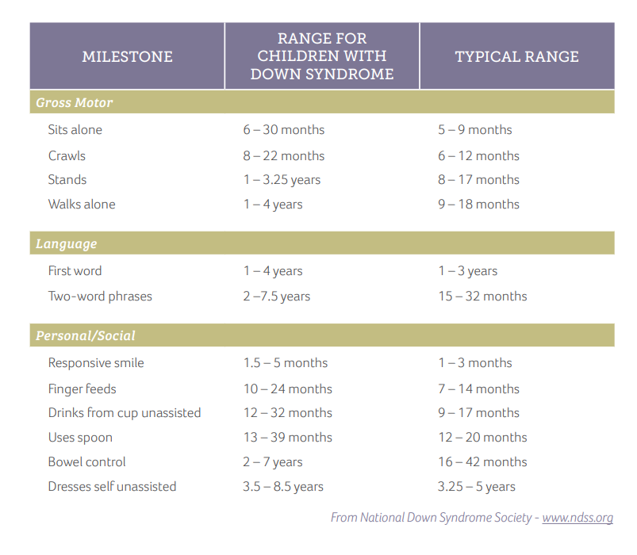
Notes:
This chart has specific milestones but notice the wide variability and range in time of acquisition!

Slide 37
International Classification of Functioning, Disability and Health
Framework for describing functioning and disability related to a specific health condition.
Provides a common language and framework
Describes what a person with a specific health condition can do (level of function) in their unique environment
Notes:
The ICF was developed to understand each child and family’s unique functional abilities and needs.
The ICF divides each condition into 3 interconnected parts such that influences on 1 part will affect or change aspects of the others
The ICF was approved for use by the World Health Assembly in 2001, after extensive testing across the world involving people with disabilities and people from a range of relevant disciplines. A companion classification for children and youth (ICF-CY) was published in 2007.

Slide 38
Notes:
Health condition: can be a diagnosis, or can be a description such as hypotonia
Body function/structure: how body parts work – decreased strength, tight muscles, pronated feet, etc
Activities: Execution of a task or action. What motor skill or skills that child is working on: walking, playing, jumping, kicking a ball
Participation: How child engages with the world and with their environment: Playing soccer with peers, biking on a trail with friends
Environmental factors: The physical, social and attitudinal environment in which people live and conduct their lives; these are either barriers to or facilitators of the person’s functioning
Personal Factors: Internal personal factors which can include gender, age, education, profession, past and current experience, character and other factors that influence how disability is experienced by the individual

Slide 39
The Six F-Words of Child Development
Function
Family
Fitness
Friends
Fun
Future
Rosenbaum, P., & Gorter, J.W. (2012). The ‘F-words’ in childhood disability: I swear this is how we should think! Child: Care, Health and Development, 38(4), 457 – 463. DOI: 10.1111/j.1365-2214.2011.01338.x; CanChild’s F-words Knowledge Hub: www.canchild.ca/f-words

Slide 40
Notes:
Broad, strength based approach to a child’s development, based on the ICF framework from the World Health Organization
The CanChild website has a number of resources devoted to the 6 F words

Slide 41
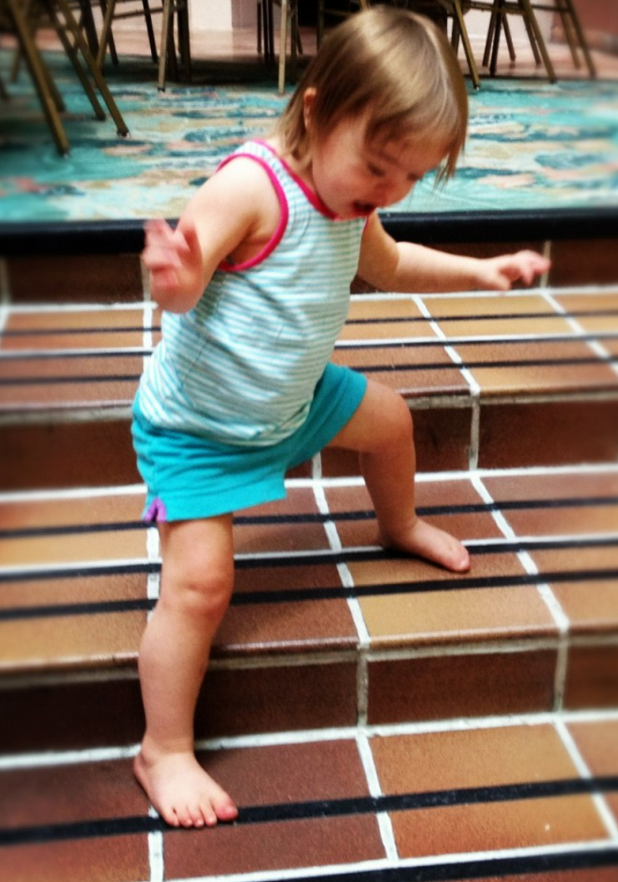
FUNCTION
“ING” words
Is the activity meaningful?
FUNCTION for a purpose in meaningful life activities = PARTICIPATION
CAPACITY versus PERFORMANCE
Notes:
Thinking ahead to participation – it isn’t just that the child can perform a skill, but why are they are doing it? Is it meaningful to them. An example: crawling versus walking. The child may be able to take steps, but they still see crawling as an efficient way to move from place to place. Walking isn’t yet meaningful to them.
Capacity=our best performance in a controlled environment
Performance=what we do everyday in our everyday environment
“can’t” and “won’t” are two different things

Slide 42
FAMILY
First and central learning environment for children
Each family is unique
https://www.youtube.com/watch?v=sJLSj43nSiI
Notes:
The family is the constant in the child’s life
Parents are the experts on the child’s needs and abilities

Slide 43
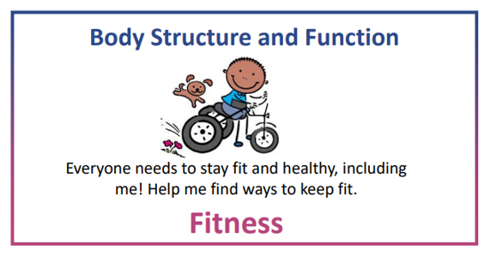
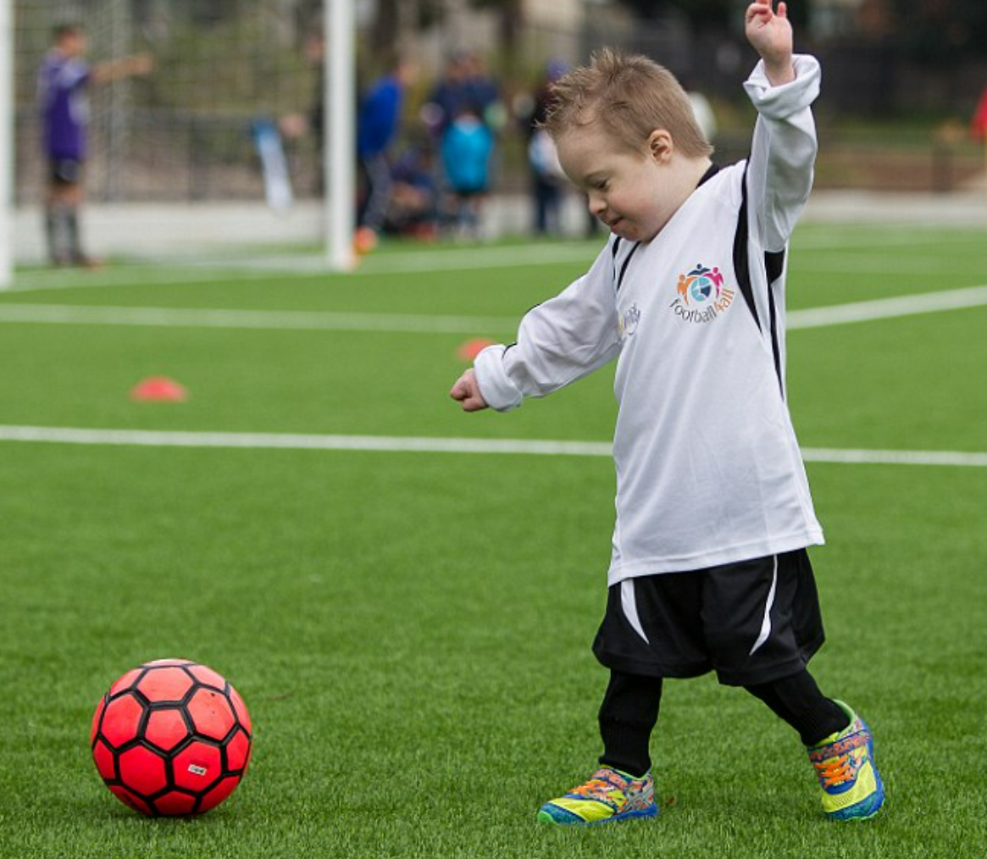
FITNESS
Definition: good health and strength achieved through exercise/ physical activity (1)
WHO definition of physical activity: any bodily movement produced by skeletal muscles that requires energy expenditure. (2)

Slide 44
WHO Physical Activity Guidelines
Under 12 months of age
Active several times/ day, particularly through interactive floor-based play
At least 30 minutes of floor time each day
1-2 years of age
At least 180 minutes of activity spread throughout the day
Energetic play, crawling, running, climbing
3-4 years of age
At least 180 minutes of activity throughout the day with at least 60 minutes of moderate to vigorous intensity activity
Exploring, running, jumping, playing on the playground
5-17 years of age
At least 60 minutes of moderate to vigorous intensity, mostly aerobic, activity
Include vigorous intensity activity that strengthens bone and muscle 3 days/ week
Playing at recess, swimming, organized sports
18-64 years of age
At least 150-300 minutes of moderate intensity physical activity
Or at least 75-100 minutes of vigorous intensity activity
Or an equivalent combination of the two each week
At least 2 days a week, participate in moderate intensity muscle strengthening activities that include all major muscle groups
Information taken from Physical activity (who.int) October 2021
Notes:
Merriam Webster dictionary
Physical activity (who.int)
Children with DS are LESS active than children with typical development
EI may have an impact on future motivation for ongoing physical activity
Improving motor skills to enhance motivation for physical activity may have an impact on reducing likelihood for obesity later in life

Slide 45
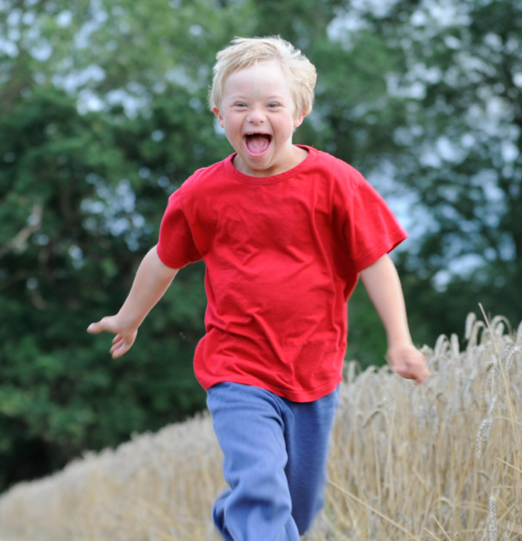
Physical Activity in Children with Down Syndrome
Children with Down Syndrome tend to be less active than their neurotypical peers
Many challenges to being active
Promote life long fitness from infancy
Physical activity level of parents and siblings have a significant effect on the child’s activity level⁶
Notes:
Challenges: physical factors – low muscle tone, medical issues
Improving motor skills to enhance motivation for physical activity may have an impact on reducing likelihood for obesity later in life
6-The child's PA level was significantly associated with parents' PA (OR = 5.5), siblings' PA (OR = 5.1) and the child's locomotion ability

Slide 46
What does the research say?
We suggest…change the focus…from underlying impairments such as low tone or joint laxity or from developing motor skills in isolation and "correct" movement patterns. Instead, physical therapists should allow the physical activity preferences and the environmental contexts of the children and adolescents they are working with to direct the treatment plan. In this way, (it) becomes more child centered by concentrating on developing the specific skills and strategies required for success in the child's preferred physical activity.⁵
Notes:
Wentz, et al, 2021 in Physical Therapy - Promoting Participation in Physical Activity in Children and Adolescents With Down Syndrome

Slide 47
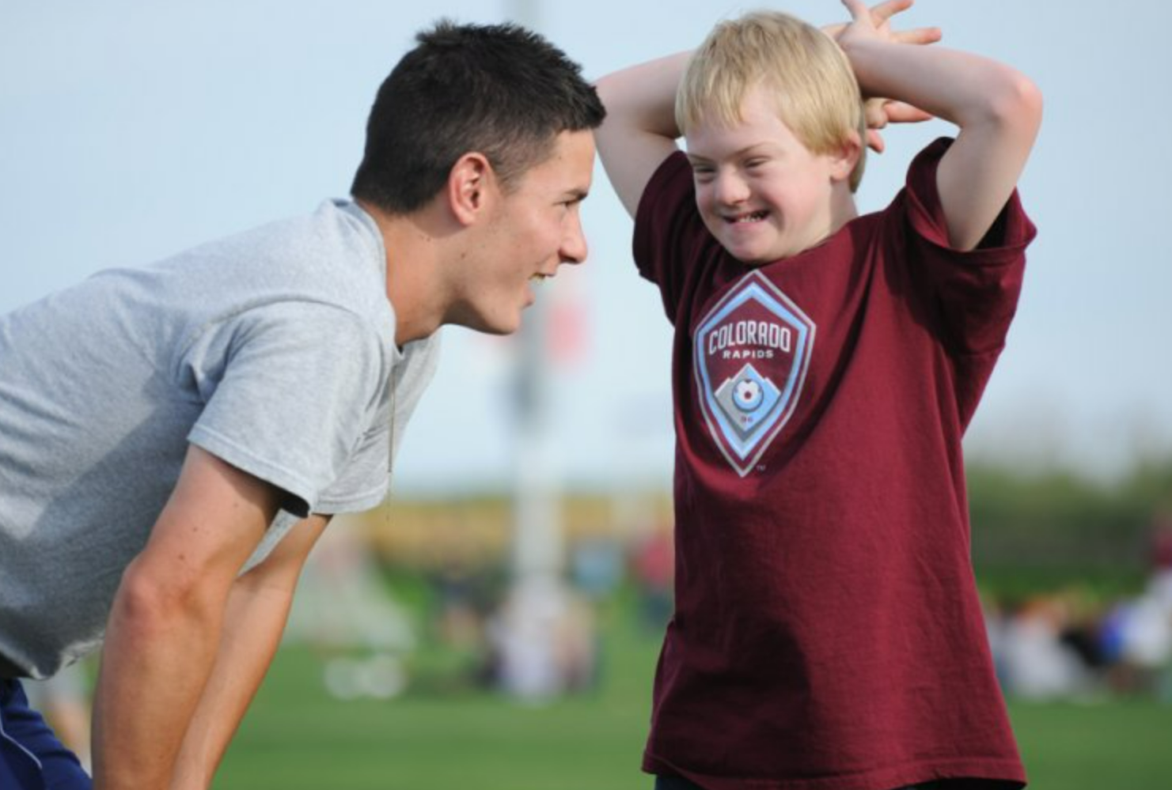
Physical Activity Considerations for Individuals with Down Syndrome
Talk with your child’s doctor before starting any formal exercise program
Start slow if not currently exercising
Aim for at least 60 minutes/ day
Include muscle strengthening, cardiovascular, and balance activities
MAKE IT FUN!
Notes:
Discuss articles – decreased activity in children with down syndrome
Family involvement in fitness activities

Slide 48
To Summarize…
Physical activity is any movement of our body that uses energy.
Physical activity needs to be FUN and MEANINGFUL.
Everyone needs regular physical activity to stay fit and strong.
Physical activity improves
Motor skills
Muscle (including our heart!) and bone health
Focus and attention
Memory
Problem solving
Brain development
Our ability to do our daily tasks or FUNCTION!

Slide 49
Physical Activity Resources
Community Resources
CDC
Canadian Physical Activity Guidelines
raisingchildren.net.au
Community Resources
Munroe Meyer Recreational Therapy Programs
Special Olympics
Young Athletes
Dancing Beyond Limits
TOPSoccer
AllPlay
Metro Stars Gymnastics
Adapted Swimming
Notes:
Merriam Webster dictionary
Physical activity (who.int)

Slide 50
FRIENDS
Friendships help
promote social, cognitive, language, and emotional development
Provide security and social support
support social problem-solving skills
Improve attitudes about school, self-image, and overall well-being
Notes:
Friends are important in helping make life fun!
Fitness activities help build friendships!

Slide 51
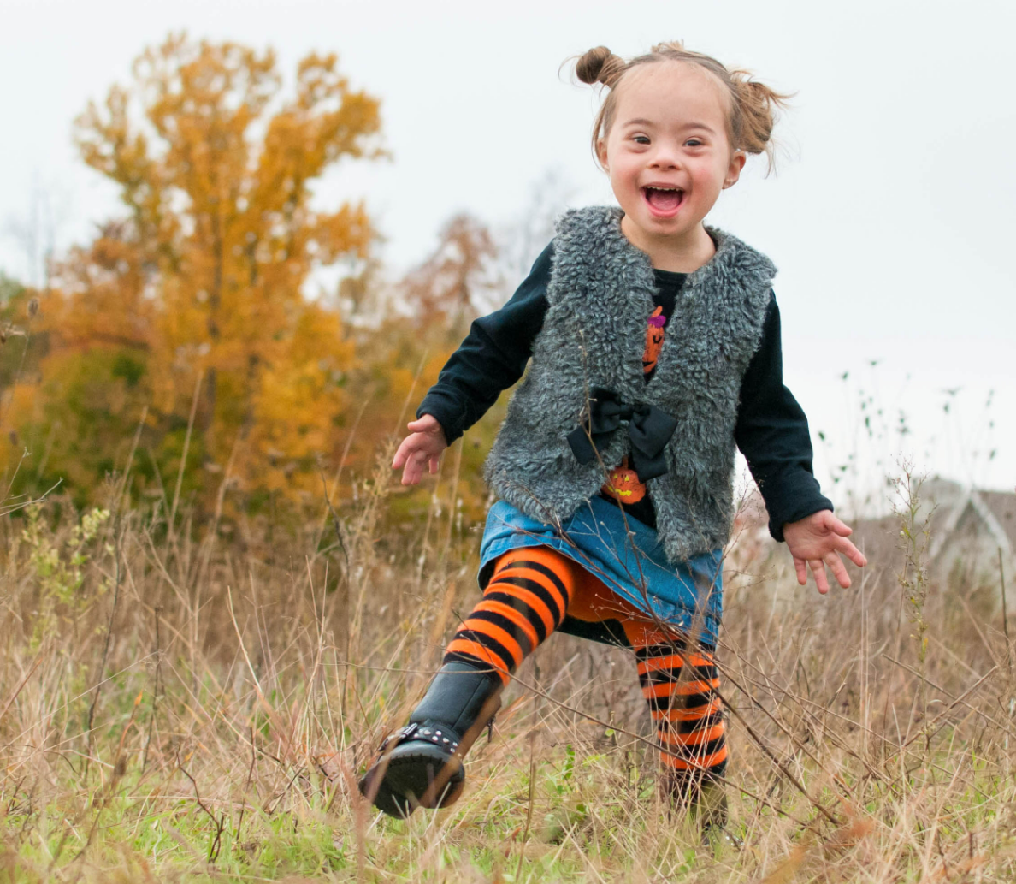
FUN
Having FUN is a product of play
Supports cognitive, physical, social, and emotional well-being
Characteristics of optimal learning (1)
Active
Engaged
Meaningful
Social
Iterative
Joyful…or FUN!
Notes:
Active play builds strength, endurance, balance
Social play builds social skills and language development
(1) Frontiers in Psychology

Slide 52
FUTURE
Today sets the stage for tomorrow
Notes:
Life is full of transitions. Infant to baby, baby to toddler, toddler to preschooler, preschool to kindergarten, elementary school to middle school, middle school to high school, high school to adulthood. If you can anticipate questions or challenges at the next transition point, it is important to address them as soon as possible.
Example – life long fitness. It is important not to wait until your child is older to start incorporating physical activity into his or her daily routine. Start when your child is an infant. Once you have the routine, you can change the activity based on what you find your child is most interested in.
As you think about the future, it is important to consider what questions you might have as you make the t

Slide 53
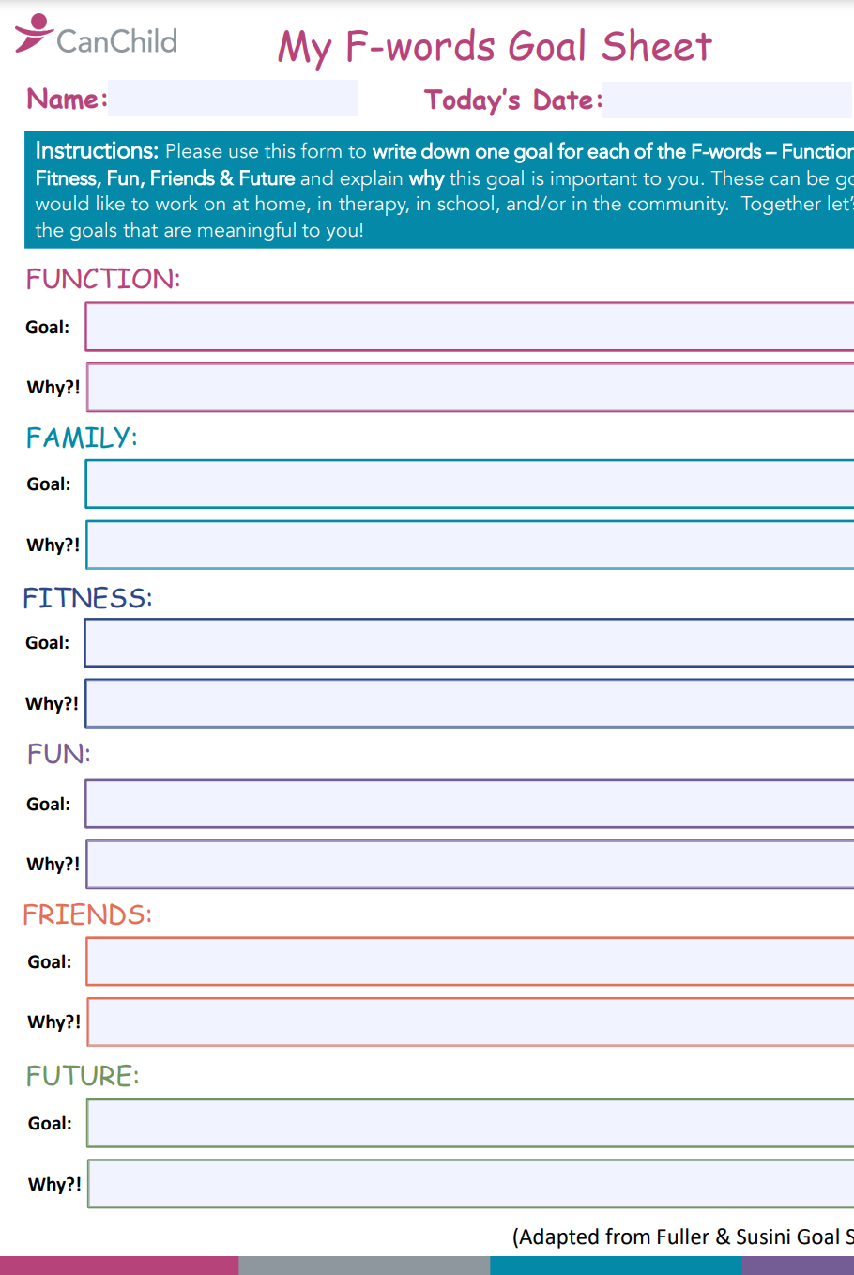
How Can I Use This?

Slide 54
Early Intervention Services
Children ages 0-3
Coaching Model/ Primary Service Provider Model
Supports needs of the child and family in their natural environment
Individualized Family Service Plan
Notes:
Review EI/ Rule 52
Discuss transition at age 3

Slide 55
School-Based Physical Therapy
Children ages 3-21
Individualized Education Plan
Related Service
Direct Service and/ or Consultative Service
Supports child’s ability to physically access and participate in the educational environment
Notes:
Discuss Rule 51
Discuss variety of services (direct versus indirect/ consultative)
Transition program

Slide 56
Outpatient Physical Therapy
All ages
Addresses child and family goals through direct intervention and home program
Typically clinic/ center based
FUNction, FUNction, FUNction
Notes:
When learning new skills
Develop home program
Pain
Goals should be related to daily routines and function

Slide 57
References
1. Winders, P. C. (2014). Gross Motor Skills for Children with Down Syndrome: A Guide for Parents and Professionals (Second Edition). Bethesda, MD: Woodbine House Inc.
2. Weber, A., & Martin, K. (2014). Efficacy of Orthoses for Children with Hypotonia: A Systematic Review. Pediatr Phys Ther, 26, 38-47.
3. Grounding Early Intervention: Physical Therapy Cannot Just be About Motor Skills Anymore: Michele A Lobo, Regina T Harbourne, Stacey C Dusing, and Sarah Westcott McCoy. PHYS THER 2013; 93;94-103.
4. Dare, David; Dodwell, Emily. Pediatric Flatfoot: cause, epidemiology, assessment and treatment. Current Opinion in Pediatrics. 26(1): 93-100, February 2014.
5. Wentz EE, Looper J, Menear KS, Rohadia D, Shields N. Promoting Participation in Physical Activity in Children and Adolescents With Down Syndrome. Phys Ther. 2021 May 4;101(5)
6. Sollerhed AC, Hedov G. Active Parents-Active Children-A Study among Families with Children and Adolescents with Down Syndrome. Int J Environ Res Public Health. 2021 Jan 14;18(2):660.
7. Zosh JM, Hirsh-Pasek K, Hopkins EJ, Jensen H, Liu C, Neale D, Solis SL, Whitebread D. Accessing the Inaccessible: Redefining Play as a Spectrum. Front Psychol. 2018 Aug 2;9:1124
Websites:
Canchild.ca
Ndss.org

Slide 58
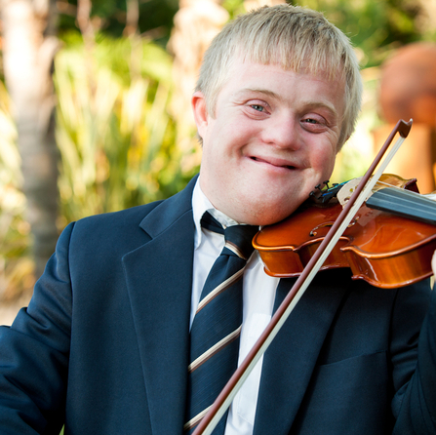
Questions?
This Photo by Unknown Author is licensed under CC BY-ND

