Slide 1

Meredith
Tools for the Journey Conference
Employment for Youth with Disabilities: Preparing for a Bright Future
Notes:
PRESENTER NOTES:
Presentation introduction slide. Include information such as presenter’s names, date, location, or event. Customize for your own presentation. Provide attendees with the “Brighter Future” handout.
Our goal for this presentation is to promote the vision that everyone can work and has talents and skills to share with the world if given the proper support, including youth with the most significant disabilities.
This presentation is the first of a series and will focus on setting goals for employment from an early age, preparing for employment, and cultivating and sharing a vision for the future. Future presentations will focus on navigating transition to employment in the school system, working with teachers and professionals as a unified team focused on customized employment, and creating a solid foundation for successful employment. We won’t be able to cover everything today, so we will definitely follow up with more in future trainings and resources. And please let us know in the evaluations what you want to learn more about, and we will incorporate your feedback.

Slide 2

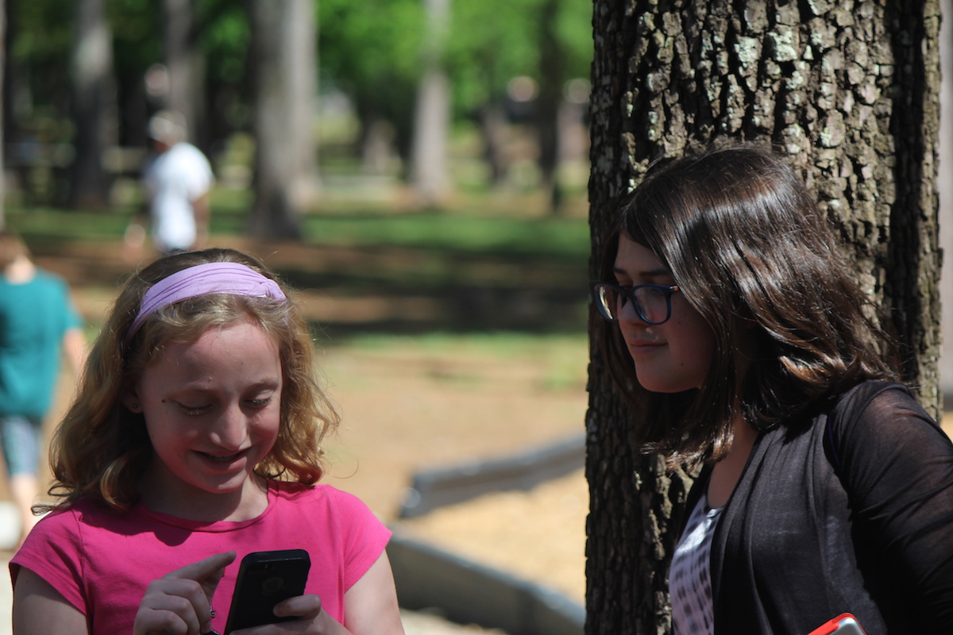

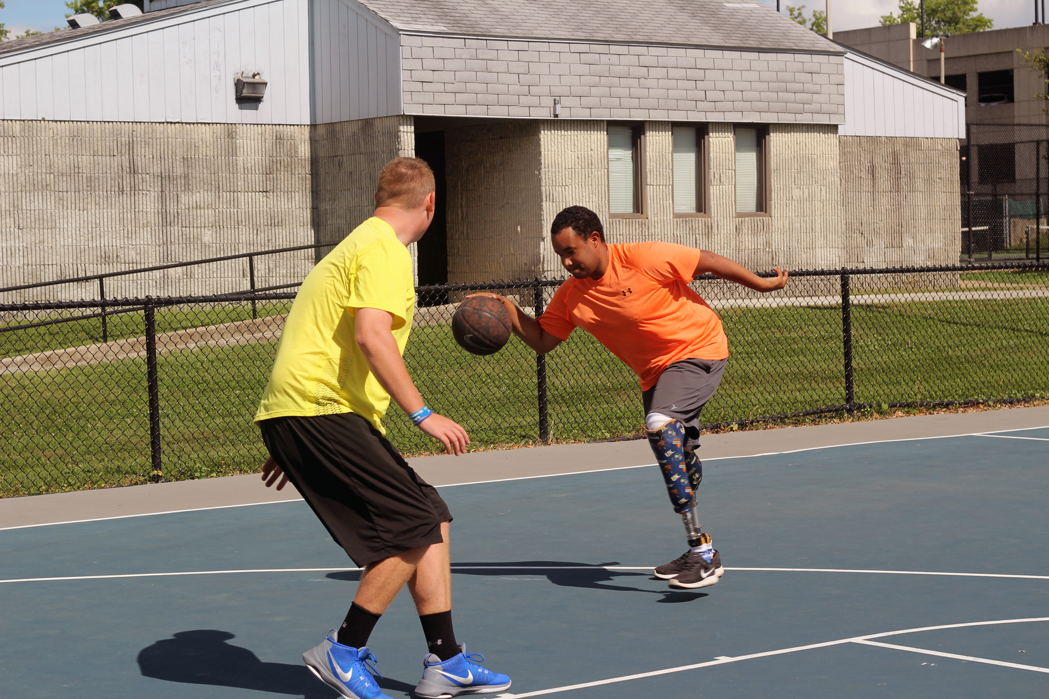
Today, people with disabilities are …
Working in their communities
Attending college programs
Starting families and owning homes
Speaking up for themselves
Developing meaningful friendships and relationships
Living independent lives based on their own dreams and goals
Notes:
PRESENTER NOTES:
We put this slide to show the bigger picture of how employment, community life, and adulthood are becoming more inclusive and independent for people with disabilities with the proper supports.
Today people with all types of disabilities are working in their communities in a variety of professions, such as teaching assistants, artists, musicians, public speakers, medical assistants, entrepreneurs, and so much more! They are attending programs for people with intellectual disabilities found at more than 250 colleges nationwide. They are getting married and owning homes, often with some support to become more independent. As they are included in their schools and communities, they are developing meaningful friendships and relationships. Ultimately, they are living more independent lives and following their own dreams and goals.

Slide 3
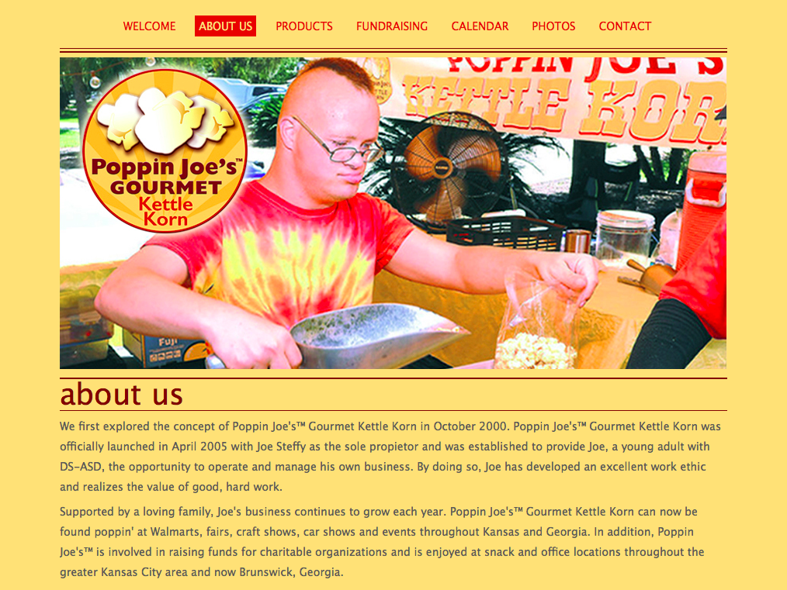
Joe: Poppin’ Joe’s Gourmet Kettle Corn
29-year-old Joe Steffy: Born with Down syndrome & autism & has limited verbal skills
Enjoys making kettle corn and the repetitiveness of popping and bagging the popcorn
Runs a kettle corn business with his family posts with annual sales around $75,000 Kansas Council on Developmental Disabilities purchased startup equipment
Vocational rehabilitation purchased a computer and laser printer and provided startup costs
Social Security Administration also provided startup costs in 2005
Notes:
PRESENTER NOTES:
We put Joe’s story in the beginning of the presentation as an example of a person with significant disabilities who has employment to illustrate that work is possible.
For example, 29-year-old Joe Steffy was born with Down syndrome, autism, and he has limited verbal skills. Some people might assume that someone like Joe could not work or could only do certain types of jobs. However, his family and professionals looked at his strengths and created a business based on Joe’s interests and skills. What they found was that Joe enjoyed the repetitiveness of popping and bagging popcorn. Now, he sells kettle corn at events throughout Kansas and Georgia and has a very lucrative business. To achieve this success, he also received support from the DD Council, vocational rehab, and Social Security to pay the startup costs of his business, which allowed him to become more independent and fulfilled.

Slide 4
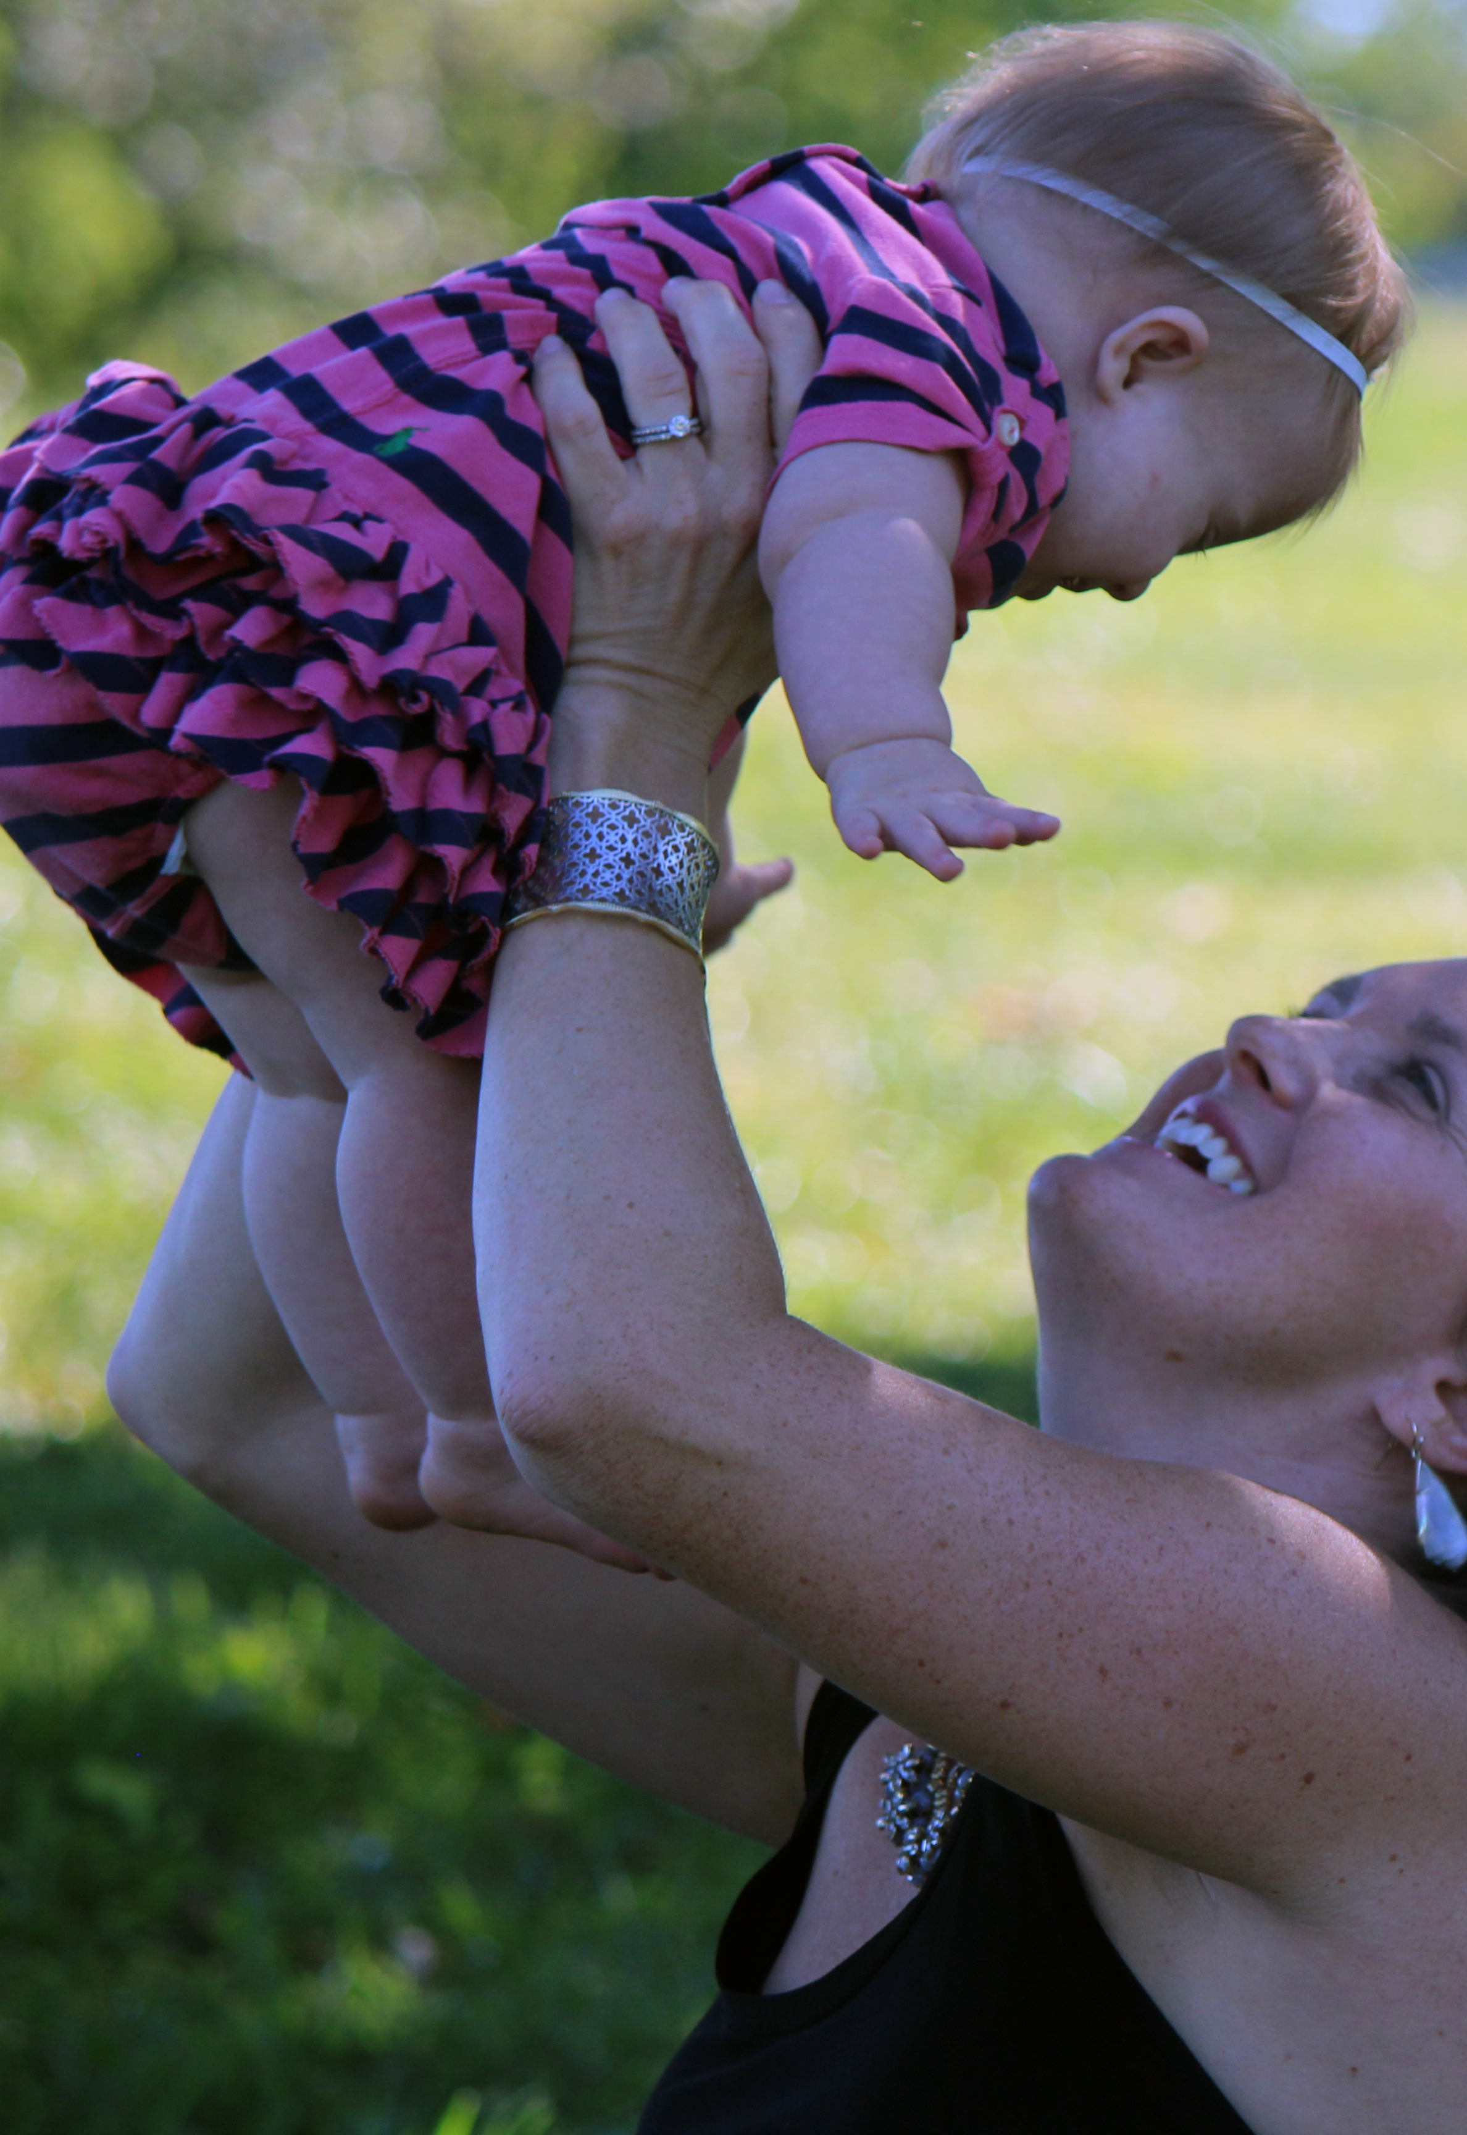
What are your hopes and dreams for your son or daughter’s future?
Notes:
RELATED ACTIVITY
Take a moment to write down your hopes and dreams for your son or daughter’s future. Invite 2-3 families to share their examples. Everybody has hopes and dreams for their son or daughter’s future, so let’s talk about how work in the community can help fulfill those dreams.
*Use Brighter Futures handout.

Slide 5
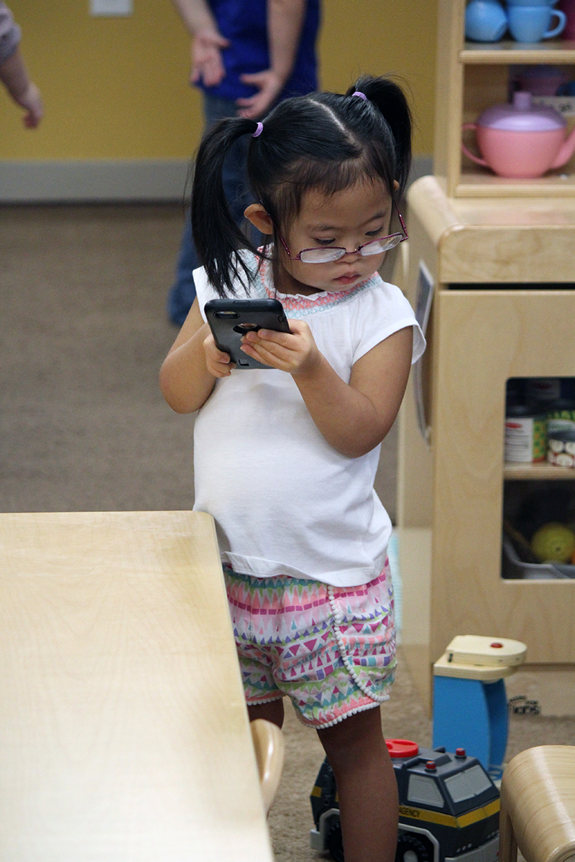
Work is Possible
What do you want to be when you grow up?
Every child deserves to develop their talents and follow their dreams.
Make employment the goal at a young age.
Notes:
What do you want to be when you grow up?
We need to start asking children with disabilities from a very early age, “What do you want to be when you grow up?” just like we do with every child. Certainly, that answer will change over time with maturity, but we need to set the expectation for the child and everyone around them that children with disabilities should follow their dreams.
Caroline here might imagine being a chef in the kitchen or a business person, and we should encourage that.
Every child deserves to develop their talents and follow their dreams.
SHARE STORY (Share your own story about how a young child with a disability can follow their dreams, or use the one provided):
Karen Gaffney was born with Down syndrome into a family where she was encouraged to swim from infancy. In high school, she had hip surgery, and swimming was an important part of her therapy. She also made friends on the high school swim team. She ended up wanting to become a long-distance swimmer, and many people believed in her: her parents, her swim coach, friends, and many others. She also believed in herself and worked hard to achieve her goal with support. She ended up being able to swim across Lake Tahoe and a relay across the English Channel, and now she works as a motivational speaker.
Make employment the goal at a young age.
We can make the connections early on that if a child likes art, they can become an artist and if a child likes animals, they can work at a veterinarian’s office or groom horses. Let them know how interests, talents, and dreams can become jobs in the future. And our children should also expect to earn a competitive wage, just like everyone else.

Slide 6

Raising Expectations
Working in the community for a competitive wage.
Integrated, competitive employment means:
Full or part-time or self-employment with or without supports
In the competitive labor force
On the payroll of a competitive industry (not provider)
At least minimum wage and benefits
Notes:
But what does competitive employment mean? Basically, it means that a person is working part time or full time and earning minimum wage or more. They are being paid directly by an employer, not a service provider. And they may receive support from a job coach or receive technology assistance, but they ultimately report directly to an employer. Competitive employment is just work like most people envision it - where an employee works at a job in the community for an employer instead of in a sheltered workshop or day program.

Slide 7
Raising Expectations Across Society
Legislation supports employment as the priority for all people.
Employment First
IDEA: Inclusion and required role of school in transition.
Americans with Disabilities Act
WIOA Section 511: Restricts use of subminimum wage
WIOA: Pre-Employment Training Services for in-school youth with disabilities
Paid, competitive employment in the community is the first goal.
Notes:
Legislation supports employment as the priority for all people.
Brief Overview: Many pieces of legislation and advocacy efforts over the past 30 years support the movement away from sheltered workshops and toward competitive employment, and that includes youth with more significant intellectual disabilities. We will give a quick overview here, but we will cover these topics more in depth in future presentations.
Paid competitive employment in the community is the first goal.
The goal with all this legislation is to move people into jobs that utilize their skills and talents, jobs that are meaningful to them rather than sending large groups of people to sheltered workshops.
PRESENTER NOTES
Don’t let yourself get stuck in a legislation rabbit hole. Be sure to tell families that we will cover more details about legislation in future presentations, but we are just laying the groundwork today. They will miss out on the foundation if they get stuck in the details of legislation.
If you have more parents at a beginner level of employment understanding, you may just want to give the brief overview of this slide above. If you have parents with more of an intermediate/advanced understanding of employment, you may want to provide the more detailed information outlined below
Detailed Explanation:
Employment First
Recently our governor signed an Executive Order making Kentucky an Employment First state. Employment First means that employment in the general workforce is the first and preferred outcome in the provision of publicly funded services for all working age citizens with disabilities, regardless of level of disability.
IDEA: Inclusion and role of school in transition.
Students with disabilities are entitled by law to be educated in the least restrictive environment with access to typically developing peers. This legislation is important because research shows that children with disabilities learn valuable social and academic skills from peer modeling. They learn to get along with the people who will be their coworkers someday.
And the law also requires, in KY, that beginning at age 14, the IEP address the student’s transition needs in relation to the student’s course of study. At age 16, the student’s transition plan has to include measurable post-secondary goals addressing both employment and post-school education (what the student wants to do after high school), as well as the essential transition services in order to attain his or her goals. In addition, the transition plan must be updated yearly to reflect annual transition goals that support the student’s achievement of his or her post-secondary employment and education goals.
Americans with Disabilities Act
Title 1 of the Americans with Disabilities Act also prohibits discrimination against people with disabilities and requires employers to provide reasonable accommodations, like allowing adaptive equipment that allows a person to perform a job.
WIOA Section 511: Restricts use of subminimum wage
Since July 2016, the federal government has put restrictions on the use of subminimum wage to encourage employers and schools to aim for minimum wage or higher for people with disabilities.
WIOA Pre-Employment Training Services (or Pre-ETS).
WIOA authorizes the provision of Vocational Rehabilitation Pre-Employment Transition Services (Pre-ETS) to in-school youth ages 14-21 who have an IEP or 504 plan. The five Pre-ETS categories are:
Job Exploration Counseling, (e.g., career counseling, job exploration in the community)
Work-Based Learning Experiences (e.g., in-school or after school work opportunities or experiences, internships, job shadowing).
Workplace Readiness Training, to develop social and independent living skills (e.g., job readiness training, promoting self-awareness).
Post-Secondary Counseling (e.g., exploring and experiencing opportunities for enrollment in comprehensive transition or postsecondary educational programs at 2 and 4 year colleges).
Instruction in Self-Advocacy (e.g., peer mentoring, disability skills training, benefits planning and financial readiness).
To learn more about Pre-ETS services, families should contact their local school system or Vocational Rehabilitation office.
RELATED RESOURCES
Vocational Rehabilitation
APSE
Build Inclusion
CWTP

Slide 8
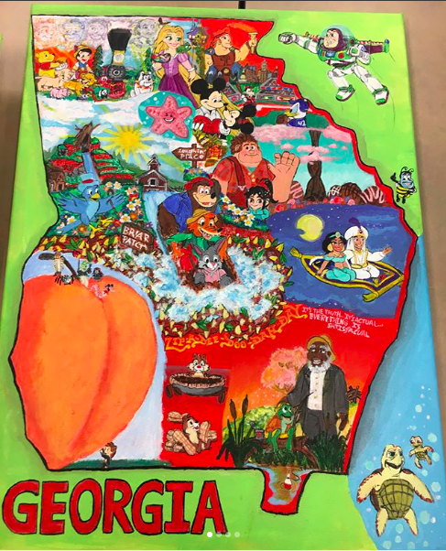
Success may look different for each person
Flexible and customized
Success may look different for each person
Different hours of work
Notes:
Now competitive employment may take different forms and look different for each person. We understand that some people may need more flexible hours and have different types of skills and challenges.
SHARE STORY (Share your own story about a person who has a customized employment solution, or use the one provided):
For example, one young man with autism really enjoys Disney and art, so his parents and job coach helped him to set up online storefronts to sell his art on Etsy and Instagram. That way he can do work he enjoys and also earn some income, so he is currently working on building this business.
He also works about 10 hours per week from home for the University of Kentucky filling mail orders for $12 per hour. He received job coaching, some accommodations, and help with transportation to get started, but after 2 years of working in this position, the support he needs now is very minimal.
He also volunteers in his church about 5 hours per week in a food bank.
So even though this young man doesn’t work full time, he has meaningful work through a combination of paid, competitive employment, a small business, and volunteer work

Slide 9

What is the role of employment in your son or daughter’s life?
Notes:
RELATED ACTIVITY
The reality is that many parents of youth with disabilities may not see work as a major part of their child’s future. If they don’t see work as an expectation, then they may not find the information in this curriculum useful. The following points are meant to help parents begin including competitive employment as part of their future outlook for their youth.
Ask parents to write down what they see as the role of employment in their son or daughter’s life on their worksheet.
*Use Brighter Futures worksheet.

Slide 10
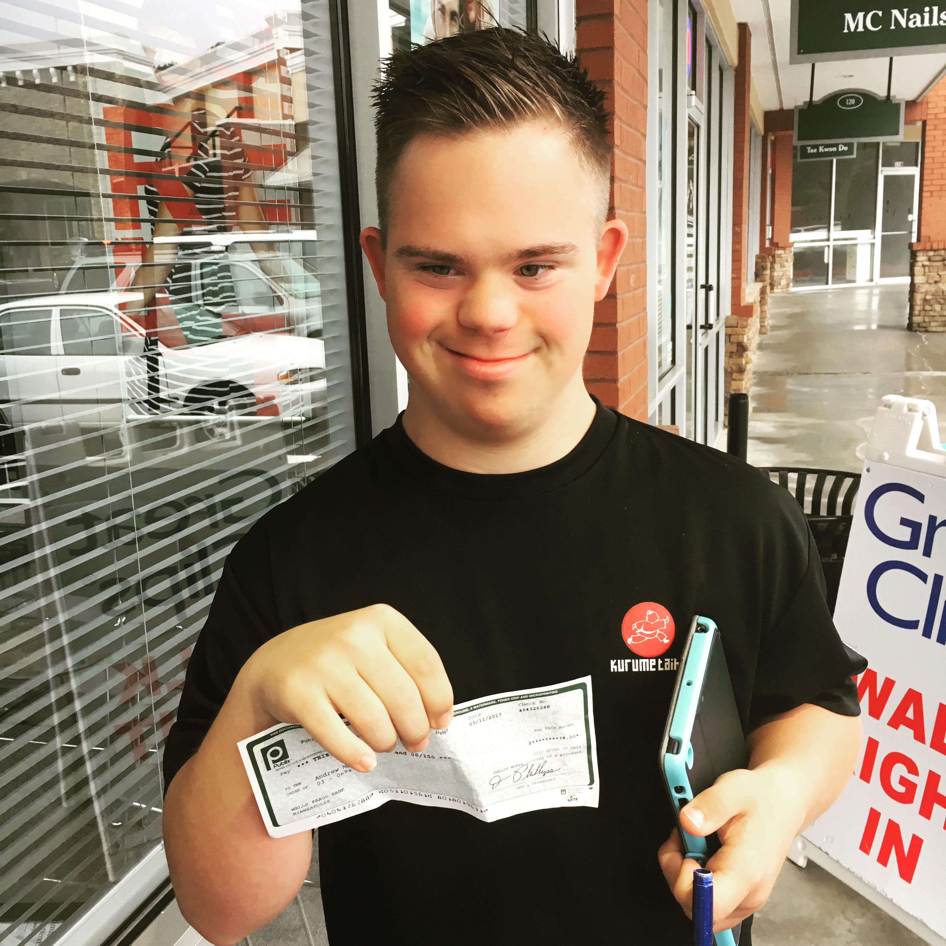
Work is Valuable
Social Connections
Sense of worth
Developing and contributing talents
Money
Independence
Regular Expectation of Adulthood
Notes:
There are many reasons why we work and see value in that in our society. Work helps us make friends and find fulfillment. Work can also help us develop and contribute our talents and skills as mentioned about the young man with autism developing his artistic talents. We work to earn money, and people with disabilities often say they love many things about theirs job, but money is often the favorite. And, of course, that money gives independence, as do many of the skills we learn from work. Basically, work is a fundamental expectation of adulthood that we see as important and valuable for everyone.

Slide 11
What does your son or daughter like to do? What are some of his or her talents or skills?
Notes:
RELATED ACTIVITY
So, our next question we want you to think about is what your son or daughter likes to do, and what are some of his or her talents or skills? Please take a moment to write down your thoughts.
*Use Brighter Futures worksheet.

Slide 12
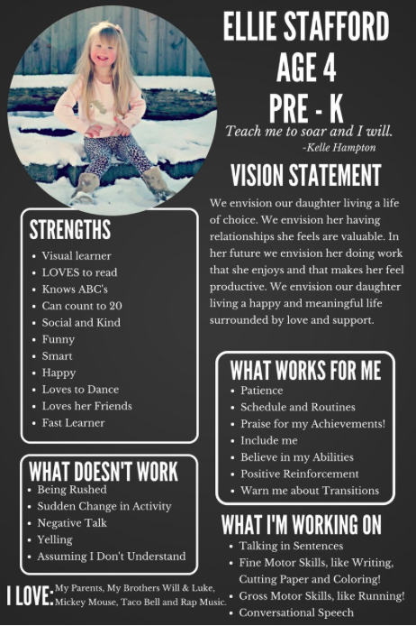
Vision Statement for Younger Students
Thanks to Tiffany Stafford for sharing!
Find details about how to create your own at: https://our3lilbirds.blogspot.com/2017/05/how-to-make-one-page-profile-ellie-style.html?m=1
Notes:
You can craft a vision statement to share the future you envision for your younger child so that the entire team of professionals who work with your child can see the bigger picture. A vision statement is a description of what you would like your child to achieve as they grow up. It is intended to serve as a clear guide for choosing current and future courses of action.
Tiffany Stafford created this wonderful mission statement for younger children, which she shared at the Down Syndrome Diagnosis Network conference a couple of years ago. She said that she envisions her daughter at 4-years old doing work someday that she enjoys and that makes her feel productive. Work can be a focus of the conversation even when children are very young to set that expectation. The vision statement can also highlight strengths that can one day transform into work skills, and the statement can include important guidance for what motivates and what doesn’t motivate the child.
RELATED RESOURCES
https://our3lilbirds.blogspot.com/2017/05/how-to-make-one-page-profile-ellie-style.html?m=1

Slide 13
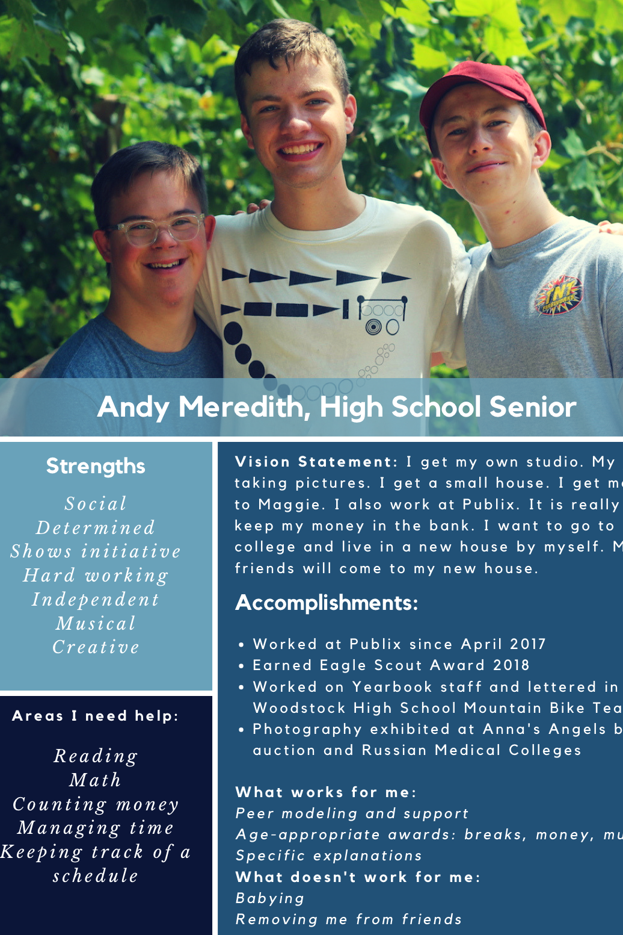
Vision Statement for Older Students
Modify and create your own at:
https://tinyurl.com/ybkz765w
Notes:
As your son or daughter gets older, they can start crafting their own vision statement of what they want for the future. Encourage them to think about what they really want to do as they start discovering their skills and talents by participating in extracurricular activities and seeing what interests them at school and at home.
In Andy’s vision statement, he dictated the content himself about what he wants for the future and then his parents helped him shape the rest of the content. Sometimes as youth with disabilities get older, they start to be directed down some more predictable employment paths: janitorial, cooking, retail, etc. And those are fine if that’s truly what a young person wants to do, but he or she can also forge a different path. Because Andy has always said he wants to be a photographer, his teachers have been more creative where his transition goals have been to take photos for yearbook class or take a design class with a modified curriculum.
As your son or daughter gets older, they can also share accomplishments as they participate in extracurricular activities, do volunteer work, and take leadership opportunities as available. These accomplishments will help prepare them for the world of work and also build their resume.—just like any other high school student.
The vision statement can also highlight the strengths of the students to better show what soft skills the student might have that could transform into work skills.
RELATED RESOURCES
https://tinyurl.com/ybkz765w

Slide 14
Sharing the Vision
Start each IEP or planning meeting with a vision of the future
Parent-led ->> Student-led
One page vision statement or PowerPoint
Notes:
Now that you and your son or daughter have created a vision for what the future may look like, how are you going to use it to help reach that goal? You can start each IEP meeting or pre-employment transition services meeting with a vision of the future by sharing a vision statement or PowerPoint about your son or daughter’s dreams for the future, talents, strengths, challenges, and accomplishments. In the primary school years, these vision statements will largely be driven by parents, but the students should take the lead as soon as they are able, especially by 14 when transition starts to become a reality. These vision statements can also be used moving forward with vocational rehab or community employment programs. As all members of the team understand the bigger picture, they can better understand what steps need to be taken along the way to get there.

Slide 15
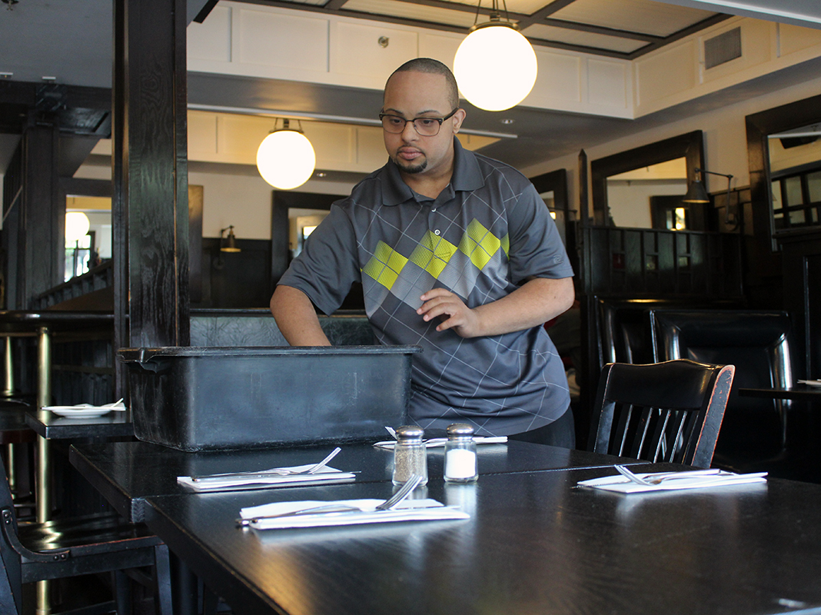
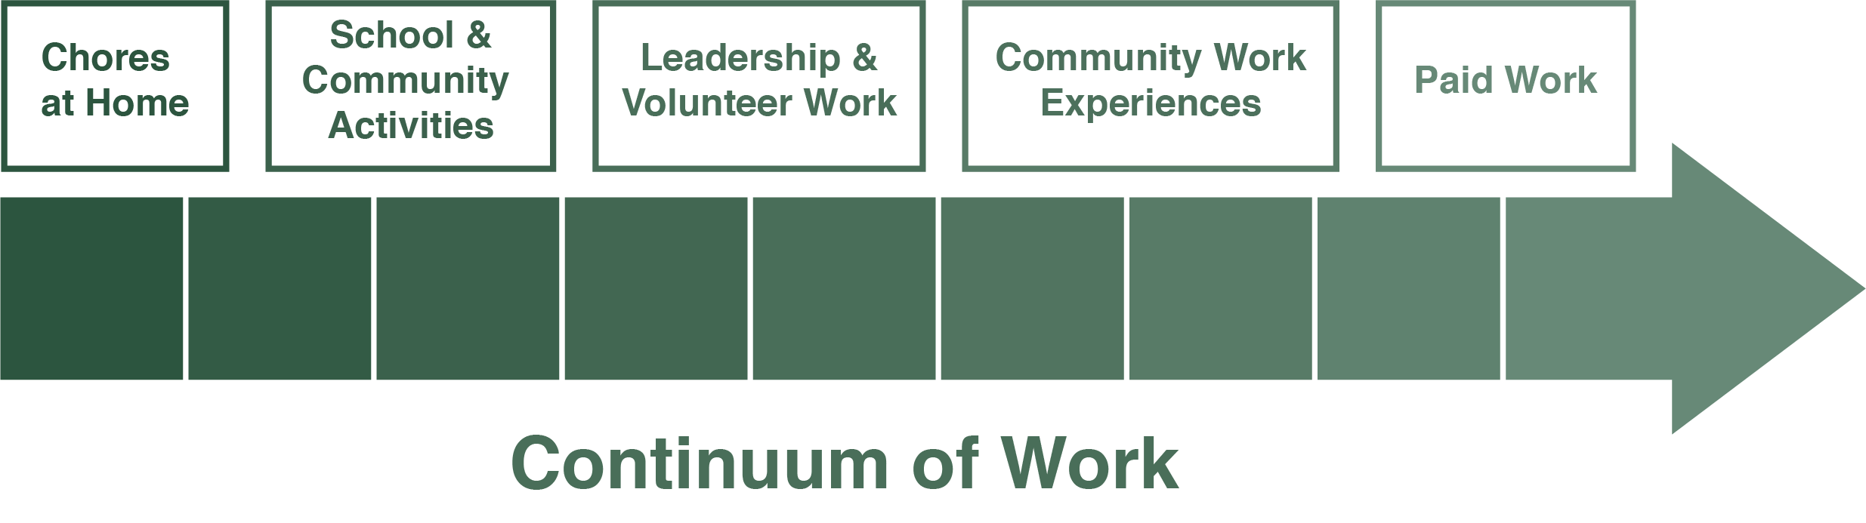
Preparing for Work
Notes:
Preparing for work is a lifelong process, and it’s never too early or late to start. You just want to make sure that your son or daughter is at making as much progress as possible on the continuum of work that starts with chores at home and then moves through stages that can ultimately lead to paid work.
PRESENTER TIP: Point to the different stages on the continuum as you share this example.
In a real life example, if your son is interested in cooking and working in the kitchen, you could give him chores to clear the table and help in the kitchen gathering ingredients for dinner. Over time, you may teach him to make fruit salad or other basic recipes as part of his responsibilities. He could also take home economics in an inclusive setting at school and earn a Boy Scout cooking badge as his school and community activities. Next, he could start to offer volunteer work by stocking the pantry or helping to cook and serve meals at a local food ministry. He could also serve as a leader in a Scout troop by helping with Scouting for Food. Then, he could start working through community work experience programs for a few hours on Friday at a coffee shop as facilitated by the school transition coordinator, or a friend with a catering business may hire him to serve or prepare food at a wedding. Finally, he could start applying for competitive employment at restaurants and coffee shops, and, ideally, he has made a number of contacts through his home, community, and school experiences who could offer him employment, and he could have supports to help him be successful .
Ultimately, we know that youth who have access to these meaningful work experiences will have improved employment outcomes as adults, so we want to make sure we are consistently working along this employment continuum.

Slide 16


Preparing for Work: Starting Early
Talk about the value of work and different kinds of jobs.
Compliment and cultivate skills/talents
Ask about interests & explore careers
Read books about different jobs
Give your child chores and responsibilities.
Assign household chores
Give supports/motivation/consequences
Use social stories & charts
Demonstrate how to do chores & break into steps
Notes:
Here are some different strategies for making sure your son or daughter understands what kind of jobs are available and that might be interesting.
Compliment and cultivate skills/talents
When your son or daughter shows that he or she has a skill or talent, be sure to compliment them and look for ways to further develop talents. For example, if a young person shows a talent for photography, you can compliment his talent and hang up his photos in the house, enroll him in classes, encourage him to enter school contests, sign him up for yearbook as an extracurricular activity, and take him to photography exhibits.
Ask about interests and potential jobs
As your son or daughter develops interest, talk about the different jobs that involve that interest. You could talk to a child who like animals about becoming a dog groomer or a veterinarian, and you could talk about working in a kitchen to a young person who likes to cook. You can also look online for different kinds of jobs in different areas of interest.
Read books about employment and working
You can also encourage children and young adults to read books about different kinds of work. There are books about specific kinds of careers for older students and basic books about work for younger children.

Slide 17
Preparing for Work: Community
Encourage inclusion as much as possible and participation in extracurricular activities.
Local, integrated school & community classes: dance, sports, martial arts & Unified Sports (part of Special Olympics).
School teams and activities.
Consider for IEP as part of son or daughter’s school program.
Recreation programs, such as Friends’ Club and Best Buddies
Girl and Boy Scouts and other clubs
Faith-based groups
Notes:
Another important way to prepare for work is for young people to get involved in their communities to build relationships and social skills—some of the most important criteria for work. You will want to give your child as many inclusive, integrated experiences at school and in the community as possible because the social skills and independence they learn will be important as they start looking for employment. You also want them to be included with the “typical” population as much as possible because studies show that inclusion benefits everyone. You also want to share the vision with those other students that people with disabilities are valuable members of their community with skills and talents they can contribute … because someday those other students will be the co-workers and employers that will be working alongside your son or daughter.
Local community classes, such as dance, sports teams, and martial arts classes.
Give your son or daughter the opportunity to participate in inclusive community activities that interest them. Take a local karate or dance class and just assume they belong because they do! These activities and classes give them opportunities to build relationships with adults and peers who can see their talents and skills, and add supports as needed.
School teams and activities. Consider for IEP as part of son or daughter’s school program.
Your son or daughter can also participate in school teams or activities. They can participate in chorus, the yearbook staff, the Spanish club, or the wrestling team just like anyone else. You can even include these school activities as part of their IEP or transition plan. For example, if they want to become an artist, you can include joining art club as part of the transition plan. This means they will also meet more students studying art who may become coworkers someday.
Recreation programs, such as Friends’ Club at some schools, Best Buddies, and Unified Sports (part of Special Olympics).
Your son or daughter may also benefit from recreation programs that give extra support to people with disabilities to help learn social skills, like Best Buddies, Friends’ Clubs, and Unified Sports.
Girl and Boy Scouts and other clubs
Girl Scouts and Boy Scouts are another way to learn valuable life skills like cooking, finances, and family among peers as they work together to earn badges.
Faith-based groups (churches, synagogues, church youth groups, etc.)
Churches and religious organizations provide tremendous opportunities for your son or daughter to become involved with his or her peers, especially on church projects, activities, and often community service learning activities, in which students are learning potential employment-related skills and to give back to their communities. There is also the opportunity to learn important social interaction and soft skills, to make new friends and have fun!

Slide 18
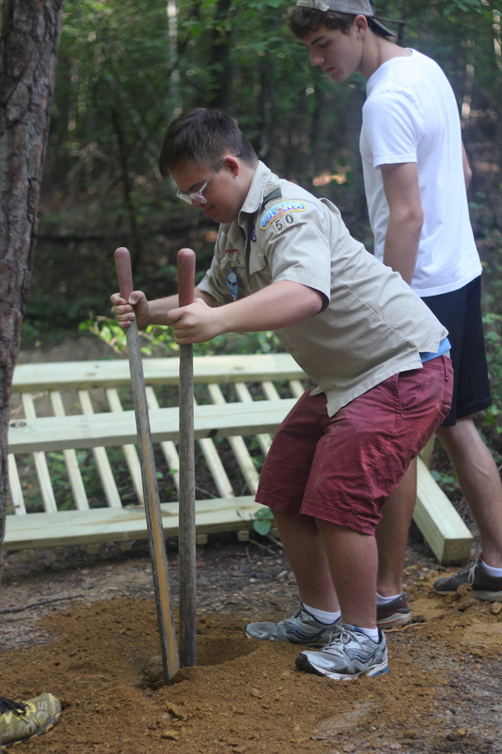
Preparing for Work: Leadership
Encourage volunteer work and leadership opportunities.
Give your child and family opportunities to volunteer at food drives, church events, nursing homes, and more
Encourage leadership at school activities, church, Scouts, and more.
School service learning clubs.
Note: Volunteering can be an important stepping stone toward employment.
Notes:
Give your child and family opportunities to volunteer at food drives, church events, nursing homes, and more
Take your entire family to do community service. Many times our children with disabilities are the recipients of service, but it’s important that they learn to serve others and that people see what they can do. For example, we volunteered at our local food ministry, Scouting for Food, and visited nursing homes on holidays. Make sure your kids are also granted leadership opportunities as available at school, in clubs, and at church.
Encourage leadership at school activities, church, Scouts, and more. For example, Andy is President of Deacon’s Quorum and Scout Historian. He is in charge of announcements as quorum president at church; this also gave him confidence to speak in public. (Trainer Note: Share examples from your own experience here).
School service learning clubs.
School service learning clubs are another opportunity for your son or daughter to work with his or her peers in a school or community project (e.g., planting a school or community garden, shopping and delivering groceries for elderly citizens, collecting food donations for homeless shelter, etc.). School service learning projects are a great way to establish friendships, learn important soft skills, and develop a sense of how one can contribute to his or her community!
Note: Volunteering can be an important stepping stone toward employment. However, it is important to avoid the volunteer employment trap – volunteer experiences can be tremendous opportunities to learn critical job skills, but volunteer work is not the ultimate goal. Paid, regular work is!

Slide 19
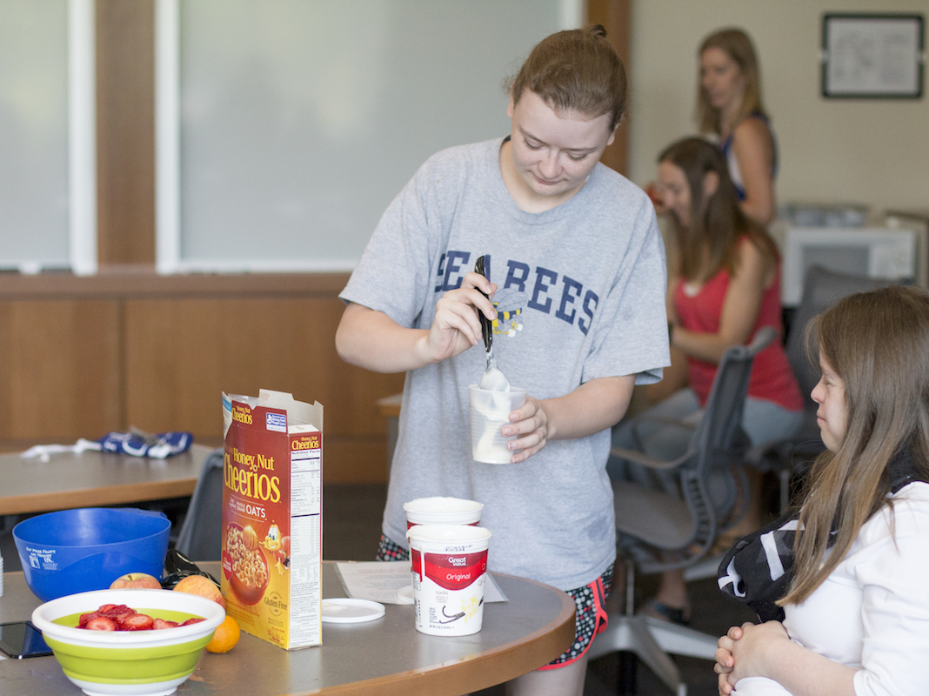
What are 2 steps you can take at home or in the community right now to prepare for work?
Notes:
RELATED ACTIVITY
Invite parents to write down 2 steps you can take at home or in the community to prepare their son or daughter for work. Ask 2-3 parents to share their thoughts.
PRESENTER TIP: Be prepared that some parents may say that their child’s disabilities are too significant for chores or activities. Be sure to reinforce that everyone can do something, and parents can start wherever their son or daughter is at. They can start with teaching a child to put their clothes in a laundry basket or take cups to the sink but then move to the next step as their son or daughter learns a skill. Other parents may be afraid of rejection if they enroll their son or daughter in community activities. Remind them also that their son or daughter doesn’t need permission to sign up for an activity in the community-just a plan for supports where needed.

Slide 20
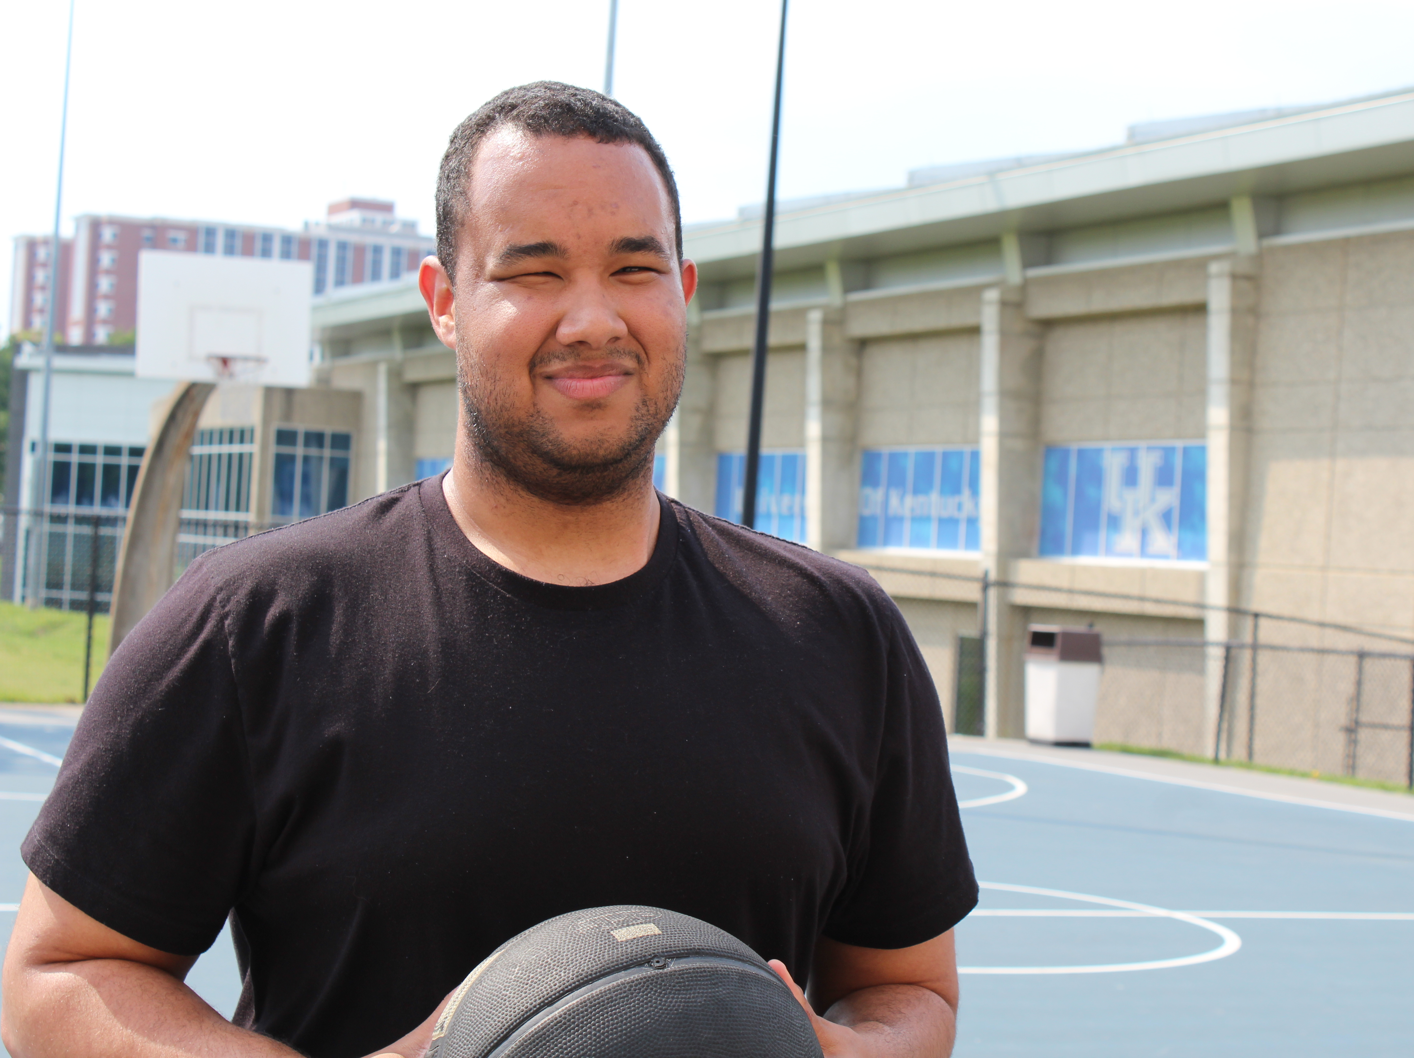
What are your greatest concerns about employment?
Notes:
RELATED ACTIVITY
Now that we have discussed some ways to prepare your son or daughter for work, let’s talk about some possible concerns about employment. Are there some barriers or obstacles that might be holding you back? Take a moment to write down your greatest concerns about employment, and invite 2-3 participants to share their concerns. Tell participants you will be covering more concerns in subsequent slides.

Slide 21
Common Concerns
Vulnerability
Disruption in services
Transportation
Availability of appropriate supports
Putting the puzzle pieces together
Making time for work
Losing benefits
Notes:
Individuals and families often have a number of concerns about employment. Sometimes they worry about disabilities being too significant for the world of work. They might be concerned about finding a job and whether the job environment will be safe. They might worry about getting started with a job and losing supports that make that job possible. Sometimes transportation can be an issue. Families might be concerned about finding available the services they need to identify and keep a job, and they may be unsure about how all the different services in their lives fit together. Families might be worried about making time for work if they already have a reliable schedule.
And one of the biggest concerns individuals and families have is the possibility of losing benefits like SSI and Medicaid. We will address all of these issues in a subsequent presentation, but we did want to address this last one since that can be a major barrier for some families.

Slide 22
Losing Benefits
Supplemental Security Income Home Page (2018): ssa.gov
How to Make SSI Work for You: Simply Said: pacer.org
Get individual guidance from a benefits counselor (WIPA).
Learn the math for your circumstances.
Module: Benefits 101
  Helps you find our how income impacts benefits.
  Teaches you how to do the math.
  You can almost always earn more money by working than by collecting SSI alone!
Notes:
One of the most prominent concerns for families is losing benefits. Keeping track of how work and SSI fit together can be complicated, but the main point to remember is that you almost always get more money by working than collecting SSI alone. Below are some great resources to help you understand how the math works and how to make sure you understand the different cut-offs for qualifying for Medicaid. The key is to know what resources can answer your questions.
RELATED RESOURCES
Supplemental Security Income Home Page (2018): ssa.gov
How to Make SSI Work for You: Simply Said: pacer.org
KENTUCKYWORKS Module: Benefits 101
Local WIPA Benefits Counselor: https://choosework.ssa.gov/findhelp/

Slide 23
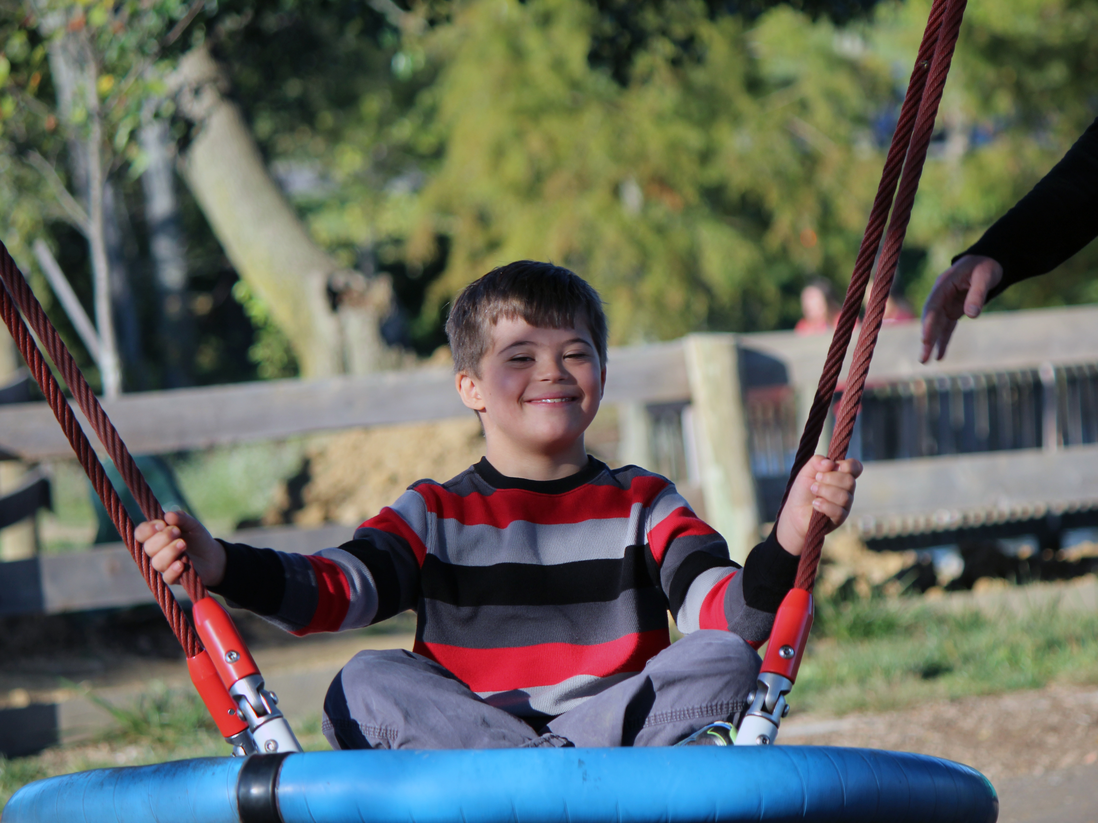
RESOURCES
Notes:
You can find many resources at the state and national level to help you with employment and transition, and you can get those resources in-person, online, in books and pamphlets, or through videos. There are so many wonderful resources out there, and we’re here to help you find the ones that will be most helpful for your individual needs.

Slide 24
Available Resources
Work support: Vocational Rehab
School Transition Team
Pre-Employment Transition Service Providers
(Pre-ETS)
Disability Rights California: Transition Services for Students
Notes:
We have a wealth of employment and transition resources in Kentucky for you to access through state programs and organizations. You can contact the Kentucky Office of Vocational Rehab for evaluation at 16 and above—whenever a youth is ready to get a job. Voc Rehab can facilitate services like job coaching, driving evaluations and training, employment adaptations and resources—like a timer for breaks, education about transportation, and so much more. The school transition team for youth 16 and over should also be implementing an individualized transition plan, developed in full partnership with the youth and his or her family, with post-secondary employment and education goals, as well as independent living goals whenever appropriate. The team should also be creating annual IEP goals to cultivate employment skills based on the interests, skills, and dreams of the student.
Community employment and pre-employment service providers can also help youth and families with creating employment plans, building up experience and skills, figuring out transportation solutions, and finding employment. In addition, they can provide support on the job like job coaching and adaptations. The Community Work Transition Program is available at many school districts throughout Kentucky. KY OVR also works directly with a network of community rehabilitation programs (CRPs) to provide services to eligible individuals. A number of CRPs are offering Pre-ETS services to eligible transition-age students without charge. For example, Build Inclusion is a parent-driven non-profit organization providing employment support in the central KY area.
PRESENTER NOTES
Provide any real-life examples of when these programs have helped a family or individual or refer back to Joe Steffy utilizing Voc Rehab to start his business and purchase equipment.
RELATED RESOURCES
Work support: Kentucky Office of Vocational Rehab: https://kcc.ky.gov/Vocational-Rehabilitation/Pages/default.aspx
School Transition Team, Special Education Cooperatives
Community employment and pre-employment service providers: such as Community-Based Work Transition Program: http://hdi.uky.edu/cbwtp/ and Build Inclusion

Slide 25
Finding Mentors
Find other parents who share a similar vision and are further down the path.
Local Parent Advocacy Groups: such as Club 21
Family Voices
Parent to Parent/Family to Family
The Arc
Notes:
There are also many organizations in Kentucky that can provide family mentors who can answer individual questions in person or over the phone. Kentucky SPIN has regional coordinators who are assigned to all the counties in Kentucky and who can answer questions across the lifespan for individuals with disabilities. Many parent advocacy groups also have staff or volunteers who can help parents who want to learn more about employment and transition; some of them offer classes and specific employment programs like the Career Solutions program at Down Syndrome of Louisville (DSL) and the We Work! Career Planning Initiative at Down Syndrome of Central Kentucky (DSACK. Parents can also learn how to get involved with employment public policy at the Arc of Kentucky.
PRESENTER NOTES
You may want to provide any real-life examples of when these programs have helped a family or individual.
RELATED RESOURCES
KY SPIN
Parent Advocacy Groups: DSACK, DSL, Autism Society of the Bluegrass
Arc of Kentucky

Slide 26
Available online Resources
KentuckyWorks Modules: https://www.hdilearning.org/product-category/employment/kentucky-works/
KentuckyWorks Bright Futures Checklists:
Pamphlet: Charting the Lifecourse (UMKC Institute for Human Development)
Pacer’s National Parent Center
Postsecondary Programs: ThinkCollege.net
Notes:
There are many online resources that can be very helpful for families navigating employment and transition. KentuckyWorks offers a short online course about the basics everyone needs to know about Transition, and the UMKC Institute for Human Development has an excellent “Charting the Lifecourse: Daily Life and Employment” booklet for individuals and families to truly assess needs, determine available support and services, and develop a plan and path to employment. The Pacer Center offers a comprehensive website with a wealth of information about employment, including videos and resources. And you can find out information about post-secondary programs nationwide at thinkcollege.net. There are many, many online resources about Transition and employment, and these are just a few of our favorites!
RELATED RESOURCES
Module—Transition 101: What We All Need to Know About Transition for Students with Significant Disabilities: kentuckyworks.org
Pamphlet: Charting the Lifecourse: http://www.lifecoursetools.com
Pacer’s National Parent Center: http://www.pacer.org/transition/
Postsecondary Programs: ThinkCollege.net

Slide 27
Resources to Learn Work skills
Develop Work Skills.
Skills to Pay the Bills NCWD: Helping Youth Develop Soft Skills for Job Success: Tips for Parents and Families
Notes:
There are lots of great resources online to help youth learn soft skills for employment. You can find links to lots of great resources on the Youth section of the KentuckyWorks website, including Skills to Pay the Bills with a video series and discussion guide, and NCWD: Helping Youth Develop Soft Skills for Job Success: Tips for Parents and Families.
RELATED RESOURCES
KentuckyWorks: Youth Section
Skills to Pay the Bills
NCWD: Helping Youth Develop Soft Skills for Job Success: Tips for Parents and Families

Slide 28
Parent Action Steps: Things you Can do right now
For a younger child:
Teach Daniel to put away his laundry by putting labels on drawers.
Make an IEP speech goal to learn proper greetings
Sign Daniel up for karate class.
For an older child:
Make Marie an IEP/transition goal about creating a personal website showcasing her art.
Apply for a post-secondary camp.
Teach her to use the washing machine.
Notes:
Based on all that we have just discussed, invite parents to try to think of some different action steps that parents can take to prepare their son or daughter for employment. This will be very different for people at different ages. For example, the parent of a younger child may say that they want to teach their child to do a more basic new chore, make an IEP goal related to future job task—like an IEP speech goal to learn proper greetings, and sign up for a community class. The parent of an older child may want to create a transition goal to develop skills in an area that interests her and develops her talents, explore post-secondary opportunities with a concrete learning experience, and teach her to do a more complicated chore.

Slide 29
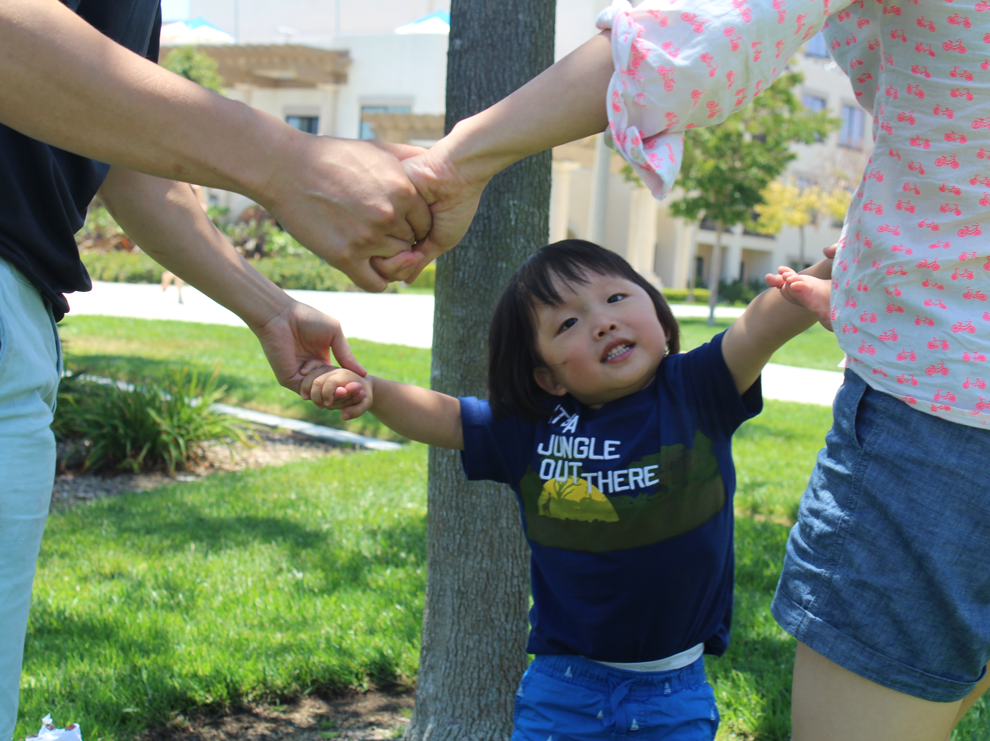
What are 3 action steps you can take right now to help your son or daughter get ready for work?
Notes:
RELATED ACTIVITY
Invite parents to write down 3 action steps they can take right now to help their son or daughter get ready for work.
*Use Brighter Tomorrows handout.

Slide 30
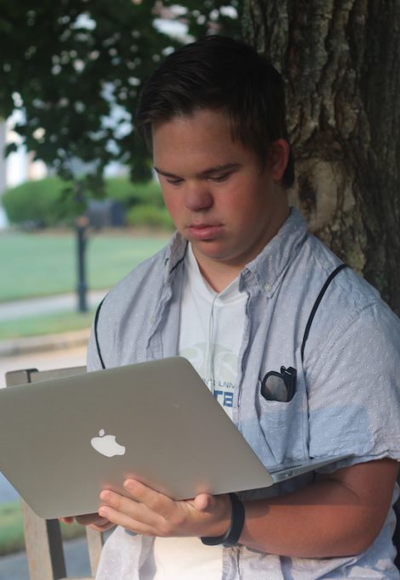
This presentation brought to you by KentuckyWorks.org
Over a hundred employment resources, including a survey to find the resources you need right now (Kentucky and national)
Youth content specifically created for individuals with intellectual disabilities with an accessible reading level, photos, audio buttons, and blog.
Modules like Transition 101 and Benefits 101 to figure out how public benefits and work can fit together
Collaborative project between multiple state agencies: Human Development Institute, the Kentucky Office of Vocational Rehabilitation (OVR), the Kentucky Department of Education , the Kentucky Division of Developmental and Intellectual Disabilities, Kentucky Protection & Advocacy, the Kentucky Office for the Blind, Commonwealth Council on Developmental Disabilities, the Kentucky Office of Autism, &the Kentucky Autism Training Center.
Notes:
This training was created by KentuckyWorks, a collaborative effort between multiple state agencies. The website includes national and state resources for the employment of individuals with disabilities with sections for youth, families, employers, and professionals. The website includes a survey to help you find the resources most appropriate for your individual needs. The youth content is also specifically created to be accessible for individuals with intellectual disabilities, including an accessible reading level, photos, audio buttons, and a family blog. The website also includes modules for individuals, families, and professionals to learn about transition and benefits from the experts.

Slide 31
Stephanie Meredith, KentuckyWorks
Human Development Institute
University of Kentucky
Development of this curriculum was supported by a U.S. Administration on Community Living grant, (90DNEM0004-01-00).
Notes:
Provide your name, title, and contact information as the presenter so that attendees can follow up with any questions or feedback.
PRESENTER NOTES
Pass out evaluation forms to participants to submit to Chithra Adams at HDI. Take a couple of minutes and complete the online, self-reflection tool for speakers on how the training went, and ways in which we can improve it: https://uky.az1.qualtrics.com/jfe/form/SV_3eqfCIlVXPED0vb

