Slide 1
Planning for a Holistic Approach for Adult Life
Janet L. Miller MS
Dementia Awareness Outreach Specialist

Slide 2
National Task Group on Intellectual Disabilities and Dementia (NTG)
Most of the information provided in this presentation came from the research and curriculum development by the NTG.
The NTG provides dementia-capable care training to families and direct-support staff.
The NTG also offers periodic webinars that are available for continuing information.
www.aadmd.org/ntg

Slide 3
How Do We Define “Aging”?
Gerontologists define aging or ‘being older’ generally as being in ones’ 60s or 70s.
There are distinct categories of aging, including:
Chronological aging
Psychological aging
Social aging
Physical/biological aging
NTG Education & Training Curriculum on Dementia and I/DD. © NTG 2014

Slide 4
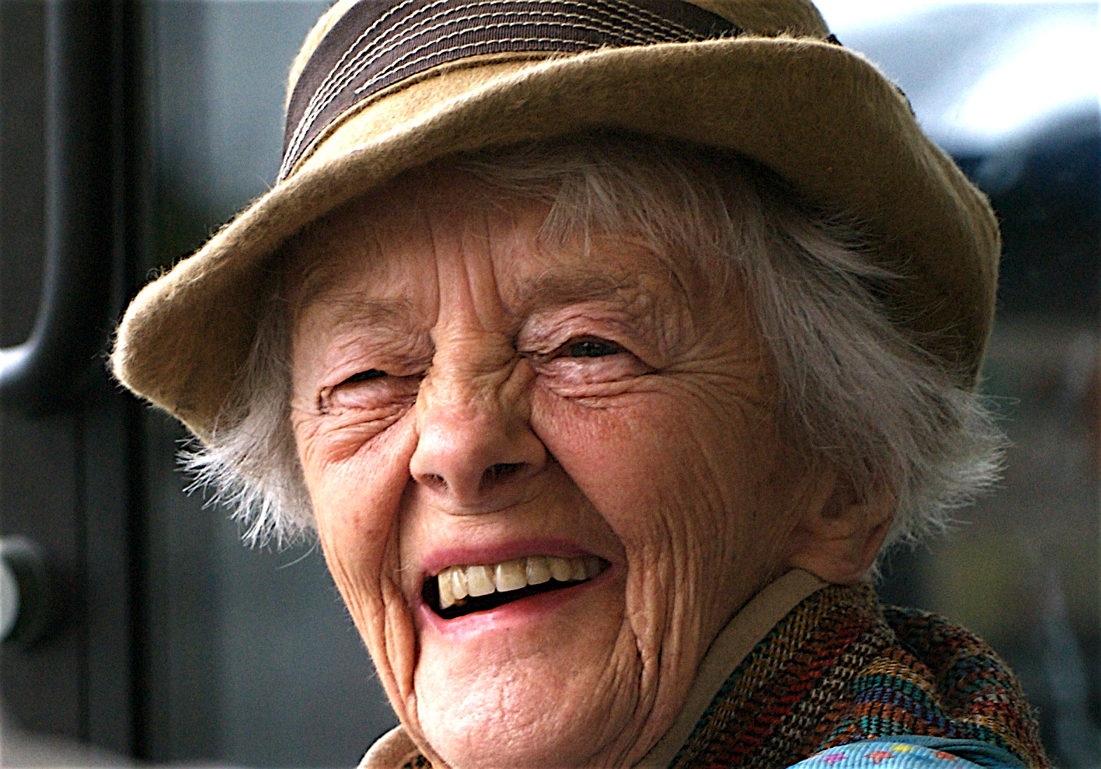
Aging Across the Lifespan
There are similar patterns of aging for all adults regardless of pre-existing disability.
Genetics, lifestyle, environment, and attitude all influence health and well-being in old age.
All adults need proper nutrition, hydration, and exercise across the lifespan.

Slide 5
Eight Dimensions of Wellness

Slide 6
Adopt a Lifespan Approach
Based on an understanding that what happens in childhood and young adulthood affects the quality of life in old age.
It is never too late to make a difference, but the earlier we start the larger difference we can make.

Slide 7
Factors That Impact Healthy Aging
Long-term consequences of early-life therapeutic interventions (ex. Post polio syndrome)
Prolonged usage of medications and polypharmacy
Problems with accessing health services
Age-associated pathologies – such as dementia or heart issues

Slide 8
Chronic Health Conditions
Heart disease
Hypertension
Diabetes
Obesity
Reduced mobility
Bone demineralization
Osteoporosis
Thyroid disease
Bowel obstructions

Slide 9
Impact of Aging on Those With Developmental Disabilities

Slide 10
A Unique Situation
Those with IDD are living longer and have more meaningful lives. Because of this we are witnessing health care concerns associated with aging that may not have been witnessed in the past.
Increasing numbers of persons with IDD who are aging will be requiring services in the community. (1.2 million by 2030)

Slide 11
Why is This Important?
Some individuals with intellectual and developmental disabilities age at a faster rate than the general population.
This means they could have more age-related illnesses and diseases.
Individuals with Down syndrome, for example, have more chances of getting Alzheimer’s disease than any other.

Slide 12
Down Syndrome and Alzheimer’s Disease
In people with Down syndrome, changes in overall function,
personality, and behavior may be more common early signs of Alzheimer’s than memory loss and forgetfulness.

Slide 13
What You Might Witness
Reduced interest in being sociable, conversing, or expressing thoughts
Decreased enthusiasm for usual activities
Decline in ability to pay attention
Sadness, fearfulness, or anxiety
Irritability, uncooperativeness or aggression
Restlessness or sleep disturbances
Seizures that begin in adulthood
Changes in coordination and walking
Increased noisiness or excitability
Researchers don’t yet know why early Alzheimer’s symptom patterns may tend to differ among those with and without Down syndrome.

Slide 14
What Should be Ruled Out as Cause of Behavior or Cognitive Changes?
Thyroid Abnormality
Gastro-
Intestinal
Disturbance
Depression
Hearing &
Vision Loss
Urinary
Tract Disturbance
Medication
Reactions

Slide 15
Factors That May Affect Behavior
Autism
Sensory overload
Pain
Anxiety/depression
Epilepsy
Osteoporosis
Arthritis
Seizures
Cerebral Palsy
Pain
Arthritis, osteoporosis
Urinary tract infections
Upper and lower gastrointestinal difficulties
Swallowing disorders
Respiratory/pneumonia

Slide 16
Challenges to Healthy Aging to Those with DD
Medical history is often incomplete or unknown.
Staff/family attending health care appointments may not be the most knowledgeable about the symptoms.
Family not available for information, historical documentation unavailable.
Health care provider turn over.
Providers not understanding baseline functioning of the presenting older adult with IDD (video can help out with this).

Slide 17
Other Health Considerations
Emotional/social considerations
A 2003 report done by Davison et al. they reported that about 23% of adults with I/DD have some form of psychiatric diagnosis. Some of these behaviors were a result of pain.
Many people with intellectual and developmental experience difficulties in establishing relationships, especially once they leave the school setting.
Frequently adults with intellectual and developmental disabilities experience depression, grief or anxiety.

Slide 18
Grief vs Depression
Grief could last longer in persons with developmental disabilities.
Loss of a family member, housemate, or close friend
Having to move
Graduating from school or having to stop a favorite activity

Slide 19
Physical Symptoms of Grief
Headache
Upset stomach
Loss of appetite or increased appetite
Fatigue (may show as unmotivated)
Changes in sleep pattern (sometimes they can’t fall asleep, they may wake up early)
Grief can effect a persons behaviors, thoughts, feelings, and well being.

Slide 20
Health Care Barriers
Clinicians lack specialized training in treating health conditions of older individuals with disabilities.
Dementia assessment protocols are not well known.
Primary care practitioners are often not familiar with those with developmental disabilities nor how dementia presents in adults specifically.
Focus is frequently made on the person’s disability and this may overshadow addressing health conditions (diagnostic overshadowing).

Slide 21
My Health Passport
Things to include in a health passport. Keep updating as changes occur.
Guardian (if applicable)
Contacts
Primary condition
Other conditions
Medical providers
Medications, dietary needs
Feeling well and “not so good”
Provided by Dr. Sarah Smith and Dr. Jennifer Parker, Transition Presentation in 2020

Slide 22
Health Passport – Page 2
Pain
Aggravating and alleviating factors
Immunizations
Recent hospitalizations
Surgeries
Adaptive communication needs
Baseline mental status
Activities of daily living
Motor abilities
Behaviors and avoiding triggers
Decision making
Provided by Dr. Sarah Smith and Dr. Jennifer Parker, Transition Presentation in 2020

Slide 23
General Health Screening
Patients qualify for all recommended screening tests and healthcare maintenance
Pap—age 21
Mammography—40-50
Colonoscopy—50 or earlier
Lipid screening—35-45
Diabetes screening
Blood pressure
Immunizations!
B-12 levels
Provided by Dr. Sarah Smith and Dr. Jennifer Parker, Transition Presentation in 2020

Slide 24
Establish a Functioning Baseline
Because those with Down syndrome are at a higher risk of acquiring Alzheimer’s disease a recommended start time for starting baseline functioning is at age 25.
One recommended tool to establish baseline and complete yearly is the NTG/EDSD Screening form.
Its purpose is to monitor and screen for any changes in health/cognitive function over time.
http://aadmd.org/sites/default/files/NTG-EDSD-Final.pdf
Or www.aadmd.org/ntg

Slide 25
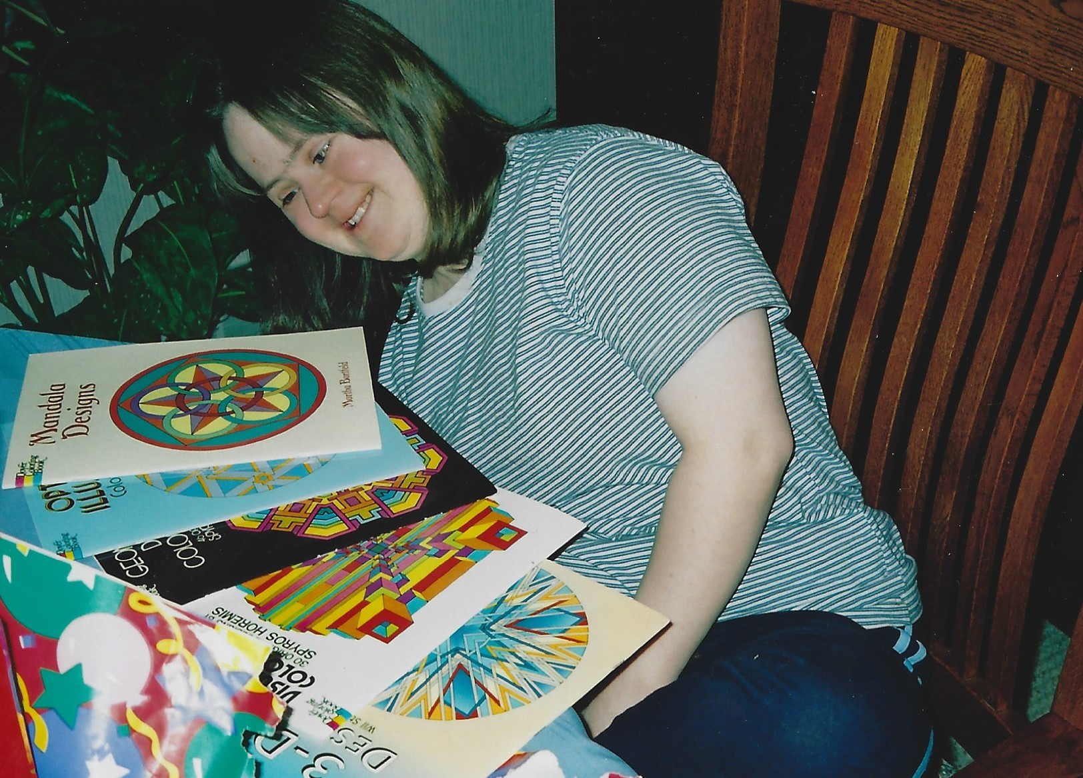
Create Video or Photo Life Story
All of us experience changes as we age and those with developmental disabilities may not be able to express behavioral and functional changes.
Take videos, if possible, of your loved one doing simple tasks such as making a sandwich.
Create a scrapbook or some type of collection of photos to help you share your loved ones interests and abilities.

Slide 26
What Can You Do to Address the Eight Dimensions of Wellness?
Emotional Occupational
Financial Physical
Social Intellectual
Spiritual Environmental

Slide 27
Community Engagement
There are many activities that you might consider:
Bowling
Ultimate Life Program
Special Olympics
Church-based activities
MMI Therapeutic Recreational programs
Next Chapter Book Club
HETRA programs
Special event vacations
Self Advocacy programs
Special choir programs
And many more!

Slide 28
Consider Employment
Start planning early for the type of employment option that seems to best match their interest and abilities.
Check out potential employment options that might be available close to your home.
Keep track of work experience opportunities they may have had while in school, if possible, and learn about the skills they may have acquired.
Consider volunteer opportunities.

Slide 29
Questions?
You can email me questions at jlmiller809@gmail.com

