Slide 1
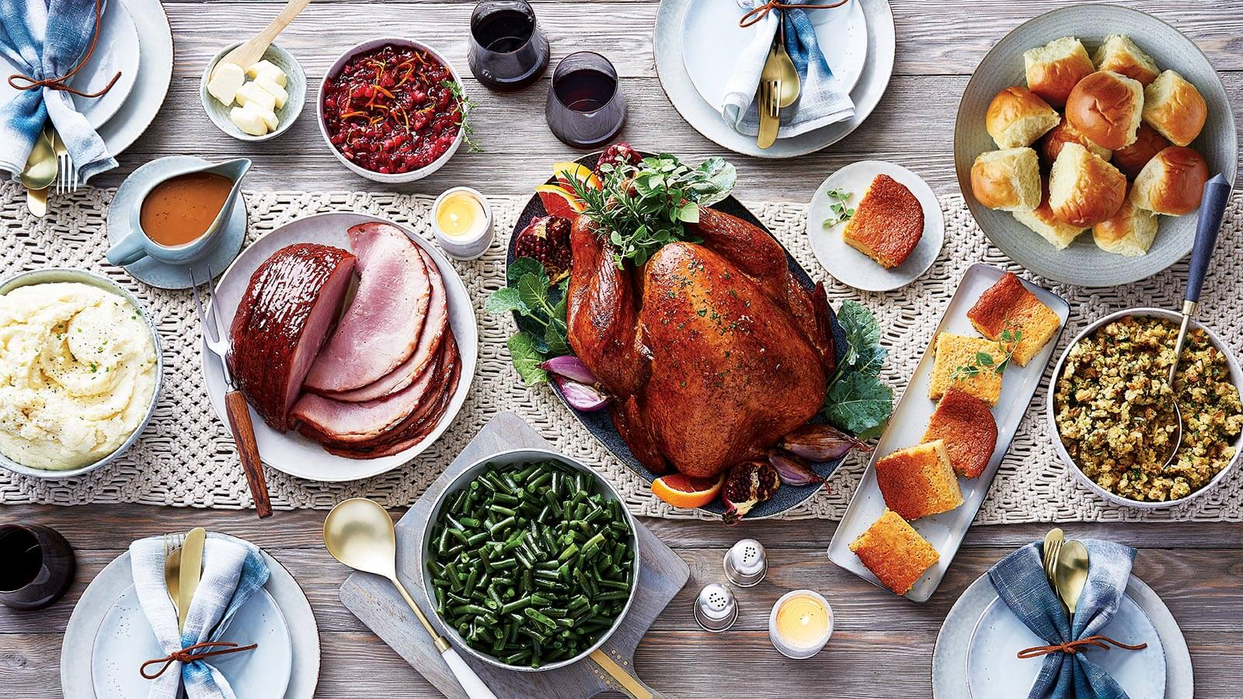
A Holiday Feast!

Slide 2
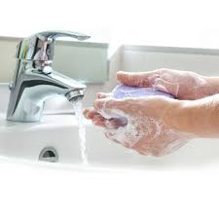
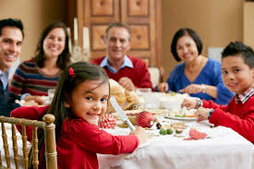
We are going to have a feast!
First I will wash my hands, then I will sit down at the table.

Slide 3
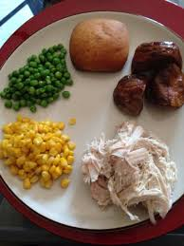
I will put the food on my plate. I will pick a food and touch it.
How does it feel?

Slide 4
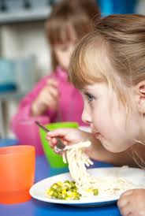
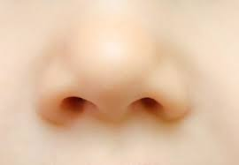
I will smell the food. How does it smell?

Slide 5
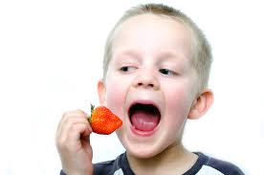
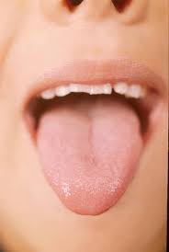
I will taste the food. How does it taste?

Slide 6
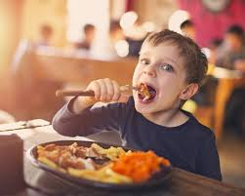
I will eat the food. Do I like it?
Yes, I will eat more!
No, I will leave it on my plate and eat something else.

Slide 7
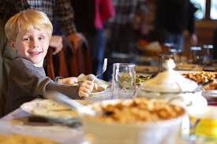
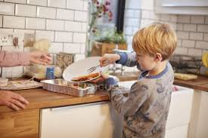
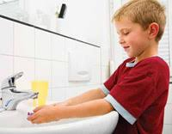
I will sit in my chair until I am done eating.
When I am done, I will clean off my plate. I will wash my face and hands.

Slide 8
I love holiday feasts!

