Slide 1
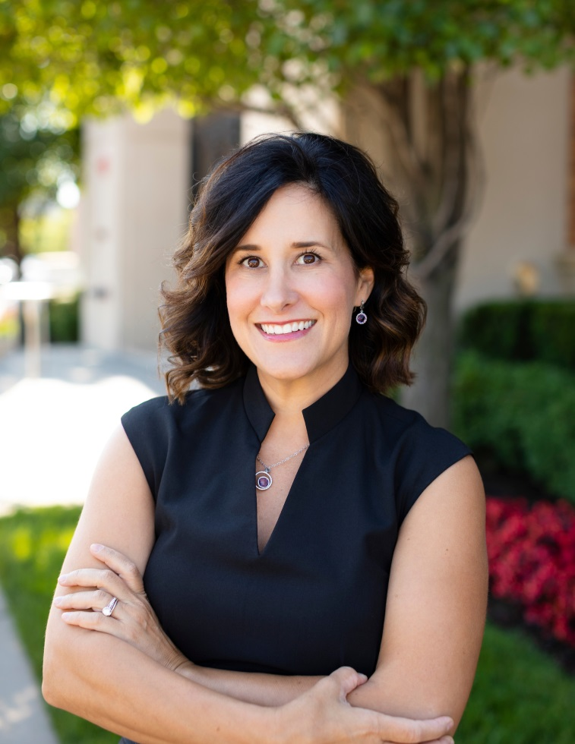
Planning for Care
Nicci Lindsey-Clark, CFP®
Financial Advisor
The Omaha Group at Morgan Stanley
Morgan Stanley Wealth Management
13625 California Street / Suite 400
Omaha, NE 68154
402-399-6167
nicole.clark@morganstanley.com
NMLS ID 1282648

Slide 2
Financial Planning Evolution
Legacy Planning Phase
CRISIS:
When there isn’t a plan or your plan doesn’t go as planned
Gifting / Philanthropy
Next Generation
Asset Preservation
Liquidity vs. Income Needs
Asset Accumulation
Retirement Savings, College and Special Needs Planning, Health Care Expenses
Risk Management
Debt Reduction / Emergency Savings / Estate Plan Strategies / Insurance
Notes:
People come to me at all stages and I’m always pleased when they ask me, “where do I start?” This pyramid is an oversimplification, but it will suffice as a starting point.
It’s loosely based on your age and stage, and it’s based on building a firm foundation from the ground up:
Risk Management: Risk Management is planning for the worst. It should be revisited and re-tested every time you review your financial plan.
You cannot possibly take all risk away, but to some extent you can predict and provide for it
2) Asset Accumulation is what most people think of when they think of financial planning—
A) we calculate what you have,
B) calculate what you need and
C) talk about what it’s going to take to get there.
Of course, it never works out exactly the way we planned, which is where regular follow-up comes into play.
A lot of what we do in this phase is manage expectations and behaviors with respect to investments. One particular behavior that people tend to avoid is planning for “unexpected” events. A good planner not only stress tests your portfolio, but also your “ideas” about how life may or may not work out.
3) Asset Preservation Phase. This is where we calculate your liquidity and income needs and protect that cash flow with asset preservation techniques—it’s important to engage a client’s WHOLE team here, clients shouldn’t go it alone and need to be encouraged to communicate about what’s going on with their health and wealth concerns, with their financial advisor, lawyer and CPA.
4) Legacy Planning Phase. For higher net-worth clients, this is where they are likely to put into place philanthropic gifting, family governance and, for the ultra high net worth clients (over $25mm), they are likely to need some family office resources.
5) Crisis Planning Phase. The Crisis Planning phase is what happens when your client either doesn’t have a plan or their plan wasn’t multi-dimensional enough to keep them out of a crisis situation.
6) Ideally, you want to work with a professional who understands and can operate in all of these levels, but DO be aware of conflicts of interest that could arise from people’s recommendations along the way.

Slide 3
Consider Care Solutions for your Parents:
In-Home Services
Home Modifications
Adult Day Care
Cognitive Evaluation
Care Facility Evaluation
Your Parents
For ALL with living parents:
Start an open dialogue with your parents about their wishes
Documents Binder
Crisis Plan
Early Life
Mid-Life
Near Retirement / Early Care
Care Phase
You / Spouse
Risk Management
Asset Titling
Financial / Estate Planning
Know Your Numbers
ID and Adjust Plans for Life Changes
Know Medicare Coverages
Revisit Estate Plan
Pre-Pay for Care
Home Modifications
Business Succession
Crisis Planning
Medicaid Planning
Estate Planning
Elder Planning
Guardianship
Funeral Plans
End-of-Life Planning
Hospice
Love-Letters
Family Foundations
For ALL Young Families:
Estate Planning Custodial/Trustee Arrangements for Minors
For Younger Children and Grown Adults with Disabilities:
Special Needs Trusts
ABLE Plans
Your Children
Nicci Lindsey-Clark, CFP®
Financial Advisor
Morgan Stanley Wealth Management
402-399-6167
Nicole.clark@morganstanley.com
NMLS ID 1282648
Notes:
Another way to look at what you should be doing when is by thinking about yourself, your spouse, your children and your parents and simply applying it to where YOU are in your life.
Early in your lives, proper titling and risk management techniques will go a long way toward preserving and transferring wealth. It’s also a good time to establish good money habits, such as knowing your numbers—starting with your income and expenses. This is usually where people are building out levels 1-2 of the previous slide. This is ALSO the time when you may have younger children who might have special needs which requires the use of ABLE plans or Special Needs Trusts, which Diane will touch on today.
Typically, as my clients approach the age of 45, we start planning for their own care, I’d be happy to address those options during Q&A.
I’d be happy to discuss them during Q&A or after the presentation, but generally speaking there are a growing number of options for the average, healthy mid-life person and there are even more options for veterans.

Slide 4
Best Practices (Don’t Go It Alone!)
Your professional team should/could be made up of:
Financial Advisor
Elder Law or Special Needs Attorney
CPA (timely, professional)
Be prepared
Documents
Bring a trusted family member or friend
Think about the desired outcome
Notes:
No matter what phase of planning you are in, you should surround yourself with competent professionals who have a variety of expertise, who answer your phone calls/emails in a timely manner and who have a HEART for your family and your situation.
A few things to consider when putting together your professional team:
Financial Advisor (see designations)---investments AND insurance (beware possible conflicts of interest in making recommendations)
Elder Lawyer or Special Needs Attorney
CPA
3) BE prepared!
1) Bring the documents that you are asked to bring—it feels invasive, but gives your practitioner a better picture of your situation
2) Bring a trusted family member if you are alone
3) Think about what you want the outcome to be and communicate it, let the professionals take the mechanics off of your plate

Slide 5
Questions?

