Slide 1
Feeding and Oral Motor Issues in Children with Down Syndrome

Slide 2
Occupational Therapist’s Perspective
Elizabeth Schroeder, MOT, OTR/L
Down Syndrome Clinic
Children’s Mercy Hospitals and Clinics

Slide 3
Feeding is Global
All organs, All muscles, All senses
Learning
Was there pain associated with eating
Development
Nutrition status
Environment
Child Temperment, Distraction, Modeling, Inconsistent Parenting, Grazing, Tricking the Child

Slide 4
Difficulties with eating
Infants and children with Down syndrome have (structural) and (functional) differences in the mouth and throat areas that make it more difficult for them to make precise movements

Slide 5
Difficulties with eating
Anatomical differences that are seen include :
small and narrow upper jaw
high palatal arch
Physiological differences that are seen include:
low muscle tone
weak oral facial muscles
These combinations result in open mouth posture, tongue protrusion, and hyposensitivity

Slide 6
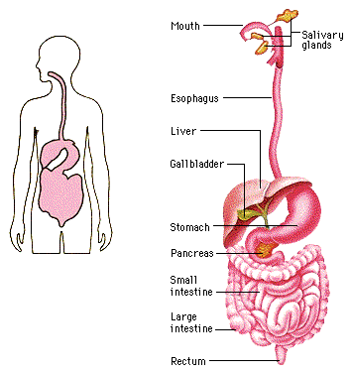
Digestive system

Slide 7
Medical Issues Related to Feeding
Constipation
Gastroesophageal Reflux
Aspiration

Slide 8
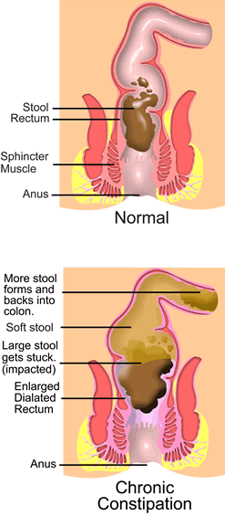
Constipation
Passage of hard and pasty stools resulting in discomfort as they are passed.
In severe cases the child is unable to pass the hard stools on his/her own.
This occurs because the diet does not contain enough water retaining elements (fiber) or because the stool is kept too long in the rectum allowing more water to be reabsorbed leaving the stool dry and hard.

Slide 9
When to be worried about Constipation:
Many days without bowel movements
Hard stools that are difficult or painful to pass
Abdominal pain, cramping, nausea
Rectal bleeding from tears and fissures
Soiling
Poor appetite
Cranky behavior

Slide 10
Treatment with your doctor
Diet: Increase in fiber, prune juice
Fiber supplements: Cellulose - Citrucel
Psyllium - Metamucil
Stool softeners: Mineral Oil - Kondremul
Polyethylene glycol - Miralax
Lactulose
Sorbitol - Karo Syrup
Laxatives: Senna
Bisacodyl

Slide 11
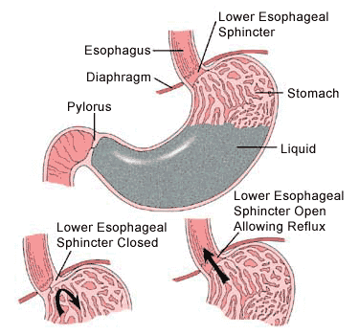
GE Reflux
Contents from the stomach come up into the food pipe.
The muscle that is at the junction of the food pipe and the stomach is the lower esophageal sphincter.
Happens when the muscle is not working well or the acid balance is not what it should be

Slide 12
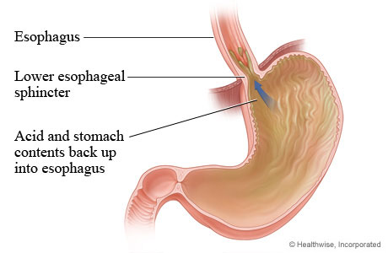
Why -GE Reflux
Posture
Tone
Size of stomach
Quantity of food

Slide 13
When should we worry about Reflux Disease
Vomiting
Fussy colic
Picky eater
Poor weight Gain
Apnea
Wheezing
Stridor - loud breathing
Ear Infections
Sandifer syndrome

Slide 14
Dysphagia
Swallowing dysfunction
Milk goes into the wind pipe instead of the food pipe
Babies will cough or choke with feeds
Micro aspirations or Silent Aspiration
Aspiration pneumonia
Apnea or stop breathing, Blue Spells

Slide 15
Management
Swallow study, OPM
Feeding Evaluation with OT or SLP
Changing: positioning, pacing, nipple flow
Thickening of feeds

Slide 16
What is an OPM?
Oral-Pharyngeal Motility Study
A swallow study completed in radiology under fluoroscopy to assess a person’s swallow and to rule out any difficulties.
What happens during a swallow study?
Possible outcomes following a swallow study?

Slide 17
Stages of a swallow
Oral Preparation: Involves opening of the mouth, lip closure, mastication (chewing if needed) and gathering and controlling of the food or liquid.
Oral Transit: Movement of the food or liquid from the mouth or oral cavity to the oropharynx (upper throat).
Pharyngeal: The food or liquid is then moved through the pharynx (throat) and into the esophagus.

Slide 18
Anatomy

Slide 19
Oral Motor Control Therapy
Essential for safe eating and swallowing.
Lip Closure
Keeping food/liquids in the mouth and creating negative pressure for propelling bolus into the throat
Tongue Lateralization, Elevation, Retraction
Placing food on teeth for mature chewing, gathering food up after it is chwed for safe swallow, and moving liquid to the back of the mouth for swallow
Neck Strength, Jaw Stability, & Laryngeal Elevation
Provide the stability necessary for safe swallowing

Slide 20
Muscle Tone and Strength
Difficulty with lip closure for spoon feeding
The child needs to be a more active participant in spoon feeding
Difficulty with lip closure for bottle feeding or cup drinking
Straw drinking
poor seal on the nipple
Avoid spouted cups
Poor oral strength or fatigue with chewing
Child may develop the habit of not chewing enough before swallowing foods
Work directly on chewing skills

Slide 21
Poor Tongue Movement
Excessive tongue protrusion-pushing the tongue out
Difficulties with tongue retraction-pulling the tongue back
Decreased tongue lateralization –moving the tongue side to side

Slide 22
Transitioning Feeding
Continue with breastmilk and/or formula
Pureed foods about 6 months if:
Can hold head up steadily
Can sit with support in a highchair
Keeps food in mouth and swallows
There is no rush to introducing this
Purees are mainly for practice not nutrition/calories
Start with a few bites 1-2 times/day

Slide 23
Developmental Food Continuum
Breast/Bottle (0-13mos)
Baby food cereal (6 mos)
Baby food purees Stage 1 (6-7mos)
Baby food purees Stage 2 (7-8mos)
Smooth Table food purees (8-9mos)
What’s next… Stage 3??

Slide 24
Developmental Food Continuum
Hard Munchables
EXPLORATION ONLY; practice moving hard solid in mouth without getting a piece off
Meltable Hard Solids
These foods melt with saliva and require not or minimal pressure
Soft Cubes
These foods turn into a puree with up down pressure
Soft Mechanical single texture
Single texture foods that break apart easily in mouth
Soft Mechanical mixed textures (Stage 3)
Two to three textures within a bite: Yogurt with fruit
Soft Table Foods
Adult soft foods cut into bite size pieces: Noodles
Hard Mechanicals
Foods that shatter: Cheerio, Pretzels, Poptarts

Slide 25
Drinking
Continue breast feeding and offering expressed breast milk as long as you would like.
Offering a bottle is great, however we want to move towards cup drinking starting at 10-12 months of age
Goal for cup drinking will be to use an open cup: may briefly need to transition to a soft top sippy cup, followed by a hard top sippy cup, and then using a flat top sippy cup (i.e. Miracle 360).
Offering a straw cup – a straw delivers the liquid very quickly to the back of the mouth and does not always allow for a controlled swallow. A mature straw drinking pattern will be to use only the lips; many children drink from a straw with it placed further back on the tongue.

Slide 26
Early Oral Motor Skills
Purees:
Offer these by spoon or long slender teething toy.
Offer these in midline, wait for lip closure on spoon – do not scrape off on top lip or gum
Offer to the lateral molar gum surfaces and encourage chewing and tongue movement
Meltable Hard Solids:
These foods melt with saliva and require breakdown with little pressure
EXAMPLES: Towne House crackers, graham crackers, Ritz crackers, Club cracker, Cheetoh puffs
EXAMPLES for child greater than 12 months with oral motor delays: cheese puffs, Pringles, Popsicles/frozen fruit bars, frozen gogurt
CHEERIOS ARE NOT A HARD MELTABLE.
Soft cubes:
These foods turn into mush with pressure
EXAMPLES: avocado, overcooked squashes, kiwi, vegetable soup ingredients without the broth, Gerber graduate fruits and vegetables, boiled potatoes, peas, bananas
EXAMPLES for child greater than 12 months with oral motor delays: ice cream, cheese cubes

Slide 27
Soft Mechanical:
Single texture. Foods that break apart easily in the mouth
EXAMPLES: toast, fruit breads, muffins, soft small pastas, cubed lunch meats, thin deli meats in small rectangles, soft pasta or soft meat soups without the broth, soft pretzels, scrambled eggs (if over 1 year and allowed by MD)
Soft Mechanical:
EXAMPLES: macaroni and cheese, micro children’s meals, soft chicken nuggets, French fries, spaghetti, lasagna
EXAMPLE for older child: fish sticks
Soft Table Foods:
Cut appropriately in small sizes and shapes
Hard Mechanicals:
Foods which shatter when you bite
EXAMPLES: Cheerios, thin pretzel sticks, saltine crackers, most other crackers and cookies, Poptarts, most chips, Fritos, and many dry cereals

Slide 28
Why Not Stage 3 Foods?
Soft Mechanical (Mixed Texture)
Often offered at 8-9 months after Stage 2 when all previous experience with eating is in midline
Tongue lateralization has not yet been learned
Chunks are swallowed directly with gagging and choking
1/3 of “normal” children fail on Stage 3
…creating aversive feeding

Slide 29
Sensory Awareness
Think of it like a grid. For each sensory processing item you either like it or you hate it and you are either active or passive about your preference…
 | Like it (Not Enough of it) | Hate it (Too much of it)
Active | Sensory seeking (rough play) | Avoidant (tactile defensive, or car sick)
Passive | Bystander It’s ok that it happens (need help getting more) | Sensor I don’t love it and I will choose other things, (will play in mud for a short while but then requests hand washing)

Slide 30
Oral Sensory Input
Textural oral input has to do with the consistency of the food we offer: is it pureed, crunchy, hard, smooth, or rough, and does it change with each bite?
Taste oral input has to do with the flavor of the food or object: spice, sour, salty, sweet, hot.
Smell oral input has to do with how close or how powerful the odor is to the eater: close and light or far away and powerful and everything in between.
Visual oral input has to do with the color, size and shape of foods.
Auditory oral input has to do with the sound the food makes as it is manipulated in both the open and closed mouth, such as very loud and crunchy or squishy and quiet.
Proprioceptive oral input has to do with the awareness of the placement of food in the mouth at any given moment: does the food shatter leaving pieces everywhere, does it stay in one bolus to chew and swallow? Aare there multiple consistencies with something thick in the center of the tongue and with pieces floating to the cheeks and teeth? Is it very chewy requiring your child to use muscles in the cheeks and jaw.

Slide 31
Oral Sensory Observation
Concerns:
Under aware causing child to swallow larger pieces of food that is not adequately chewed
Do not register that it is too much
Overstuffing of the mouth
Need stronger (more) input to register that they have food that needs to be chewed
Sensitive to food tastes and textures
Usually have problems in other areas as well

Slide 32
Improving Sensory Awareness
Thermal stimulation-alternating cold/warm
Offer high sensory foods such as sour, sweet, crunchy
Use seasonings—real homemade foods offer more taste/flavor and stimulation because they have multiple textures.
Vibration using a Z-vibe or Nuk brush—rub gums, insides of cheeks and tongue-do this before meals to “wake up” the mouth
Tummy time for babies will allow them opportunities to mouth hands, blanket, or other toys-offer toys with different textures for oral exploration

Slide 33
Picky Eaters
Decreased range or variety of foods but will eat >30 foods
Foods lost due to burn out usually re-gained after 2 weeks
Tolerates new foods on plate and usually can touch or taste
Eats >1 food from most all food texture groups or nutrition groups
Adds new foods to repertoire in 15-25 steps
Typically eats with family but frequently eats different foods then family
Sometimes reported as “picky eater” at well child check

Slide 34
Problem Feeders
Restricted range or variety of foods, usually <20
Foods lost are not re-acquired
Cries/”falls apart” with new foods
Refuses entire categories of food textures or nutrition groups
Adds new foods in >25 steps
Usually eats different foods than family and often eats alone
Persistently reported as “picky eater” across multiple well child checks

Slide 35
Definition of Behavioral Feeding Issues
Behavior that interferes with the development of appropriate oral intake
Behavior considered unacceptable at meals
Not advancing skills
Eating too much
Eating too little
Eating the wrong things
Eating at the wrong times
Disruptive behavior
Eating in the wrong places (e.g. bedroom)
Throwing things
Eating too fast/too slowly

Slide 36
General Principles of Behavior
How a child behaves in any situation is a function of the unique make up of the child (nature), the child’s learning experiences (nurture), and the child’s state.
Behavioral changes occur as a result of maturation, non-developmental physical modifications (medications, surgery), and learning experiences. Of these, parents have greatest control over their children’s learning experiences.
Behavior serves a purpose; inappropriate behavior is the maladaptive way of accomplishing that purpose.

Slide 37
Function or Purpose of Behavior
Get something—Positive reinforcement
Social (attention)
Non-social (iPad, TV, edibles)
Automatic (sensory stimulation)
Escape/avoid something—Negative reinforcement
Social (escape from demand)
Non-social (loud noises, certain foods)
Automatic (pain reduction)
How to intervene depends on the function of the behavior.

Slide 38
Approaches to Behavior Reduction
Extinction
Eliminate the reinforcement for the behavior
Reinforcing alternate behavior
Replace the behavior with a response that is more acceptable
Noncontingent reinforcement
Eliminate the antecedent events that serve to establish the behavior
Punishment
Reduce the behavior by following it with an “unpleasant” consequence
Take away something desired
Present something aversive

Slide 39
And perhaps most important
Always ask yourself what you want your child to do as opposed to what you want your child not to do.

Slide 40
Take Home Points: Managing Behavioral Feeding and Mealtime Problems
Make sure the rules are clear and consistent by your words and actions.
Know what you want your child to do and that she has the ability to do it.
To the degree possible, eliminate all reinforcement for the wrong behavior.
Actively teach/reinforce the right behavior.

Slide 41
Healthy Feeding Relationship
Caregiver’s job:
What foods are offered (ideally MyPlate)
When foods are offered (scheduled)
Where foods are offered (ideally at the table, no distractions)
Child’s job:
If foods are eaten (avoid forcing/bribing/coaxing)
How much is eaten (within reason)
Notes:
Parents job is to decide:
What food is offered
When the food is offered
Where it will be eaten
Children’s job is to decide:
If he/she will eat or not
What he/she will eat
How much he/she will eat

Slide 42
Child Feeding
Structured meals/snacks
At the table, no distractions
Spaced 2-4 hours apart (no grazing)
3-4 food groups per meal, 2-3 food groups per snack
Family meals, avoid “short order cooking”
Multivitamin/mineral—hard chewable instead of gummy

Slide 43
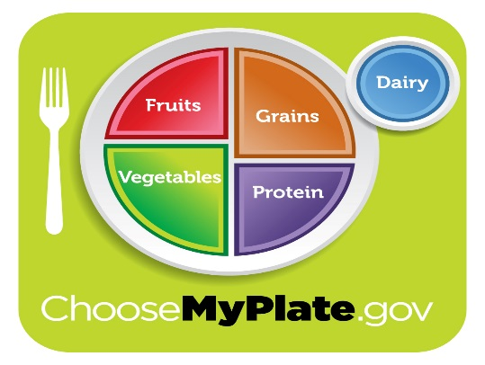
Adolescent Feeding
Structured meals/snacks
3 dairy servings, 5-8 ounces grains, 5+ fruit/veg servings, 5-7 ounces meat/protein, limit juice to 4-6 ounces
Adequate calcium, folate, vitamin D, zinc

Slide 44
Weight Control Ideas
Prevention—much easier than treatment
Establish family rules for healthy eating
Structured eating—3 meals and 1-2 snacks
Avoid “grazing”
Avoid using food as reward
Get Kids in the Kitchen

Slide 45
Weight Control Ideas
Non flavored, low fat milk with meals
Non sugared drinks between meals—water is best
High fiber, low calorie snacks (fruit, vegetables, popcorn)
Limit main entrée and side dishes to 1 serving
Unlimited servings of fruits and vegetables

Slide 46
Kids in the Kitchen
helping choose menu items
setting table
tearing lettuce leaves
cutting fruits/vegetables (practice with playdough
Using the microwave
pouring ingredients in a bowl
breaking spaghetti noodles in half, etc
pouring drinks

Slide 47
Improving Lip Closure and Strength
Use physical prompts with the index finger on the upper lip to cue child to close lips on a spoon or cup
Strong tastes in small amounts on tip of the spoon to facilitate lip closure
Blow raspberries and have child imitate
Use whistles, straws and lip games
Vibration for sensory stimulation on the lips and cheeks
Wrap crunchy/flavorful foods in gauze and have child practice chewing
Offer a variety of chewy tubes and oral toys
Resistive straw drinking-thin to thick, fat to skinny, short to long
Flavored tongue blades-hold between the lips and shake slightly while saying “mmmmmm”

Slide 48
Improving Tongue Movement
Thermal stimulation-intense cold facilitates tongue retraction because the tongue wants to find and move the cold sensation
Hide-n-seek---place the chewy tube in different places in the mouth and have the child try to find it with their tongue or move the tube from side to side with the tongue
Put food on the outer edges of the lips and use tongue to remove it
Place toothette on the tongue and ask the child to “squeeze” the sponge with the tongue
Resistive straw games that work the tongue elevation and retraction

Slide 49
Down Syndrome Clinic at Children’s Mercy Hospital
Pediatrician & Adolescent Physician
Occupational Therapist
Registered Dietitian
Behavioral Specialist
Speech Pathologist
Audiologist (ENT if needed)
Social Work
Genetic Counselor
Team Coordinator
Karen Horne 816-960-2856

Slide 50
Multi-Disciplinary Feeding Clinic
Gastroenterologist (GI doctor)
Occupational Therapist
Speech Therapist
Registered Dietitian
Behavioral Psychologist
Nurse Manager: 816-760-8853

